Slide 1


Oregon PRIMA – Popcorn Sessions
Thursday, October 9, 2025

Slide 2

Damage Recovery Secrets and Tips
Expert strategies to maximize recovery on not at fault claims for Oregon public sector risk managers.
By Dale Cephers
1

Slide 3




Why We're Here Today
Millions lost in unrecovered claims
Actionable recovery strategies
Budget gaps widening from missed opportunities.
Practical solutions you can implement tomorrow.
Proven results across the country
Success stories from municipalities like yours.
2

Slide 4

The Hidden Value in Past Accidents
The Misconception
The Reality
If a claim wasn't pursued immediately, it's lost forever.
Oregon legal framework allows for significant past recovery.
The Key
Knowing where to look and how to structure claims properly.
3

Slide 5








Common Pitfalls That Cost Cities Money
Accepting low settlements
Leaving money on the table.
Inconsistent follow-ups
Claims that fade into background.
Incomplete documentation
Missing critical evidence.
Missed subrogation opportunities
Not identifying responsible parties.
4

Slide 6





Proven Strategies for Maximizing Recoveries
Audit Past Accidents
Identify recoverable claims hiding in plain sight.
Leverage Legal Timelines
Understand statute of limitations advantages.
Optimize Documentation
Standardized reporting increases recovery rates.
Hold Parties Accountable
Insurers and at-fault parties owe you full value.
Use Data to Find tune your process
Crash reports and tracking systems reveal opportunities.
5

Slide 7

Overcoming the "Too Much Work" Objection
Acknowledge Reality
Risk managers already stretched thin with daily demands.
Develop Smart Process
Recovery doesn't have to add workload to your team.
Implement Solutions
The right approach makes recovery nearly seamless.
6

Slide 8





Final Takeaways
Lost Claims Recoverable
Budget Impact
Six-Figure Potential
Implementation Options
Your department deserves full financial recovery.
Small strategy changes yield major returns.
Past damages aren't necessarily gone forever.
Internal processes or expert assistance available.
7

Slide 9

Q&A
Recovery Potential
Analysis Cost
Government Success Stories
Full damage recovery is possible with right approach.
Free evaluation of past claims for all attendees.
Municipalities already benefiting from these strategies.
8

Slide 11

Deadly Weapons Protection Program
2025 Oregon PRIMA Annual Conference
October 8-10, 2025
Alliant Insurance Services, Inc. 2025

Slide 12



Alliant Deadly Weapons Response: Three-Pronged Approach
PREVENTION
RESPONSE
INSURANCE
Total immunity from risk is impossible, but effective risk management can reduce it, while reinforcing commitment to the highest standards of safety.
The nature and speed of the response is everything. If handled well, the response can limit the distress caused, as well as the risk of serious reputational and financial damage.
Coverage to include Third Party Liability Insurance and Crisis Management Services, including First Party Business Interruption and Property Damage
Alliant Insurance Services | Proprietary & Confidential

Slide 13




Deadly Weapons Protection Coverage
What policy offers:
  Crisis Management Services (pre and post event) – Sub-limits Apply
  Third Party Liability & Defense Costs
  Physical Damage including Business Interruption – Sub-limits Apply
  New – Crisis Advisory Services Endorsement for events that create a “loss of control” or “negative stakeholder reaction”
Alliant Insurance Services | Proprietary & Confidential
Notes:
CrisisRisk Crisis Management Services including but not limited to: crisis response investigation, crisis management support, public relations, media management and site security
Response Services for Off-Site K-12 Field Trips: Event Responder Fees, Counselling Services, AD&D, Funeral Expenses and Medical Expenses only (if events not previously reported to Beazley)
Third Party Liability & Defense Costs
Indemnification of monetary judgments awarded following legal liability imposed by a court of law due to the negligence of the Insured following a DWP event. Inclusive of costs to defend all suits brought against the Insured
Physical Damage including Business Interruption – Sub-limits Apply
Physical Damage to Insured location including demolition, clearance and memorialization costs
Gross Earnings
Ingress/Egress & Prevention of Access by Civil/Military Authorities
Extra Expense to resume operations
Crisis Advisory Services Endorsement – NEWLY negotiated to provide sublimited coverage for response to occurrence which creates a loss of control and/or extensive negative stakeholder reaction toward you or your member insured (as stated in the attached schedule of Named Insureds). 20 hours of crisis advisory services for each crisis event or crisis circumstance and for counselling services to an amount not more than USD 50,000 each and every crisis event and/or crisis circumstance and USD 200,000 in the annual policy aggregate

Slide 14



Deadly Weapons Protection Coverage
What policy offers:
Primary coverage for liability when harm is caused by attacks using deadly weapons.
No restrictions on who the assailant is: No gang exclusions.
Cover for events including a variety of weapons.
  Any portable firearm
  Explosive device​
  Knife​
  Syringe​
  Medical instrument
  Corrosive substance​
  Any other handheld device or instrument which is used to deliberately cause death or bodily injury​
  Any road vehicle that is occupied and used by an assailant to deliberately cause death or bodily injury.​
Alliant Insurance Services | Proprietary & Confidential
Notes:
Primary coverage for liability when harm is caused by attacks using deadly weapons.
-This is in addition to business interruption and property damage costs.
No restrictions on who the assailant is: No gang exclusions
However – Any claims from assailant, family of assailant, estate of assailant not covered.
Cover for a wide variety of weapons. Including:​
Any portable firearm
Explosive device​
Knife​
Syringe​
Medical instrument
Corrosive substance​
Any other handheld device or instrument which is used to deliberately cause death or bodily injury​
Any road vehicle that is occupied and used by an assailant to deliberately cause death or bodily injury.​

Slide 15
Deadly Weapons Protection Response Services
  Response Services can include (but are not limited to):
  Crisis Management Services
  Public Relations
  Security Enhancement
  Counselling Services
  Legal Services
  Forensic Investigation
  Reputation / Brand Protection
  Media Management
  At our sole and entire discretion, we will consider other expense costs not listed above
Policy is triggered by either a threat, a circumstance or a DWP event – at which point the insured has access to crisis response.
DWP event - any event involving an assailant where a weapon has been used or brandished at any of your locations.
Alliant Insurance Services | Proprietary & Confidential
Notes:
However, for the purpose of this insurance, the lawful actions of your employees, or of a member of the security services or police department when engaged in the line of duty, in the prevention of (or attempt to prevent) a deadly weapon event shall not of itself be considered to be a deadly weapon event within this meaning.

Slide 16




Items Needed to Quote
  Statement of Values capturing all insured-owned assets
  Event Schedule for locations hosting highly-attended events (ie. Concert venues, stadiums, etc.)
  Fleet Schedule to capture insured-owned autos as “insured locations”
  Preferred Limits?
Alliant Insurance Services | Proprietary & Confidential

Slide 17
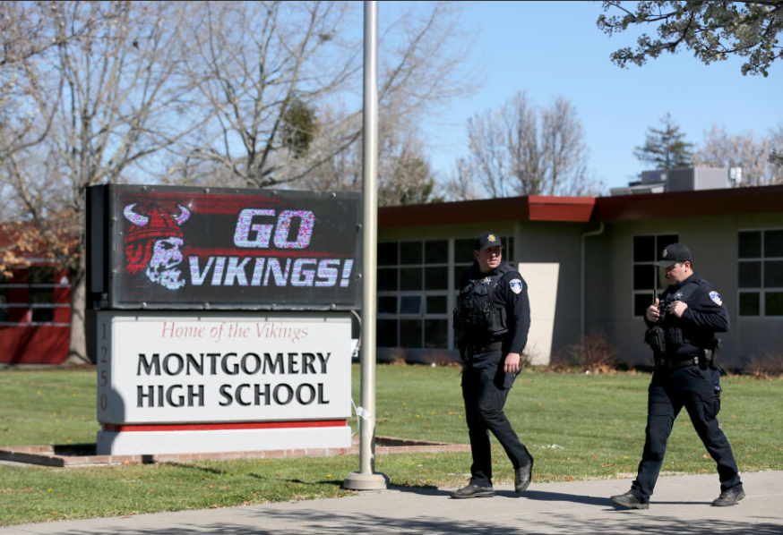
Case Study – Montgomery High School Stabbing Event
March 1st 2023
Two students, Pienta and Cruz, engage a third, Pulida, in a classroom over a long simmering fight between them.
Pulida stabs Pienta in the altercation, killing him
District reaches out to Insured who then reaches out to CrisisRisk (Beazley) to deliver services including
  Counseling
  Media Relations
  “Forensics”
  Legal Advice
Ongoing negligence lawsuits from parents against the District, cross-complaints, voluntary manslaughter and weapons possession criminal charges against Pulido
Alliant Insurance Services | Proprietary & Confidential
Notes:
Event was shocking to the community – students were in rival gangs, allegations of slashed tires, previous fights, and bullying. Fistfight was intended by Pienta, but unaware that Pulida had a knife.
On the morning of March 1, two students, both juniors, stormed into a Montgomery High School art class around 11 a.m. to fight a sophomore they believed had slashed the tires on one of their vehicles.
Daniel Pulido, the sophomore, pulled a knife and stabbed 16-year-old Jayden Pienta in the chest and back. He also cut Juan Cruz, 16, on the hand. Pulido, 15 at the time, fled. He was recently acquitted on homicide charges.
Students, including Pulido in his criminal defense, said school and district officials failed them. Countywide protests to end school violence erupted. Many have called March 1 a call to action among parents and students, who picketed at school board meetings and formed alliances across schools. Teachers joined them.
A wrongful-death lawsuit filed by Pienta’s parents names the school district, Montgomery High School, district Superintendent Anna Trunnell, Montgomery Vice Principal Tyler Ahlborn and former Montgomery Principal Adam Paulson for failing to protect their son. The district later filed a cross complaint, alleging Pulido, his parents, Cruz and his mother are responsible for the killing.
The lawsuit contends Jayden Pienta’s death was preventable and “occurred due to the negligence of the teachers, staff, administrators, superintendent, board members, and other personnel.”
Besides accusing school personnel of knowing that Daniel Pulido, the 15-year-old freshman who has been accused of killing Jayden Pienta, had a history of fighting and had been seen with a knife on campus, the suit contends school officials failed to provide prompt medical care to Pienta, who was stabbed three times during an altercation in an art class.

Slide 18
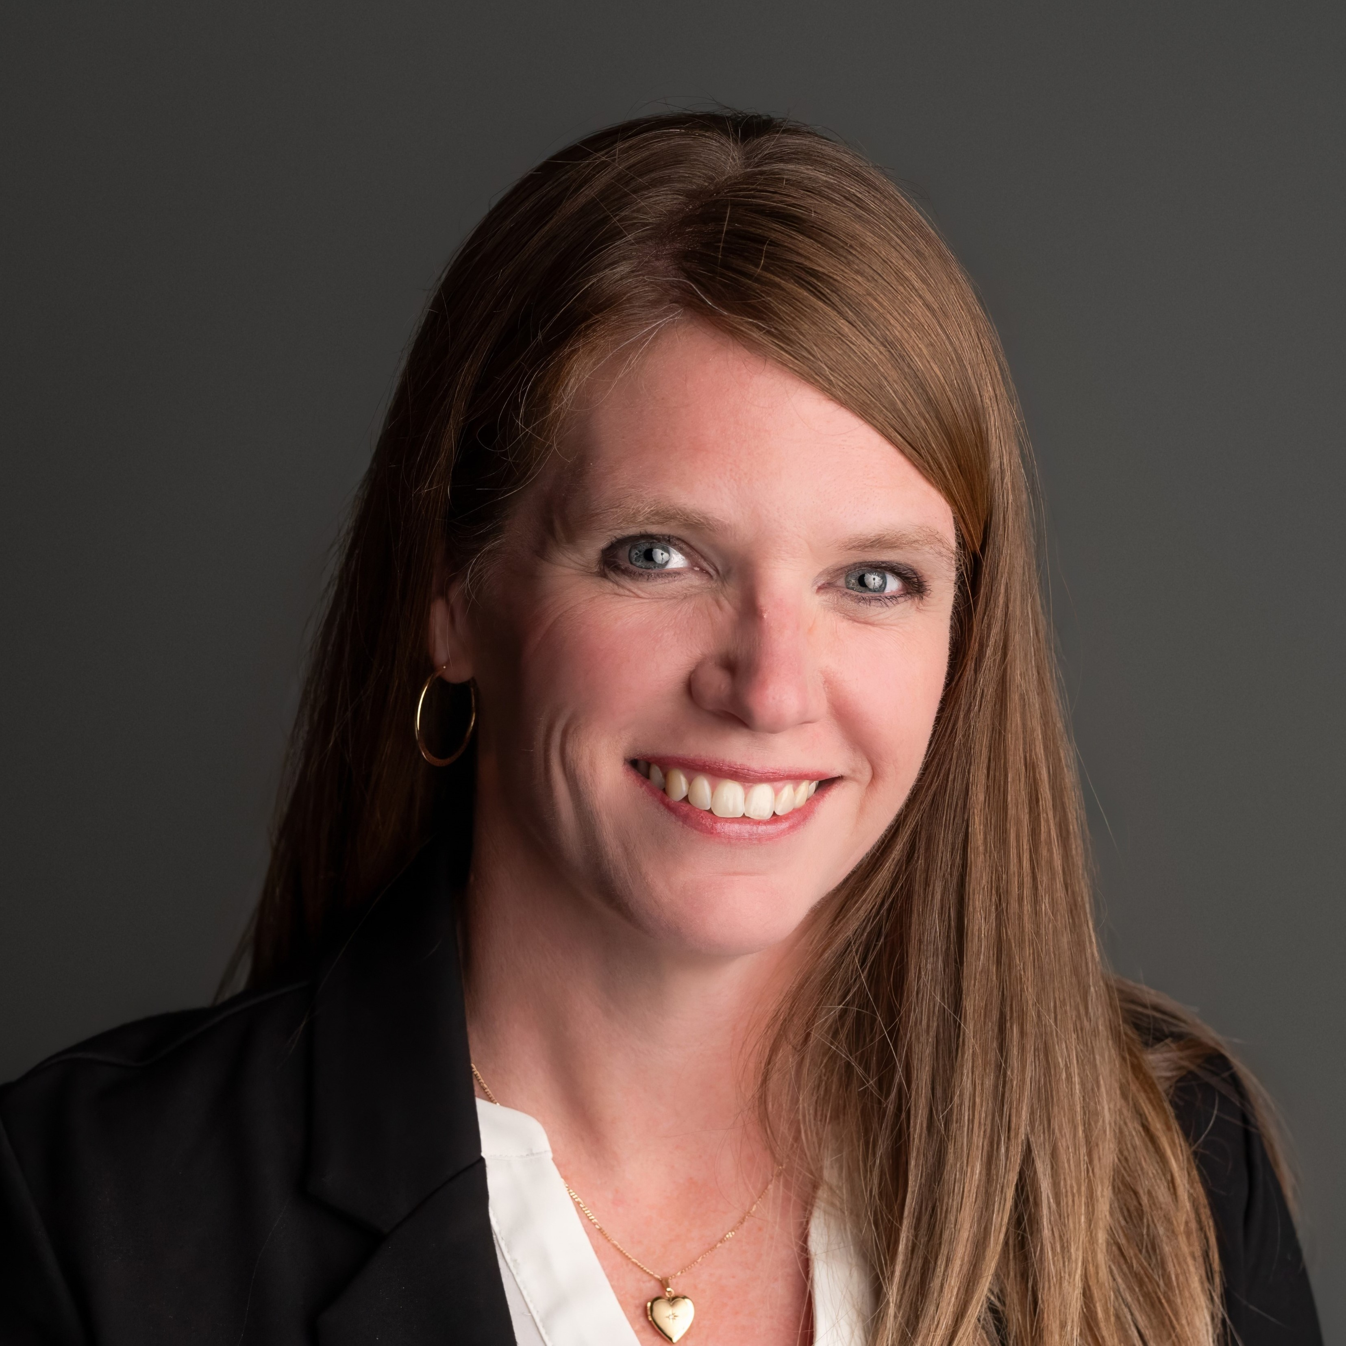
Anne Shackelford
Anne.Shackelford@alliant.com
425/231-4714
Please contact us if you would like a copy of this presentation!

Slide 20
AI in Risk Management
Lorin Williams – WHA Public Entities Account Executive
Dave Nelson – WHA Risk Management and Public Entity Consultant
Copyright © WHA INSURANCE AGENCY INC.

Slide 21

Disclaimer Time…
Copyright © WHA INSURANCE AGENCY INC.
Notes:
Briefly mention that this is just a 100,000-foot level discussion on AI and Risk Management. As an industry we need to continually watch the growth of AI not only in Risk Management but in Insurance overall

Slide 22
AGENDA
How AI is currently being used
How AI could be used in the future…and not!
Copyright © WHA INSURANCE AGENCY INC.

Slide 23
How AI is Currently Being Used
Telematics
Claim processing
Underwriting
Copyright © WHA INSURANCE AGENCY INC.
Notes:
Telematics is a function of AI. Examples would include. Scada systems communicating through computer systems to provide information on systems functionality. Providing monitoring without human involvement until a problem is reported.
GPS systems. Showing us not only where to go on Google or Apple maps, but how fast we drive, hard breaking, distracted driving. Predicting when maintenance is required.
Claim processing. We can currently load photos and claim data via mobile device and generate a claim. The claim can be approved immediately to speed up the repair time and reducing down time.
Underwriting can be done in a similar fashion. Making online application and with AI in the background the application can be approved, or denied, based on the algorithms built into the system.

Slide 24
How AI Could Be Used In The Future
Enhancement of Predictive Modeling
Improved Decision Making
Real time detection of Fraud and Cybersecurity
Not used…
Field audits and inspections
Copyright © WHA INSURANCE AGENCY INC.
Notes:
In the future…will AI replace Risk Managers? Not completely.
Risk Managers can upload data which will be able to use predictive modeling to determine future frequency and severity of claims. Perhaps determine which department is more likely have a claim.
Hopefully, AI will be able to determine fraud or cybercrimes in real time to reduce the frequency and severity of these losses.
Where AI is NOT going to be help is in the physical inspection you all conduct. Being out in the field looing at your facilities, actual eyes on the systems, process and procedures.
But AI will be able to take what we see and upload and generate reports for us in real time.

Slide 25
Thank You!
Lorin Williams
lwilliams@whainsurance.com | o: 541.284.5140 | m: 541-556-2957
Dave Nelson
dnelson@whainsurance.com | o: 541.284.5133 | m: 971.404.4975
Copyright © WHA INSURANCE AGENCY INC.

Slide 27

Job descriptions, do they really matter?
A brief discussion on why they matter for workers’ compensation claims
Presented by Lorrie Spencer

Slide 28
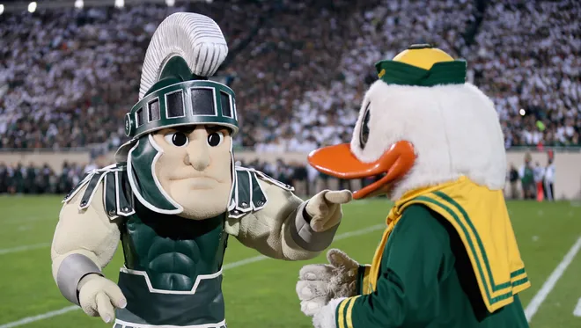
Little bit about me
Senior litigation attorney in the Oregon workers’ compensation practice group at Reinisch Wilson PC.
Prior to joining Reinisch Wilson PC in 2021, Lorrie was a litigator in the public sector then practiced workers’ compensation defense in Honolulu, Hawaii. Lorrie has defended her respective clients in dozens of jury trials, bench trials, and Hearings.
Lorrie, a native of the Chicago suburbs, received her bachelor’s degree from Michigan State University before receiving her Juris Doctor from the University of Oregon School of Law. There, she was an Executive Editor of the Journal of Environmental Law and Litigation. While in law school, Lorrie clerked at the Oregon Department of Justice and Multnomah County District Attorney’s Office gaining valuable experience researching, writing, litigating, and negotiating complex cases as well as providing advice to clients.

Slide 29
Claim Closures
If the attending physician endorses permanent restrictions that are not clearly listed in the job description (but could be implied as part of worker's job-at-injury), it gets messy.
Just because an attending physician assigns permanent work restrictions does not automatically mean claimant is unable to return or be released to their job-at-injury. Assuming such means a worker is unable to return to their job-at-injury can be a very costly mistake.
If an employer wants to argue that a restriction isn't in the job description so the worker is released to their job-at-injury, to avoid a hefty work disability award at closure, employer could risk an allegation of unreasonableness in regards to the way the claim was closed

Slide 30
Claim closures cont.
A worker's attorney would argue it was unreasonable to a) assume that duty was not required by the job-at-injury given it seems like the type of job that would require worker be able to perform that duty, or b) we the employer/insurer had a duty to at least clarify with the attending physician if claimant was released to the job-at-injury based on the vague job description
If the person processing the closure paperwork is not comparing and contrasting the permanent work restrictions to the duties in the job description, they may just assume any permanent work restrictions mean the worker is not released to their job-at-injury. Again, costly mistake if no one catches this

Slide 31
Value of a highly detailed and specific job description
Ideally the job description is highly detailed and provided to the attending physician before closure, so that the attending physician can sign-off that the worker is released to their job-at-injury, avoiding a work disability award
That way there can be no confusion, and the closure specialists can clearly identify there should be no work disability awarded upon issuance of the Notice of Closure

Slide 32
Modified duty job offer
If worker is not released to their job-at-injury, and has temporary work restrictions endorsed by the attending physician, we can still try to get the worker back to work in a modified duty role
We typically want to get the attending physician’s written approval that the worker can return to a modified duty job, and we want a through job description with an accurate description of the physical requirements of the job so the attending physician can sign-off
If attending physician signs off, worker goes back to work, we save money in time loss and ideally claimant is earning full wages at a modified duty position
The clearer the description = the more likely AP will sign-off on a return to a modified duty job

Slide 33
Speaking on this more at BOLI’s conference!
Speaking at BOLI's 41st Annual Employment Law Conference on 11/6/25 with an employment law attorney from Barran Liebman. We’ll build on this!
It’s virtual - hope to see you there!
Questions before then? E-mail me! lorries@rwlaw.com

