Slide 1
Workplace Violence: Practical Planning and Response
Oregon PRIMA Conference 2017

Slide 2
First Things First
Establish policy and protocols addressing workplace violence, including domestic violence
Establish a reporting process and track incidents
Establish training for employees.
Establish a Threat Response or Incident Response Team
Change your culture.

Slide 3
Establishing Policy
Work with HR and legal
Identify elements needed in policy
    Policy statement
    Exceptions (if any eg. consumers)
    Reporting
    Investigation
    Domestic Violence
    Threats of harm to self
    Warning Signs
    Work Rules
    Disciplinary Action
    EAP

Slide 4
Establish Reporting Process
Report ALL incidents
Security Incident Report Form
Determine procedures and process flow
Determine repository
Trend analysis
Improve mitigation measures
Train employees

Slide 5
Employee Training
Establish curriculum
Determine best method to reach employees
    Computer Based
    Face to Face
Reinforce policy
Reinforce reporting
Change Culture
Establish Threat/Incident Management Teams

Slide 6
Threats/Threatening Behavior
Any statement or conduct that is sufficiently severe, offensive or intimidating to create a reasonable fear for one’s own safety, or the safety of co-workers, family, friends or property.

Slide 7
Establish Threat Management /Incident Response Teams (TMT/IRT)
Primary objective – Assess and manage threats of violence in the workplace

Slide 8
What is a TMT/IRT?
Multi-disciplinary team within the entity
Familiar with HR and workplace violence policies
Members should have sufficient authority to manage threatening situations
Primary objective is to assess and manage threats of violence

Slide 9
Who should be on the TMT/IRT?
Persons with decision making authority
  Example: operations director, facilities director or equivalent, security/police, mental health, business manager, legal, risk management, HR director
May vary depending on situation (may need specific expertise such as mental health)
Optimum size is five persons (more or less)

Slide 10
Three Best Indicators
Threat (direct or implied)
History of violence – best indicator of future violence
Gut level feeling (instinct we are all possess)

Slide 11
Five Elements of Violence (all forms)
Victim (control)
Perpetrator (power)
Environment (involvement, where both interact)
Conflicts between the perpetrator and victim
Threats – direct/implied, verbal/physical

Slide 12
Assessment:
Signs of Seriousness of Threat
Specific
Names potential victim or victims (list)
Access to potential victim or victims
Stated commitment
Access to weapons (and has indicated such)
Justification
Willingness to suffer consequences

Slide 13
Protective and Restraining Orders
Indicate in policy to comply with Order of Protection (Protective Order, Temporary Restraining Order, Criminal Trespass Order, Magistrates Order)
Provide Protective Order kits to employees who self-declare

Slide 14
5 Common Sources of Threats in the Workplace
Strangers;
Current or past customers;
Current or past clients;
Current and former employees;
Current or former partners of employees; and
Stalkers or infatuation with an employee.

Slide 15
Managing Threats of Violence Process
Immediate response
Gather information
TMT/IRT meet
Action planning and implementation
Resolution and disengagement

Slide 16
What do I do now? Internal/External Threat
Determine if law enforcement should be contacted
Review security needs
Evaluate “duty to warn” measures (who should I tell?
Domestic violence- Who can I tell?
Determine what additional information is needed
Determine facility/employee/client/consumer safety measures
Document decisions and actions - WHY and WHY NOT

Slide 17
It’s Good to Know
Threatening individual’s history:
Previous altercations
Domestic violence
Fights
Aggravated assault
Verbal abuse
Any previous threatening or inappropriate behaviors?
What appears to be provoking the individual?
What are stressors he/she appears to be experiencing?

Slide 18
Some Red Flags
Marked personality changes
Demonstrated paranoid or delusional behavior or statements (confused thinking, delusions, hallucinations, increased withdrawal, seclusion from others, manifesto)
Scares other employees
An obsession with weapons/brings to work
Sympathizes with perpetrators of workplace violence

Slide 19
Sources of Information
Criminal History/Background
Reference Checks
Garnishments (child support, etc.)
Grievances
Altercations
EEO Complaints
Disciplinary actions
Performance reviews

Slide 20
Interviewing the Threatening Employee
Prepare in advance
Room set-up
Opening statement designed to help put the individual at ease
Prepare Questions:
  Easy questions first, more direct and difficult at the end
  Explanation of seriousness of investigation and interview
  Convey strong and exact expectations (follow existing policy to the letter)

Slide 21

Domestic Violence and Stalking in the Workplace

Slide 22
Definitions
Domestic Violence - a pattern of coercive behavior that is used by one person to gain power over their current or former partner.
Stalking – Course of conduct directed at a specific person that would cause a reasonable person to feel fear.

Slide 23
Most likely victims?
Domestic violence occurs between people of all walks of life
DV has no socio-economic boundaries
Most stalking victims are current/former partners/friends/acquaintances of their stalker

Slide 24
DV is a Pattern of Behavior
Domestic Violence is NOT an isolated event
PATTERN of behaviors used against a victim--a variety of abuses occurring throughout the relationship
Power and Control are the keys

Slide 25
Forms of Domestic Violence
Physical abuse - all forms of external and internal physical injury.
Psychological abuse – includes, but not limited to:
  Threats of violence and harm (workplace)
  Attacks against pets or property
  Stalking
  Discrediting victim’s reputation
  Damaging victim’s relationship with others

Slide 26
Forms of Domestic Violence (2 of 2)
Emotional Abuse - verbal attacks and humiliations, emphasizing the victim’s vulnerabilities in front of family, friends or strangers.
Isolation - cuts off victim from support networks (family, friends, etc.) with claims of interfering.
Economic Control - controls victim’s access to family resources: perpetrator controls the finances.

Slide 27
Domestic Violence At a Glance
Leading cause of injury to a woman, more than any other cause of injuries…combined.
Annually in the U.S., over 2.24 million women are stalked by a current or former intimate partner.
1 out of 4 workplace homicides
Intimate partner homicides account for one-third of the murders of women and 4% of the murders of men

Slide 28
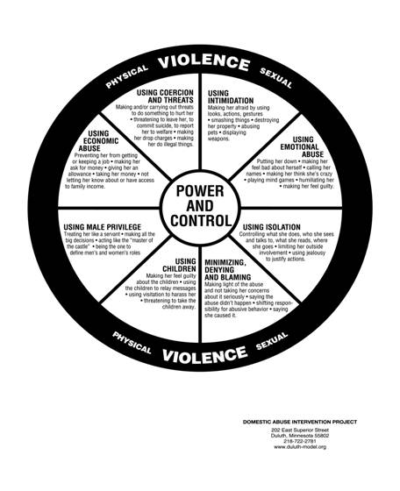
Power and Control Wheel

Slide 29
DV is NOT Caused by:
Victim’s behavior
Illness
Genetics
Alcohol or other drugs
Gender
Anger
Stress
Relationship problems

Slide 30
Barriers to Leaving
Fear of Violence (most dangerous time).
Immobilization caused by psychological and/or physical abuse.
Isolation – lack of support network
Being told by abuser, family, friends or co-workers that the abuse is her fault.
Dependence on abuser for insurance and finances.
Belief the abuser will commit suicide, get sick or die if victim leaves.
Threat of “outing” a gay or lesbian partner if the victim leaves.

Slide 31
DV Victims at Work
Cannot be identified by a “profile”.
At work a victim may:
  Show obvious injuries
  Excessive absenteeism or tardiness
  Isolates herself from others
  Have work errors and/or inconsistent work
  Denies being in an abusive relationship (fear)

Slide 32
DV Perpetrators at Work
Cannot be identified by a “profile”.
At work a perpetrator may:
  Blame others especially the victim
  Uses the system to his advantage to look like the victim
  Show defensive marks
  Gain sympathy by sharing convincing stories about his difficult partner, miserable he is, etc.

Slide 33
DV in Texas 2015
Women Killed: 158 (20% increase from 2014)
  19 Family members & friends killed
  61% by gun
  767 killed (2010-2015)
Youngest: 16; Oldest: 93
  16yo – strangled by 17yo ex-boyfriend
  93yo –shot by husband in their retirement home; he then went to sleep and when caretaker found victim, he woke up and turned himself into law enforcement
15 victims were 70+
78% at home but 2% occurred at work
14% occurred in public place
Adults denied shelter (due to lack of space): 39%
Hotline calls answered: 183,294

Slide 34
Stalking Behaviors
Follows you and show up wherever you are
Sends unwanted gifts, letters, cards, e-mails
Damages your home, car, or other property
Monitors phone calls or computer use
Uses technology, like GPS, to track where you go
Drives by or hang out at your home, school, or work
Threatens to hurt you, your family, friends, or pets
Researches you using public records or online search services, hiring investigators, going through your garbage, or contacting friends, family, neighbors, or co-workers
Posting information or spreading rumors about you on the Internet, social media, in a public place, or by word of mouth
Other actions that control, track, or frighten you

Slide 35
Stalking Statistics
6.6 million people are stalked every year in the US.
1 in 6 women and 1 in 19 men have experienced stalking.
Majority of stalking victims are stalked by someone they know.
  66% of female victims and 41% of male victims of stalking are stalked by a current or former intimate partner.
>50% of female and >33% of male victims were stalked before age 25.
1 in 5 female victims and 1 in 14 male victims experienced stalking between the ages of 11 and 17.

Slide 36
More Stalking Information
11% of stalking victims have been stalked for 5 years or more.
46% of stalking victims experience at least one unwanted contact per week.
1 in 4 victims report being stalked through technology.
10% of victims report being monitored with GPS
8% report being monitored through video or digital cameras, or listening devices.
Repeated unwanted calls, voice, or text messages most common tactic reported.

Slide 37
Safety Planning
Meet with the employee (if possible)
Empower, do not tell employee what to do
Things to consider
  security protocol
  parking
  controlled access
  workplace safety
  alternate work site

Slide 38
What is an Active Shooter?
An individual actively engaged in killing or attempting to kill people in a confined and populated area in most cases, active shooters use firearms(s) and there is no pattern or method to their selection of victims.

Slide 39
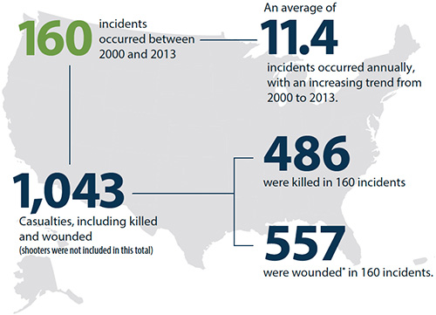
Active Shooter Incidents Source: FBI

Slide 40
Quick Facts from FBI Report
66.9% of the incidents ended before police arrived.
Of the 160 incidents, 56.3% ended on the shooter’s initiative.
In 64 incidents where the duration of the incident could be ascertained, 44 (69.0%) ended in 5 minutes or less, with 23 ending in 2 minutes or less.
From 2000-2006: average of 6.4 incidents occurred annually.
From 2007-2013: average increased to 16.4 incidents annually.

Slide 41
An Active Shooter Expects To Die
Not concerned with dying; has nothing to lose.
Moves throughout a building or area until either
    commits suicide,
      Self
      suicide by cop
    stopped by others,
    stopped by police.

Slide 42
A Little Background
Active Shooter incidents are spontaneous, little or no warning.
Incidents often occur in a target rich (highly populated) environment.
Perpetrator’s are often depressed, angry and suicidal.
Perpetrator’s motive is to punish others for their fragile view of themselves.
Negotiation will NOT work. (Exception Richard Farley, stalker of Laura Black)
Average age for a school shooter is 14.5 years old

Slide 43
Action Items Post Incident
Primary Concerns
  PEOPLE
  Continuity of Operations
  Client services
  Alternative site
  IT
  Reputation
  Emergency Procurement

Slide 44
Recovery
Stabilize those traumatized and calm employees.
Account for all staff.
Implement security plan at the incident site and establish a sense of safety.
Appoint someone to coordinate mental health resources. (CISM, DBH, EAP)
Anticipate questions from staff and be prepared to address concerns.
Establish location to hold media updates and shield staff from media.

Slide 45
Recovery
Communicate current, appropriate information to staff:
  Identify the true nature of the crisis and formulate answers.
  Tell the truth.
  Acknowledge the significance of the crisis.
  Dispel rumors.
  Educate staff regarding staff reactions and symptoms.
  Give direction to the staff for the short term (work schedule, location, etc.).
  Advise staff not to speak to the media.
  Be visible to staff.

Slide 46
Recovery
Establish a support system to maintain contact with staff.
Arrange transportation for distraught employees.
Remain afterward to speak with anyone who still have questions.
Establish recovery system involving all impacted employees.
Provide a short written summary to staff with current information regarding:
  safety,
  security,
  counseling resources available, and
  plans for when and where to return to work.
Ask Yourself – What resources are available within your entity?

Slide 47
What can we do?
Develop a Occupant Emergency Plan (OEP)
Update Key Contacts (Who and When)
Notification process (Internal, External)
Establish next-of-kin notification process and who is responsible? (Personal belongings)
  Training and guidance for those who serve.
Training of staff; tabletop exercises; full-scale exercises

Slide 48
Test
Most victims are stalked by strangers. (T/F)
How many states have stalking laws?
Most stalking victims will report the stalking to police. (T/F)
Leaving the relationship is the most dangerous time for a victim of DV. (T/F)
Domestic violence is not a workplace issue. (T/F)

Slide 49
Questions?
Regan J. Rychetsky, ABCP
Risk Control Manager
York Pooling
York Risk Services Group
10535 Boyer Blvd., Suite 100
Austin, TX 78758
Office: (512) 427-2305
Cell: (512) 924-3041

