Slide 1
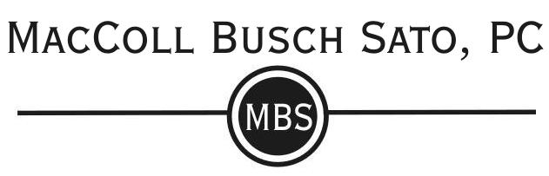
The Intersection of National Healthcare and Workers’ Compensation Insurance, and its Impact on an Aging Workforce
Lindsay E. Landstrom, AAL
Jonathan A. Rose, AAL
Alexander F. Sargent, AAL

Slide 2
Disclaimer
This presentation is not intended to offer legal advice for your specific situations. We aim to provide general education and information.
We recognize that all employment situations are unique. Collective bargaining agreements, industry practices, and the demands of a specific workforce complicate things.
We welcome questions, concerns, compliments, and constructive criticism. Please feel free to contact one of us if you have feedback.
  Lindsay – llandstrom@mcbuslaw.com
  Jon – jrose@mcbuslaw.com
  Alex – asargent@mcbuslaw.com

Slide 3
What’s the Plan?
Overview and Assessment of the Aging Workforce: What’s the Issue?
Pre-Hire and Pre-Loss Strategies: Some Do’s and Don’ts.
Managing a Workers’ Compensation Claim with an Aging Worker.
Please feel free to ask questions or provide input as we go along. We don’t want to talk for 70 minutes!

Slide 4
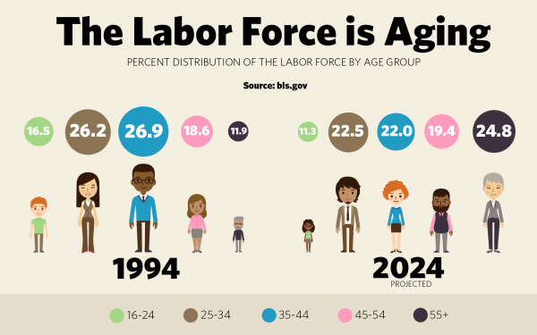
Overview and Assessment of the Aging Workforce: What’s the Issue?

Slide 5
Some Workforce Statistics
By 2020, the subpopulation of older adults in the US is expected to reach 97.8 million, comprising 28.7 percent.
  Up from 24.7 percent in 2010.
By 2020, the proportion of the US labor force will be 25.2 percent older adults.
  Up from 13.1 percent in 2000 and 19.5 percent in 2010.
Employment rates among older adults continue to increase.
  In 2011, 16.7 percent of people 65 or older were employed. 29.9 percent of those aged 65-69 were employed.
As of 2015, 37 percent of non-retired Americans don’t expect to stop working until after age 65.
  Up from 14 percent in 1995.

Slide 6
More Stats
By 2050, the number of those aged 65 or older in the workforce is expected to grow by 75 percent.
  The number of individuals aged 25 to 54 expected to grow by 2 percent.
The number of centenarians worldwide will double by 2023 and double again by 2035.
  Life expectancy expected to surpass 100 in some countries by 2050.
Projections show increasing number of people working into their 80s and 90s.

Slide 7
Why is the Workforce Aging?
Baby Boomers getting older.
  76 million born between 1946 and 1964.
Shortage of skilled workers, mostly in trades and 2-year degree programs.
  Older skilled workers remain in demand.
Decreasing reliability of social security and pension plans.
Increasing life spans and quality of life for the average American.
Declining fertility rates for those born to Baby Boomers and Gen Xers.
Financial need.

Slide 8
Brass Tax
1 out of 4 workers are projected to be over age 55 by the year 2020.
Disability prevalence doubles between ages 40 and 55.
This could be a HUGE problem for employers and insurers in the workers’ compensation system.
  Burden shifting.
BUT! All is not lost. First, though, some thoughts…

Slide 9
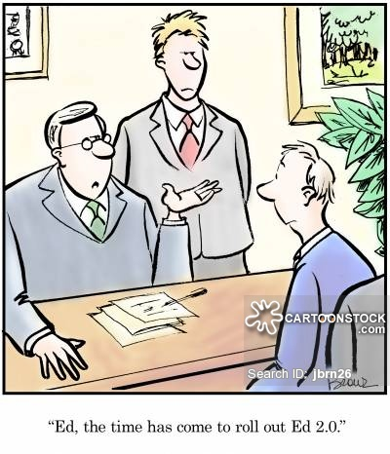
Benefits of an Older Workforce
“Older workers tend to stay longer, work more productively, and have better health and wellbeing when their work is appreciated.”
  Axel Borsch-Supan, director of Munich Center for the Economics of Aging.

Slide 10
Some Ideas to Accommodate Older Workers
Flexible roles and schedules.
  Telecommuting.
  Working in teams.
  Modifying positions or even creating new ones.
Continuing education.
  “Older workers are less likely to be unemployed, but are less likely to receive training to improve their skills.” US Department of Labor.
Wellness programs.
Consciousness of workplace ergonomics.

Slide 11
Workers’ Compensation Issues
Older adults tend to exhibit losses in eyesight, hearing, and physical strength.
Older adults have low overall injury rates compared to all age groups, but are more likely to suffer from severe and fatal occupational injuries.
  Lower overall claim rate but higher cost per claim.
Return to work for older workers is extended.
  Greater median number of lost work days and longer recovery times.
Occupational injuries and conditions more likely to be complicated by “age-related” conditions like arthritis and chronic diseases.
  Difficulty becomes parsing out the work-related component from the personal component.

Slide 12
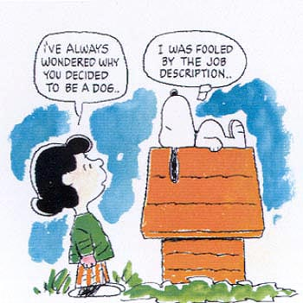
Pre-Hire and Pre-Loss Strategies:
Some Do’s and Don’ts.

Slide 13
Relevant Laws
Age Discrimination in Employment Act of 1967, 29 USC 626(e)
  Prohibits discrimination against employees aged 40 years or older on the basis of age in hiring, promotion, discharge, compensation, or terms, conditions or privileges of employment.
ORS 659A.030
  Prohibits discrimination against employees aged 18 years or older.

Slide 14
Bona Fide Occupational Qualifications
Discrimination is not an unlawful employment practice IF:
  Discrimination results from a bona fide occupational qualification reasonably necessary to the normal operation of the employer’s business; or
  It is impossible or highly improbable to deal with the older employees on an individualized basis.
Not So Fast!
You probably do not have a bona fide occupational qualification allowing discrimination.

Slide 15

I thought this was a workers’ compensation discussion!?!

Slide 16
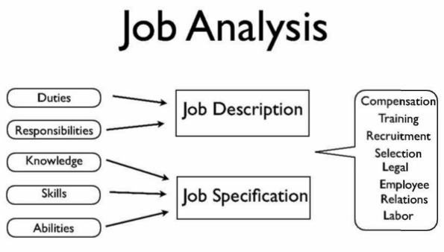
Job Description
Absolute basic requirements:
  Accurate.
  Details essential functions of the job.
  Updated regularly and as necessary.

Slide 17
The ADA Allows Medical Examinations
ADA examination covers all employees, not just those with a disability.
Pre-employment: Prohibition of all disability-related inquiries and medical examinations even if related to the job.
Conditional job offer, before starting work: Allowed to make disability-related inquiries and conduct medical examinations, regardless of whether related to job, as long as done for all employees in same class.
After employment: May make disability-related inquiry or require medical examinations only if job-related and consistent with business necessity.
Please note: All medical information received must be kept as a confidential medical record.

Slide 18
What about Physical Agility Tests?
Physical Agility Tests are not medical examinations as long as they:
  Measure an employee’s ability to perform actual or simulated job tasks; and
  Require physical fitness tests, which measure an employee’s performance of physical tasks (e.g. running, lifting, climbing); but
  Do not include examinations that could be considered medical (measuring heart rate, blood pressure, breaths per minute, etc.).

Slide 19
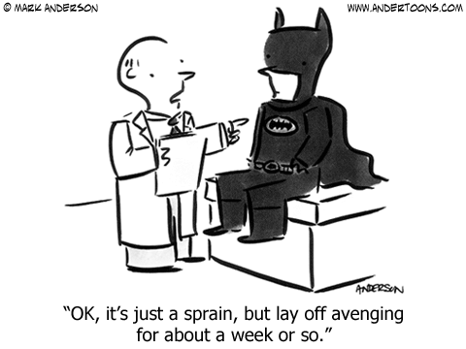
Managing a Workers’ Compensation Claim with an Aging Worker

Slide 20
Initial Investigation Considerations
Distinguish what is age-related.
Don’t overlook past injuries.
Beware of work restrictions.
Explore combined condition processing.
Consider Medicare implications.

Slide 21

The Medical Record
Request EVERYTHING.

Slide 22
Possible “Age-Related” Conditions
50 over 50 rule
Prior surgery
Addiction
Obesity

Slide 23
Age as a Preexisting Condition?
Lowells v. SAIF Corp. (In re: Lowells), 285 Or App 161 (2017)
  OD claim for chronic pain disorder denied because major contributing cause was factors personal to claimant, such as weight, deconditioning, and history of tobacco use.
  AP testified that “if there’s anything that’s really causing her symptoms, its really her deconditioning, her age, her weight, et cetera, and not adequately making herself physically fit for the job that she currently has.”
  Court says, “a worker’s personal factors are part of the [major contributing cause] equation if, and only if, they are causes” as opposed to personal susceptibilities or predispositions (which cannot be taken into account).
  Court says it did not consider age, per se, but instead non-industrial conditions which were, in this case, probably exacerbated by aging.

Slide 24
Prior Injuries and Surgeries
Pre-existing conditions.
  Carriers/TPAs should request or subpoena prior claim files for injuries and diseases which were not administered by the current carrier/company.
Look for patterns, both good and bad.
  Good: Attend PT, IMEs. Comply with work restrictions. Recover as expected.
  Bad: Malingering. Missed appointments. Excuses. Doctor shopping.
Medication reconciliation.

Slide 25
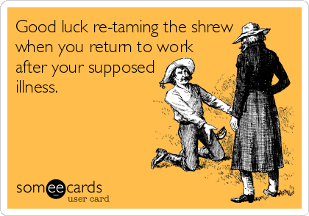
Returning to Work
Higher wages.
  Higher time loss (currently capped at $1,944 per week).
  Higher PPD (currently capped at $1,280 per week).
Higher age.
  Slower to return to work.
  Additional 13 days to recover from same or similar injury.
Higher age.
  Greater risk of severe injury or reinjury?

Slide 26
Combined Condition Processing
Initial injury.
  Limit scope of acceptance. Better under Brown.
Scour records for qualifying preexisting conditions.
  Develop causation opinion. Educate attending physicians as to what qualifies as a preexisting condition. Use IMEs.
Can you issue a combined condition acceptance/major cause denial?
Claim Closure.
  Job descriptions.

Slide 27
Medicare
Medication Overlap.
Medicare Set-Asides.
  Get CMS approval (even for a $0.00 MSA).
  Minimize MSA amount.
  Use responsibility-shifting language in settlement.
  Revived old claims.

Slide 28
Questions?
Lindsay E. Landstrom – llandstrom@mcbuslaw.com
Jonathan A. Rose – jrose@mcbuslaw.com
Alexander F. Sargent – asargent@mcbuslaw.com

Slide 29
Sources and Reading Recommendations
https://blog.dol.gov/2016/11/18/why-more-people-ages-55-are-working
http://www.asaging.org/blog/issues-impacts-and-implications-aging-workforce
https://www.usnews.com/news/articles/2015-12-24/older-workers-to-dominate-labor-market-by-2024
http://fortune.com/2016/06/22/aging-workforce-retirement/
https://hbr.org/2014/04/four-ways-to-adapt-to-an-aging-workforce
https://www.dol.gov/odep/pdf/NTAR-AgingWorkforceHealthCare.pdf
Silverstein, Michael (2008). "Meeting the challenges of an aging workforce". American Journal of Industrial Medicine. 51 (4): 269–280.
Caban-Martinez, Alberto J.; Lee, David J.; Fleming, Lora E.; Tancredi, Daniel J.; Arheart, Kristopher L.; LeBlanc, William G.; McCollister, Kathryn E.; Christ, Sharon L.; Louie, Grant H.; Muennig, Peter A. (2011), "Arthritis, occupational class, and the aging US workforce", American Journal of Public Health, 101 (9): 1729–1734.
Grosch, James W.; Pransky, Glenn S. (2010), "Safety and Health Issues for an Aging Workforce", in Czaja, Sara J; Sharit, Joseph, Aging and Work: Issues and Implications in a Changing Landscape, Baltimore, Maryland: Johns Hopkins University Press.
Centers for Disease Control and Prevention (2011), "Nonfatal occupational injuries and illnesses among older workers - United States, 2009", Morbidity and Mortality Weekly Report, 60 (16): 503–508.

