Slide 1
All aboard: best practices for [~new employee orientation ~]
Leigh Manning
Sr Safety Management Consultant
September 28, 2017
Notes:
Written by Leigh Manning – last reviewed June 2017.
This presentation is about best practices for new employee orientation, or “NEO.” It discusses several ideas, but be aware that there is no “one size fits all” approach. Some of the ideas may work at your organization, others may not – but they are meant to spur a larger discussion of ways to improve your process.
This is a good place to talk about the concept of “onboarding” – otherwise known as organizational socialization. This is an all-encompassing term that includes everything from the initial checklist about policies, to OJT, and to building the necessary relationships to flourish in any organization.

Slide 2

Agenda
Why is new employee orientation (NEO) so important?
Thinking differently
Planning
Best practices
Mistakes Learning opportunities
Creative ideas
Toolkit examples
Resources
How do I retain the best workers?
Notes:
Quick overview of agenda and items to be covered

Slide 3
Why is NEO so important?
New hires are 58 percent more likely to stay with a company for at least 3 years if they attend a structured orientation program. —2007 Wynhurst Group Survey
31 percent of new hires quit a job in the first 6 months; one third of those had little or no onboarding. —2014 Bamboo HR Survey
U.S. companies with 100 or more employees spend an average of $3,500 to hire and onboard a new employee. —2011 Bersin & Associates Study
Notes:
Provides statistical overview about turnover, and the cost of hiring and onboarding new employees

Slide 4

Why is NEO so important?
1/3 of all nonfatal occupational injuries in 2013 were from workers with less than a year on the job. — Bureau of Labor Statistics
Notes:
BLS statistics

Slide 5

Why is NEO so important?
Decade-long study found risk of injury much higher for workers with less time on the job—even higher for those with less than one month.
Only 1 in 5 new workers received safety training. —Institute for Work & Health
Notes:
The Institute for Work & Health is Canadian – but this study included US data

Slide 6
Why is NEO so important?
New work trends contribute to injuries:
“The growth of precarious forms of work means more temporary employment, a higher proportion of workers with shorter job tenure, and higher rates of job turnover. If frequent job changing continually puts a worker at high risk, then job turnover becomes a potential health and safety issue.”
— Dr. Curtis Breslin, Institute for Work & Health Scientist
Notes:
Important note about temp work – and how it contributes to injuries (the idea of short job tenure and high turnover rates)

Slide 7
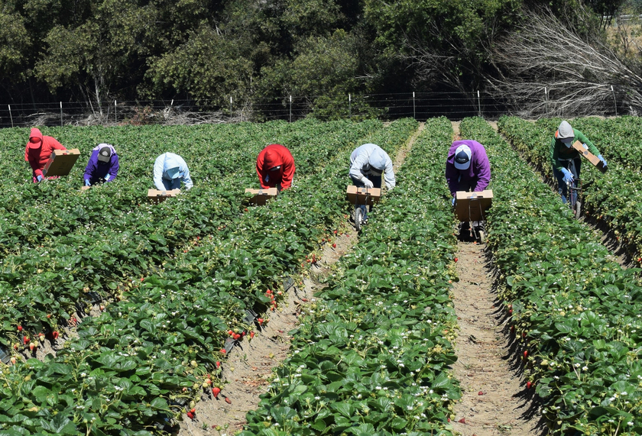
Why is NEO so important?
Certain types of employees are always “new”:
Temp workers
Seasonal help
Migrant agriculture
Notes:
(Istock photo: 72811801 - Photo downloaded for use by C+D 8.16.16)
While it is true that many workers may be familiar with the duties they perform (as with migrant workers), they are not familiar with the employer or where they are working – which makes them “new”.
You can use the example of the worker who knew how to operate forklifts, but was unfamiliar with the terrain as well as the specific forklift they would be operating. It resulted in a rollover incident.

Slide 8
Why is NEO so important?
Model for achieving best results
Set expectations
Provide
training
Recognize achievements
Hold
accountable
Provide
feedback
Notes:
The model for achieving best results was the result of a SAIF survey of policyholders who always achieved consistently good results. These are the practices they had in place, which have been adopted as best practices. In NEO – setting expectations is critical to the success of new employees – as is providing the training to match those expectations.

Slide 9
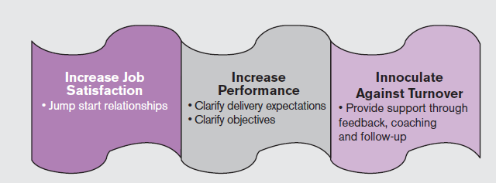
Why is NEO so important?
- Originally published as Onboarding New Employees: Maximizing Success by Talya Bauer. © 2010, the SHRM Foundation, Alexandria, VA. Used with permission. All rights reserved.
Notes:
Self explanatory – these findings are based on research that is cited in the larger SHRM publication – but it gives a very good overview of the benefits of onboarding successfully.
Talya Bauer is at Portland State

Slide 10

Thinking differently
New research—make NEO participatory and focused on individual identity. It created:
Stronger employment relationships
Lower turnover
Greater customer satisfaction
Higher productivity
Fewer errors
—Daniel Cable, MIT Sloan Business Review
Notes:
(photo downloaded for use from Istock id: 87964761, C+D 8.8.16)
What does individual identity mean? It means allowing employees to express themselves – to talk about WHO they are. To the extent that you can allow employees to have some control over the NEO tasks you set, is good, too. We will talk about specific ways to create opportunities for employees to express their identity later in the presentation.

Slide 11



Planning
Set the stage for the new employee
Write agenda for at least the first week
Provide a comfortable work area
Give a welcome gift—branded items
Send helpful information
Notes:
Write an agenda – planning required meetings, setting aside desk time to get familiar with surroundings; make it flexible, giving the employee some control over how they accomplish it
Comfortable work area – can be in any environment – wherever they will be working should be clean and free from evidence of previous occupants
Welcome gift – branded items are appropriate
Helpful information mailed – parking, dress code, how to arrive at office on the first day and who to contact. Sending information on benefits beforehand is also a great idea.

Slide 12
Planning
Set the stage for the new employee
Announce new team member and start date to other employees
Order business cards and nameplate (if needed)
Stock area with all needed tools
Set up computer/phone to be ready upon arrival
Create a NEO plan with target dates—what you would like them to be able to do, and by when
Notes:
Again – many items from this list do not apply to all organizations – but it is pretty self explanatory and can be accompanied by specific examples. Such as – stocking area with needed tools at a welder station may include setting up the tanks, the hood, the screens, the wiring/rods, etc.

Slide 13
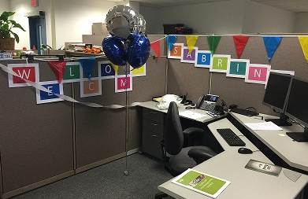
Planning
Set the stage
Plan a warm welcome
  Decorate desk/work area with welcome banner
  Welcome card signed by all staff
  Post their photo with a short bio
  Personalized welcome videos—put names to faces
Assign mentor/job coach—they should assist in preparing helpful materials
Notes:
The warm welcome also may not fit into the culture of every organization. However, it is a good way to make employees feel welcome. The picture here is the welcome given to the new TWH consultant, Sabrina Freewynn. There are also briefer ways to welcome others – just a simple welcome card is another idea. Posting their bio with a picture, either on intranet, or on a small breakroom poster helps colleagues get acquainted and may provide them with conversation starters – he’s a Ducks fan? Cool!
The mentor or job coach is important because they can be the point of contact for the new employee, should they have any questions. They can help put together information and training materials for the new employee and they can also ensure that all bases are covered. In small organizations, this person may be the direct supervisor.

Slide 14
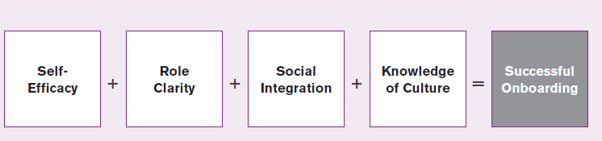
Planning: employee adjustment stages
After selection
- Originally published as Onboarding New Employees: Maximizing Success by Talya Bauer. © 2010, the SHRM Foundation, Alexandria, VA. Used with permission. All rights reserved.
Notes:
This slide is included to describe the stages an employee goes through during onboarding. It is meant to be a tool for employers to use to create their NEO plan.
Self-efficacy = self-confident in job performance, feeling that they can do the job well
Role clarity = understanding role and expectations
Social integration= feeling socially comfortable and accepted by peers and supervisors
Knowledge of Culture= understanding the organization’s politics, goals, values, and unique language and feeling comfortable operating within it

Slide 15

Best practices
Use a checklist
Ensures all items are covered
Provides organized approach
Creates a written record
Maintains consistency
Allows you to establish expectations, metrics, and benchmarks
Notes:
Checkmark Istock image 11379614 purchased 8.8.16 for this presentation usage. (C+D)

Slide 16
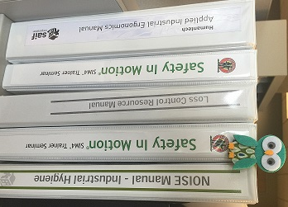
Best practices
Invest in training
Schedule time for training.
Don’t make assumptions
about new employee’s
knowledge or experience.
Use training that incorporates the
different ways we learn.
Train the trainers, too!
Notes:
Leigh Manning took photo
Making sure you set aside enough time for training is critical to a successful process – time should be included for questions.
This is a good place to discuss “common sense” in regards to assumptions about an employee’s experience.
There are several styles of learning: visual(spatial), aural (auditory-musical), verbal (linguistic), physical (kinesthetic), solitary (intrapersonal), social (interpersonal), and logical (mathematical). While learners may have one dominant style of learning, they will usually use several different techniques while learning. That is why incorporating the different styles in learning makes sense – so you give all employees the opportunity to learn effectively.
In train the trainers, too – it is making sure that the trainers you select convey company procedures effectively. For example, do they train a NEO to do a job with a machine guard off or with no PPE?

Slide 17

Best practices
Don’t forget safety!
Include safety expectations at every step.
Provide new employee with proper-fitting personal protective equipment (PPE).
Inform employee about workplace hazards and train on controlling them.
Address any safety concerns.
Notes:
Safety is a huge part of onboarding because we want every employee to go home in the same condition they came to work. In a good safety culture, safety is woven into the “way we do things around here.”

Slide 18

Best practices
Hands-on training (job coach, job shadow)
Demonstrates understanding
Provides coaching opportunity
Gives valuable experience
Increases confidence
Notes:
(Istock photo: 67365777 purchased for presentation use 8.16.16, C+D)
This employs kinesthetic learning – actually doing the duties that will be performed. It allows employees to demonstrate understanding of the training, allows trainers to correct (if needed), and provides experience so the employee can feel confident in their job duties.

Slide 19

Best practices
Create opportunities for social interaction
Lunch on first day
Staff meeting introductions
Tours of work areas to introduce others
Senior management involvement
Notes:
Photo from 100 year event
Examples of opportunities for social interaction – the sense of belonging (social integration) is very important in retaining employees.
Senior management involvement means introducing employees to owners, CEOs, or whoever is in the highest levels of leadership. This conveys commitment by them to the process of onboarding new employees.

Slide 20

Best practices
Follow up
Create opportunities for employee feedback (consider using a survey).
Schedule regular check-ins to stay on track with NEO plan.
Stay open to new employee questions and concerns.
Notes:
(Istock id: 55311778 purchased for this presentation use 8.16.16, C+D)
Some onboarding kits have surveys – one of the examples at the end has one – or you can create your own.
The follow up helps to ensure all of the plan goals are being met as well as providing an opportunity for the new employee to express concerns before they become problems.

Slide 21

Mistakes Learning opportunities
Read and sign NEO
Limited interaction
Limited content
No good way to check understanding
Does not fit adult learning model
Notes:
(Istock photo ID: 40518334 purchased for this presentation use 8.16.16, C+D)
This describes the limitations of a read and sign NEO program. The adult learning model requires using more than one learning method in order to increase retention of material.

Slide 22

Mistakes Learning opportunities
First day of work is when supervisor is on vacation
Wrong choice of mentor/job coach or no mentor/job coach
Failing to remove old
files/work from their work area
Misspelling their name
Not including safety in training
Notes:
(Istock photo id: 51175550 purchased for this presenation use 8.16.16, C+D)
Examples of mistakes made by other employers in the past, according to an article by SHRM.

Slide 23

Mistakes Learning opportunities
Putting the employee right
to work “sink or swim”
Too much information—too fast
No structure to NEO program
“flying by the seat of your pants”
No planning beforehand
Computer/phone not set—
they have to work in temporary area
Notes:
(Substituted Istock id: 85168843, to keep with same style as previous slide image use. Purchased for this presentation use 8.16.16, C+D)
Other examples of mistakes made in NEO – all are opportunities to do better.

Slide 24
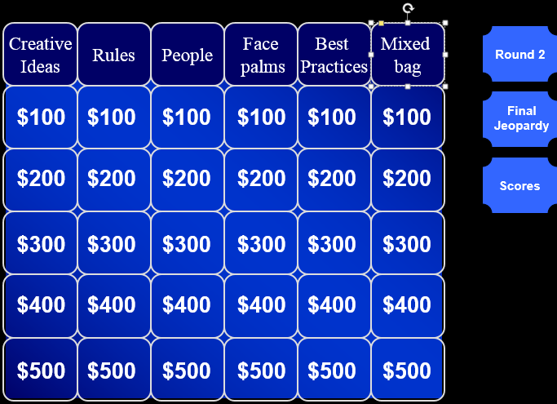
Creative ideas
Game shows—after attending new employee orientation class
Computer versions
  Jeopardy
  Who wants to be a millionaire?
Spin the wheel
Company trivia challenge
Notes:
Screen shot from my jeopardy game that I use for training.
Examples of games that can be used during NEO – it can be content about the company, or it can be content specific to the job. These are all ways to creatively promote retention.

Slide 25
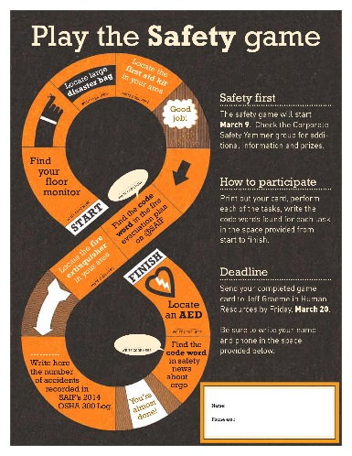
Creative ideas
Scavenger hunt
On the first day, give the new employee a tour.
On the second day, give them a map of your facility with a list of riddles—each riddle leads them to a different department, area, or key person. You could also do the same thing with a list, and no riddles.
They can get little prizes in each area,
or you can give them a big prize once
they successfully cover the map.
Notes:
(Substituted image for an actual SAIF safety game. C+D)
This can be modified to fit the organization, but it is a fun way to get employees engaged. It does take a little time to plan and execute.

Slide 26

Creative ideas
Team building—getting to know you
My river, my mountain
Best job, worst job
Anything, anytime
Human scavenger hunt
Recognition profiles
Notes:
Recognition profiles are quick surveys describing the person – their likes and dislikes. It provides an opportunity for co-workers to get to know them while allowing them to express their identity. The human scavenger hunt is also human bingo – you have a grid with different descriptive items and you go around the room finding people who meet that description. The other three are quick discussion exercises describing my river, or my mountain (participants discuss their river or their mountain – it may not be an actual river or mountain – it may be something in their lives that has been a river running through it or a mountain – an obstacle they overcame) – my best (or first) job and my worst job (and why) and anything, anytime (participants are given a topic and asked to come up with the first word that comes to mind and then discuss it – example: candy, skittles)
Photo by Don Hadley, SAIF employee – he gave me permission to use it.
Feel free.
From: Leigh Manning
Sent: Tuesday, June 14, 2016 11:34 AM
To: Don Hadley <DONHAD@saif.com>
Subject: RE: The cream of the crop
Great shots! Can I use one of your mountain pictures in one of our presentations?

Slide 27
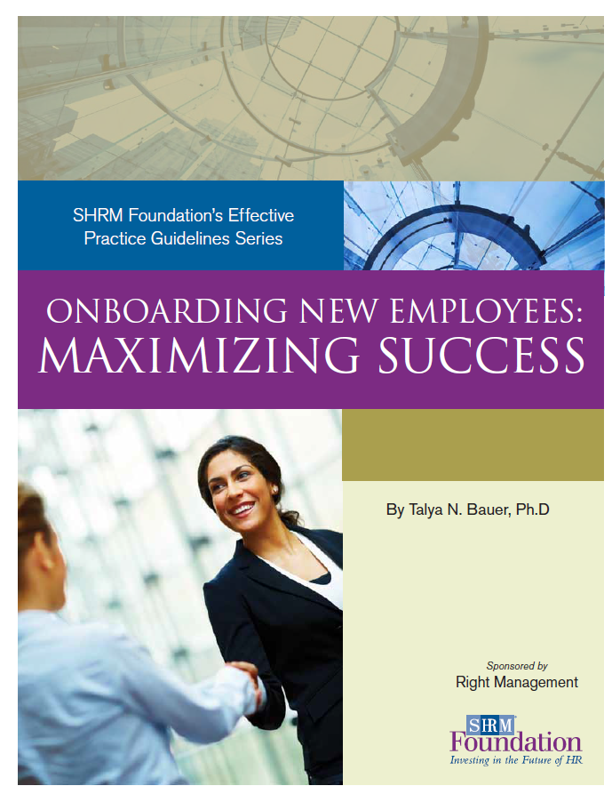
SHRM Foundation
Onboarding New Employees
Printable PDF
Evidence-based best practices
Includes:
  Academic treatment of onboarding
  Case studies
  Links to further reading
Notes:
A guide of best practices

Slide 28
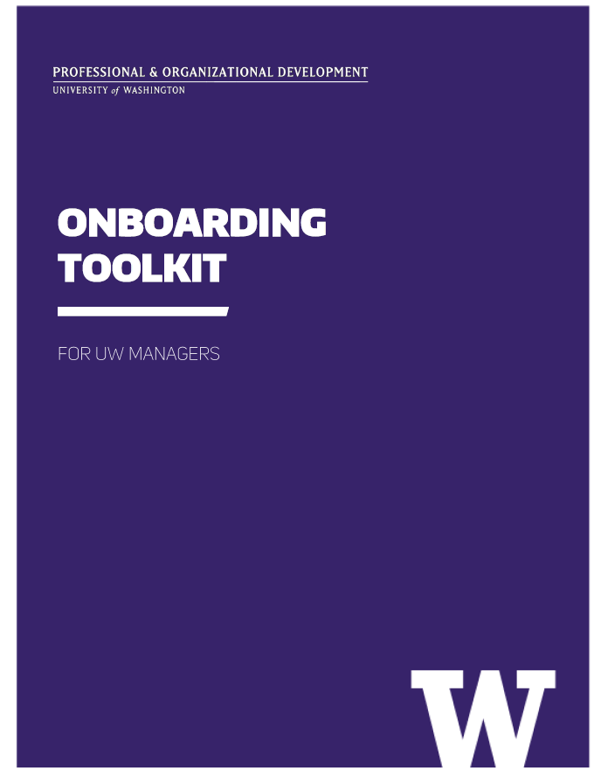
University of Washington Onboarding Toolkit
Printable PDF
Easy to customize
Includes:
  Checklists
  Recognition profile
  Employee survey
Notes:
Onboarding kit example

Slide 29
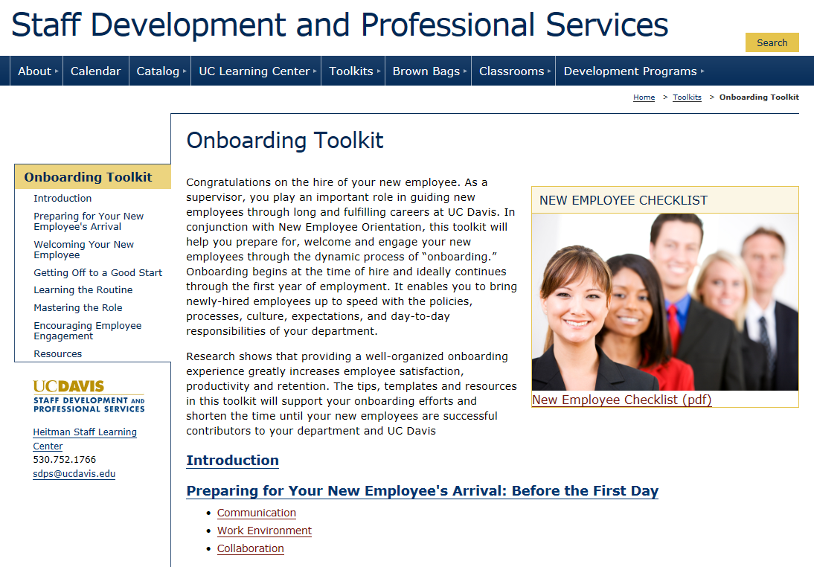
Univ. of California, Davis
Onboarding Toolkit
Interactive web format
Very comprehensive
Includes:
  NEO checklist
  Tips for encouraging employee engagement
Notes:
Another onboarding kit example

Slide 30

Other resources
HR software (examples iCIMS, Bamboo HR, Clear Company, My Staffing Pro, and numerous others)
Society for Human Resource Management (SHRM)
State of Oregon —
Bureau of Labor & Industries
Notes:
A list of other places to get information when developing NEO – or looking to improve it.
(iStock image 6221922 purchased for this presentation usage. 8.16.16 C+D)

Slide 31

Now let’s play a game....
Using your smart phone
Go to your browser
Go to the website kahoot.it

Slide 32

Questions to think about
What does our NEO process look like now?
Can I take ideas from this presentation to improve our process?
Notes:
This can be a place for open discussion, if there’s time. Employers may want to talk about what they are doing now – as a way to share other great ideas. The second question will let them reflect on what they saw and if they can take anything away from the presentation.

Slide 33
References
Bauer, Talya N., Ph.D, Onboarding New Employees: Maximizing Success. Society of Human Resource Management Foundations Effective Practice Guidelines Series. http://www.shrm.org/about/foundation/products/Documents/Onboarding%20EPG-%20FINAL.pdf
Bennington, Emily. Monster video: New Employee Orientation. http://hiring.monster.com/hr/hr-best-practices/small-business/hiring-process/new-employee-orientation.aspx
Cable, Daniel M., et al. Reinventing Employee Onboarding. MIT Sloan Management Review Spring 2013. http://sloanreview.mit.edu/article/reinventing-employee-onboarding/
Chen, Xin. Suggestions on Effective Corporate New Employee Orientation Program for Human Resource Specialists. Online Journal of Workforce Education and Development. Vol IV, Iss 3; Summer 2010. http://opensiuc.lib.siu.edu/cgi/viewcontent.cgi?article=1081&context=ojwed
Cuma, Mike A. Mastering New Employee Orientations: Common Flaws and Winning Best Practices. http://www.legacybowes.com/latest-blog-posts/entry/mastering-new-employee-orientations-common-flaws-and-winning-best-practices-.html
Grillo, Maria, et al. A Strategic Approach to Onboarding Design: Surveys, Materials, & Diverse Hires. Cornell University Digital Commons. http://digitalcommons.ilr.cornell.edu/cgi/viewcontent.cgi?article=1085&context=student

Slide 34
References
Halvorson, Chad. 12 Employee Onboarding Best Practices Every Business Owner Needs to Know. When I Work. http://wheniwork.com/blog/employee-onboarding-best-practices/
Lepi, Katie. The 7 Styles of Learning: Which Works for You?. Edudemic. http://www.edudemic.com/styles-of-learning/
Meinert, Dori. Onboarding Mistakes to Avoid-And Some Great Ideas to Adopt. Society of Human Resources. https://www.shrm.org/publications/hrmagazine/editorialcontent/2016/0616/pages/0616-onboarding-mistakes-and-good-ideas.aspx Accessed June 1, 2016.
O’Leonard, Karen. The Talent Acquisition Factbook® 2011. Bersin & Associates.
University of California, Davis. Onboarding Toolkit. Staff Development and Professional Services. http://sdps.ucdavis.edu/toolkits/onboarding/
University of Washington. Onboarding Toolkit. Professional & Organizational Development. http://www.washington.edu/admin/hr/pod/leaders/ee-careerdev/onboarding/docs/onbdtoolkit.pdf

Slide 35
Questions?
Leigh Manning
Sr Safety Management Consultant
leiman@saif.com
541-338-6718
Notes:
You can put your contact information here – or you can delete slide

Slide 36
Notes:
Branded closing slide

