Slide 1

Drones – What it takes to stand up a program.
Brian Whiteside
COO – Drone Complier
DRONE COMPLIER

Slide 2
My Background
FA-18 Pilot
First Drone: Insitu Scan Eagle 2008
VDOS Global
Complier Enterprise
COO – Complier Enterprise
Appointed Member of the Oregon Aviation Board
Member of the HAI UAS Committee
Member of ORAVI
President Emeritus Cascade Chapter AUVSI
Pilot
Mission Commander
Instructor

Slide 3

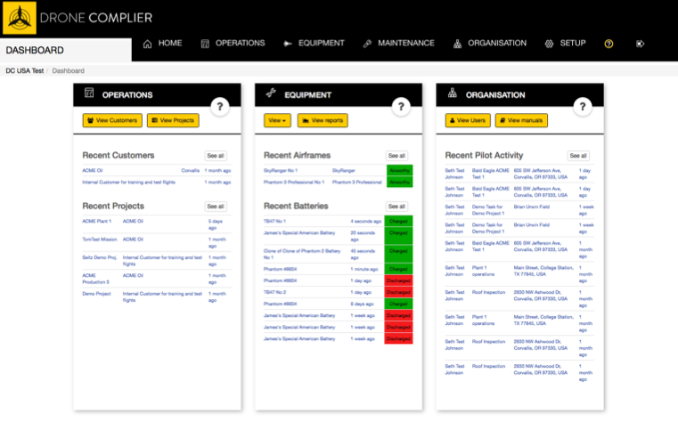
Simple Enterprise Management
Drone Complier Software
FAA reporting compliance
External mission requests and scheduling
Enterprise drone operator certification
Safety and Efficiency
All operations are managed through a corporate dashboard with permission based login.
Logbook for pilots, airframes, batteries, missions, data
Integrated job safety management
Integrated risk management.
Works on and offline.
Operations, projects, equipment, and crew are all efficiently managed based upon an organization’s standards of operations and safety requirements.

Slide 4

Brief Overview
What is a Drone
Role of the FAA
What is “National Airspace”
Federal Law
State Law
Part 107
Public vs Private Operations
What is required for a successful drone program

Slide 5
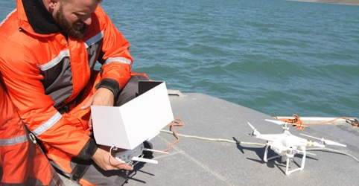

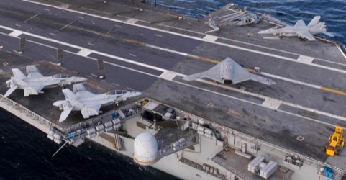
What is a Drone?(UAS, UAV, RPAS)
Tier 1
Tier 2
Tier 3/4
Less than 55 Pounds
Commercial Market
Significant Infrastructure
Long Endurance
Normally for government operations

Slide 6
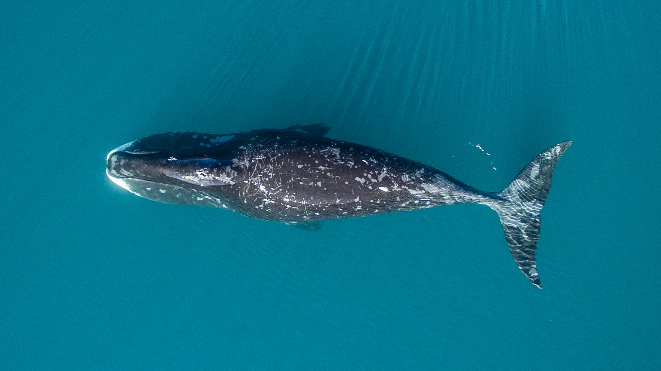
Drone Video
Video Link

Slide 7
Drone Data
Survey
Survey to 3d Print
Wild Life Monitoring
WWF Bowhead Whale Research
Energy Production
Flare Tip Inspection
Forestry
Insurance
Tree Survey
Roof Inspection
Fire Fighting
Wildfire Monitoring
Volume Survey
Rose Quarry
Farming
Agriculture

Slide 8
Federal Aviation Administration
General authority to promote safe flight of civil aircraft in air commerce.
  49 U.S.C. § 44701
Authority to prescribe air traffic regulations to protect aircraft and people and property on the ground.
  49 U.S.C. § 40103(b)
Regulatory authority from the ground up.
Unmanned Aircraft - “An aircraft that is operated without the possibility of direct human intervention from within or on the aircraft.”
Unmanned Aircraft System - “An unmanned aircraft and associated elements . . . that are required for the pilot in command to operate safely and efficiently in the National Airspace System.” Sec. 331, P.L. 112-95, Feb. 14, 2012
Definition of “Aircraft” –
  49 U.S.C. § 40102(a)(6) defines an “aircraft” as “any contrivance invented, used, or designed to navigate or fly in the air.”
  14 C.F.R. § 1.1 defines an “aircraft” as “a device that is used or intended to be used for flight in the air.”

Slide 9
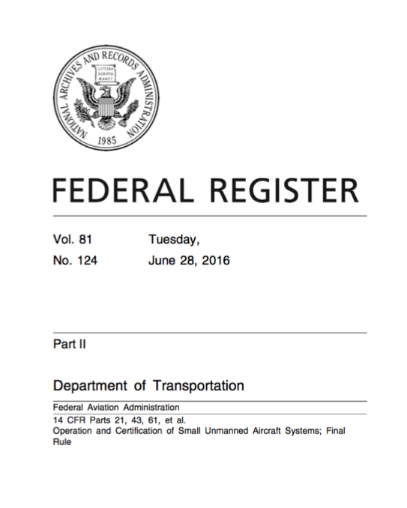
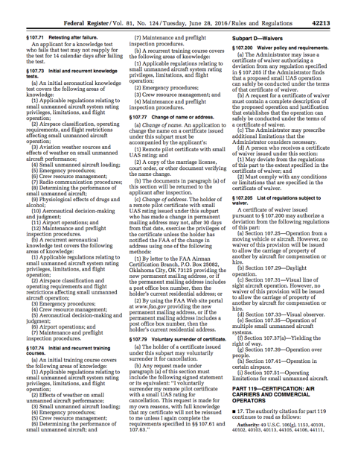
Part 107- Small UAS Rule
Pilots of a small UAS would be considered “operators”.
Operators would be required to:
  Pass an initial aeronautical knowledge test at an FAA-approved knowledge testing center.
Unmanned aircraft must weigh less than 55 lbs. (25 kg).
Visual line-of-sight (VLOS) only; the unmanned aircraft must remain within VLOS of the operator or visual observer.
At all times the small unmanned aircraft must remain close enough to the operator for the operator to be capable of seeing the aircraft with vision unaided by any device other than corrective lenses.
Small unmanned aircraft may not operate over any persons not directly involved in the operation.
Daylight-only operations (official sunrise to official sunset, local time).
Must yield right-of-way to other aircraft, manned or unmanned.
May use visual observer (VO) but not required.
First-person view camera cannot satisfy “see-and-avoid” requirement but can be used as long as requirement is satisfied in other ways.
Maximum airspeed of 100 mph (87 knots).
Maximum altitude of 500 feet above ground level.
Minimum weather visibility of 3 miles from control station.
No operations are allowed in Class A (18,000 feet & above) airspace.
Operations in Class B, C, D and E airspace are allowed with the required ATC permission.
Operations in Class G airspace are allowed without ATC permission
No person may act as an operator or VO for more than one unmanned aircraft operation at one time.
No careless or reckless operations.
Requires preflight inspection by the operator.
A person may not operate a small unmanned aircraft if he or she knows or has reason to know of any physical or mental condition that would interfere with the safe operation of a small UAS.
151 Pages of fine print

Slide 10
Federal Pre-Emption
(Mandatory authority for independent agencies created by executive order and Cabinet departments; not binding on judicially-created tribunals; congressionally-created independent regulatory agencies are encouraged to comply)
Executive Order 13132 of August 4, 1999 - See 64 Fed. Reg. 43, 255 - August 10, 1999, Sec. 4. Special Requirements for Preemption.
Agencies, in taking action that preempts State law, shall act in strict accordance with governing law.
  Agencies shall construe, in regulations and otherwise, a Federal statute to preempt State law only where the statute contains an express preemption provision or there is some other clear evidence that the Congress intended preemption of State law, or where the exercise of State authority conflicts with the exercise of Federal authority under the Federal statute.
  Where a Federal statute does not preempt State law (as addressed in subsection (a) of this section), agencies shall construe any authorization in the statute for the issuance of regulations as authorizing preemption of State law by rulemaking only when the exercise of State authority directly conflicts with the exercise of Federal authority under the Federal statute or there is clear evidence to conclude that the Congress intended the agency to have the authority to preempt State law.
  Any regulatory preemption of State law shall be restricted to the minimum level necessary to achieve the objectives of the statute pursuant to which the regulations are promulgated.
  When an agency foresees the possibility of a conflict between State law and Federally protected interests within its area of regulatory responsibility, the agency shall consult, to the extent practicable, with appropriate State and local officials in an effort to avoid such a conflict.
  When an agency proposes to act through adjudication or rulemaking to preempt State law, the agency shall provide all affected State and local officials notice and an opportunity for appropriate participation in the proceedings.

Slide 11
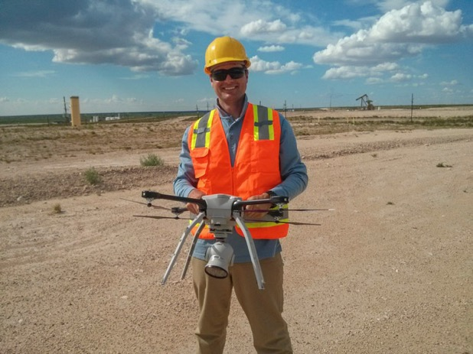
Oregon Laws http://www.oregon.gov/aviation/pages/index.aspx
Defines what is an “Unmanned Aircraft System”
Can not operate a Drone that is capable of forward firing of projectiles or operate the system to function as a dangerous weapon.
Makes a Class A violation if you interfere with a aircraft in the air.
Allows for civil prosecution if Drone is operated in a harassing manner
Makes it a prosecutable offense to operate over “critical infrastructure” without authority
Prohibits use of Drones for hunting and fishing
Defines Public Body Drone Policy – (If you are funded by tax dollars you are a public body.)

Slide 12
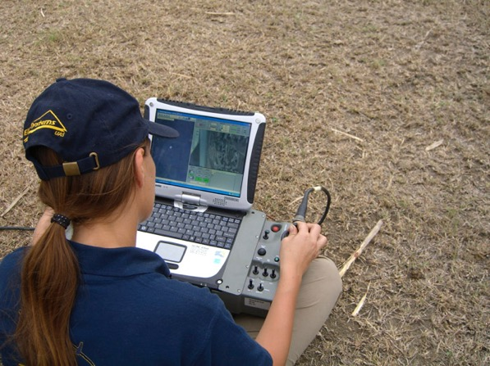
Oregon Public Body Policies
SECTION 7. Policies and procedures for use of data. (1) A public body that operates an un-manned aircraft system shall establish policies and procedures for the use, storage, accessing, sharing and retention of data, including but not limited to video and audio recordings, resulting from the operation of the unmanned aircraft system.
  (2) The public body shall post the following information on the public body’s website or otherwise make the following information available to the public:
    (a) The policies and procedures established under this section.
    (b) The text of ORS 192.501.
  (3) The policies and procedures established under this section must include:
    (a) The length of time data will be retained by the public body.
    (b) Specifications for third party storage of data, including handling, security and access to the data by the third party.
    (c) A policy on disclosure of data through intergovernmental agreements.

Slide 13
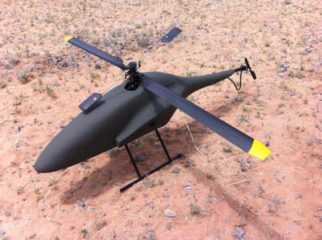
Oregon Public Laws Continued
SECTION 8. ORS 837.360 is amended to read:
837.360.
  (1) A public body may not operate an unmanned aircraft system in the airspace over this state without registering the unmanned aircraft system with the Oregon Department of Aviation.
  (2) The Oregon Department of Aviation may impose a civil penalty of up to $10,000 against a public body that violates subsection (1) of this section.
  (3) Evidence obtained by a public body through the use of an unmanned aircraft system in violation of subsection (1) of this section is not admissible in any judicial or administrative proceeding and may not be used to establish reasonable suspicion or probable cause to believe that an offense has been committed.
  (4) The Oregon Department of Aviation shall establish a registry of unmanned aircraft systems operated by public bodies and may charge a fee sufficient to reimburse the department for the maintenance of the registry.
  (5) The Oregon Department of Aviation shall require the following information for registration of an unmanned aircraft system:
    (a) The name of the public body that owns or operates the unmanned aircraft system.
    (b) The name and contact information of the individuals who operate the unmanned aircraft system. (c) Identifying information for the unmanned aircraft system as required by the department by rule.
  (6) A public body that registers one or more unmanned aircraft systems under this section shall provide an annual report to the Oregon Department of Aviation that [summarizes]:
    (a) Summarizes the frequency of use of the unmanned aircraft systems by the public body during the preceding calendar year; [and]
    (b) Summarizes the purposes for which the unmanned aircraft systems have been used by the public body during the preceding calendar year[.]; and
    (c) Indicates how the public can access the policies and procedures established under section 7 of this 2016 Act.
  (7) The State Aviation Board may adopt all rules necessary for the registration of unmanned aircraft systems in Oregon that are consistent with federal laws and regulations.

Slide 14
Public vs Private Requirements
FAA
Part 107 or COA
Public
Hobby Rules
Students
Private
Teachers
Hobby
Under Part 107
  Commercial Operations and Teachers must operate under the part 107 rules.
  Students may operate under hobby rules
Public Operations can be either under a COA(Certificate of Authority) or Part 107 rules

Slide 15
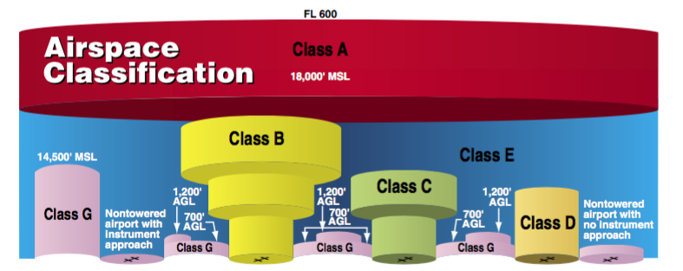
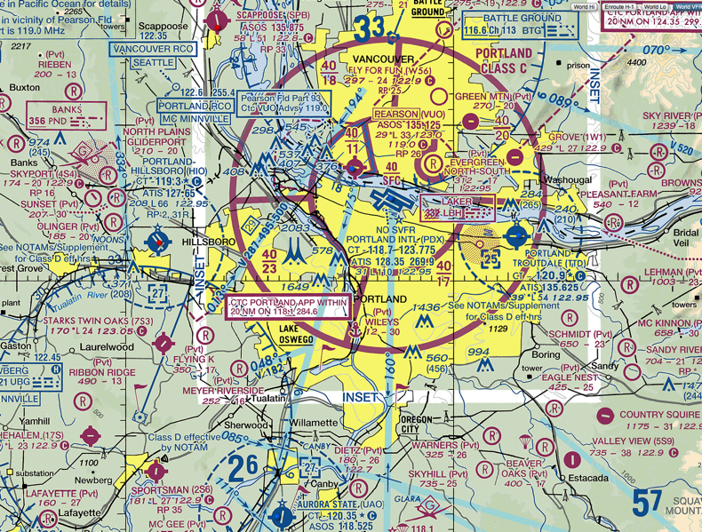
National Airspace
Federally Regulated by the FAA (Federal Aviation Administration)
Two Categories (Regulatory and Non Regulatory) broken up into four types:
  Controlled – Class A, B, C, D
  Uncontrolled – Class E
  Special Use – Military
  Other
Airspace (and its regulation) encompasses ALL flying objects EXCEPT those flying indoors or under a shelter (a netted covering counts as a shelter)
VFR Sectional

Slide 16

Successful Drone Program Requirements
Training
Insurance
Documentation/Logbooks
Safety Management
Data Management
Aircrew
Operations Planning

Slide 17
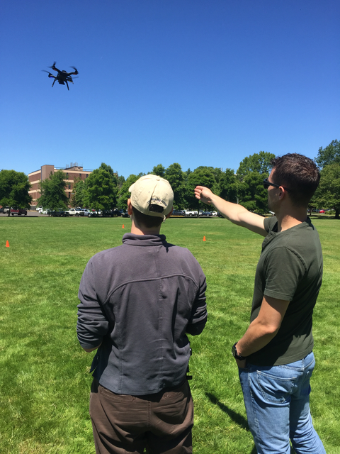
Training
Its easy to fly a drone once, but to do it in a safe and repeatable manner takes experience and a plan.
Training establishes:
  Standardization – Ensuring your team is operating in a set of best practices and policies compliant with entity mandates and constructs.
  Emergency Procedures – Ensures that the operator is capable of making decisions when faced with abnormal conditions.
  Reporting Compliance – There are numerous compliance requirements and training establishes the procedures to meet these requirements.
  Safety – Drones do fail and when that happens a safety policy properly executed will ensure controlled responses.
  Wisdom – Sharing of lessons learned and best practices about experience and hardware.
  Airmanship – Teaching flight skills and performance requirements.

Slide 18


Insurance
Who is liable if someone gets hurt when using a drone?
Does your policy cover you if you are not operating within the legal bounds of the law?
How much insurance is required?
What type of coverage is needed?
Who is insured? Pilots? Observers? Data?
If the batteries are stored improperly and they start a fire will the insurance cover the mishap?
Before any operation begins Define these questions and more to establish your operating constructs!

Slide 19
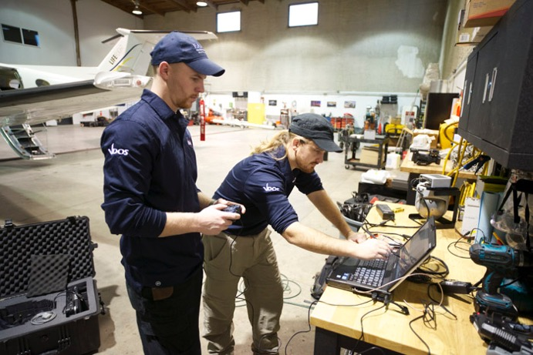
Documentation and Logbooks
Per Oregon Law you shall report on all activity annually.
Per Federal Law you shall maintain a logbook, maintenance records, and conduct a preflight.
Per Insurance requirements you may need other documentation.
Per Manufacturer warranties you may need to have other documentation.
Bottom line: For aviation operations proper documentation and recordkeeping are mandatory and a necessary part of Drone programs.

Slide 20
Safety Management
SMS
Operating Procedures
Battery Management
Crew Policies
Weather Policies
Aircraft Standards
Personal Protective Equipment
Training Standards
Flight Limitations
A safety management system is a method by which risk management and safety assurance is integrated into operational constructs.
  Decision Making
  Risk Controls
  Safety Assurance
  Knowledge Sharing
  Safety Promotion/Culture

Slide 21
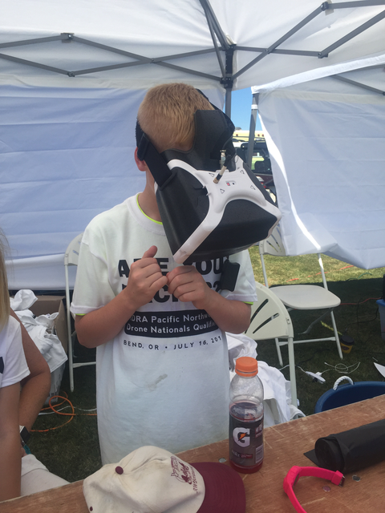
Data Management
As a public entity you are required to keep the data collected.
How are you going to manage Terra-bytes of data?
How will you upload and download?
Do you have the storage available?
Who will have access?
How will you control access?
What is ok to share?
These can be answered easily but need to be put into an established set of procedures so that they can be made available to public inquiries.
Regardless of how we feel Drones come with an perception of “big brother” and that perception has led to legislation and policies that effect Drone operations.

Slide 22
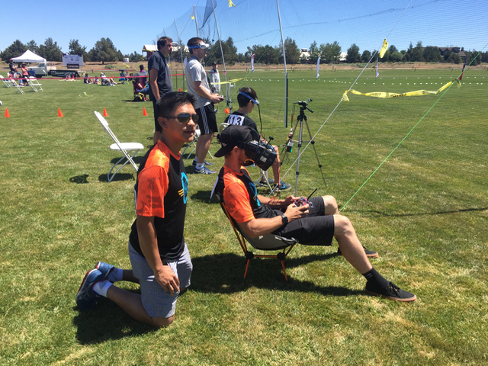
Aircrew
Who will your pilots be?
How will they be trained?
What currency will be required to keep them proficient?
What will occur if a violation occurs?
Have they passed the Part 107 exam?
What is required by insurance?
Are there any limitations on the type of Drone?
Who is the Chief Pilot? (What is a Chief Pilot?)
Who will do the maintenance?

Slide 23

Operations Planning
Location
Data Requirements
Flight Limitations
Weather
Drone
Crew
Job Safety Assessment
Risk Analysis
New Laws
Flight Approvals

Slide 24
Conclusion
FAA/Oregon/Entity Policies
Safety is the foundation
Have Fun!
Drone Operations
Establish a set of standards and operating procedures
Live the SMS
Integrate risk management
Publish and Comply

Slide 25

Questions?
brian@dronecomplier.com
971-237-9698
DRONE COMPLIER

