Slide 1

Automated Vehicles and Safety
2017 OR-PRIMA Conference
September 28th, 2017
Gleneden Beach, OR
Andrew Dick, CAEV Advisor
andrew.e.dick@odot.state.or.us
(503) 986-3839

Slide 2
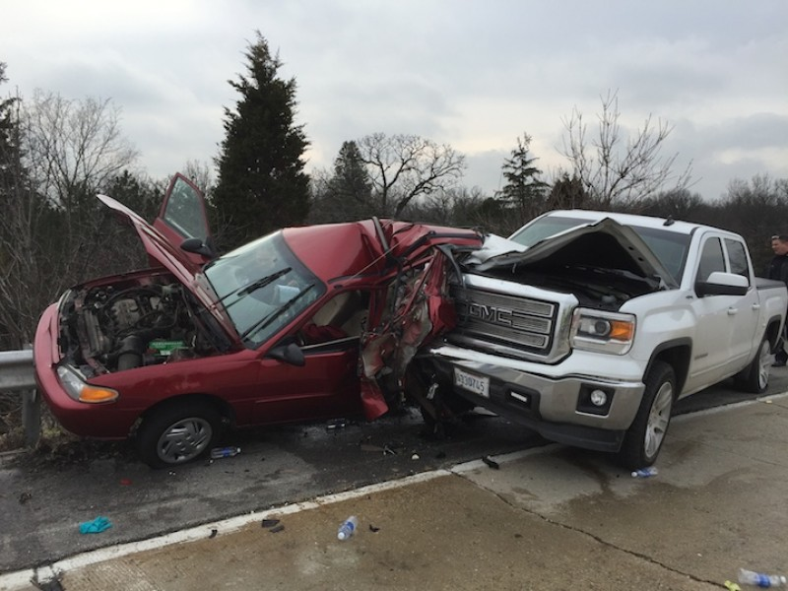

Slide 3
94%
of motor vehicle crashes
primarily caused by human error
40,000
motor vehicle deaths in U.S.,
a 6% increase over 2015
495
motor vehicle deaths in Oregon,
a 10% increase over 2015

Slide 4
What If We Could Use Technology to Improve Roadway Safety?

Slide 5
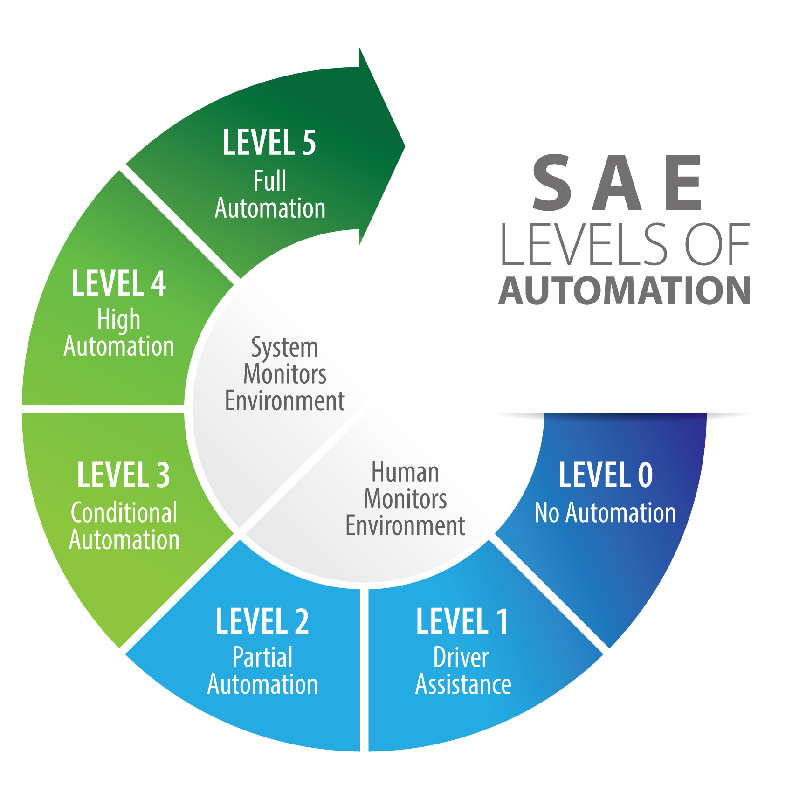

Slide 6
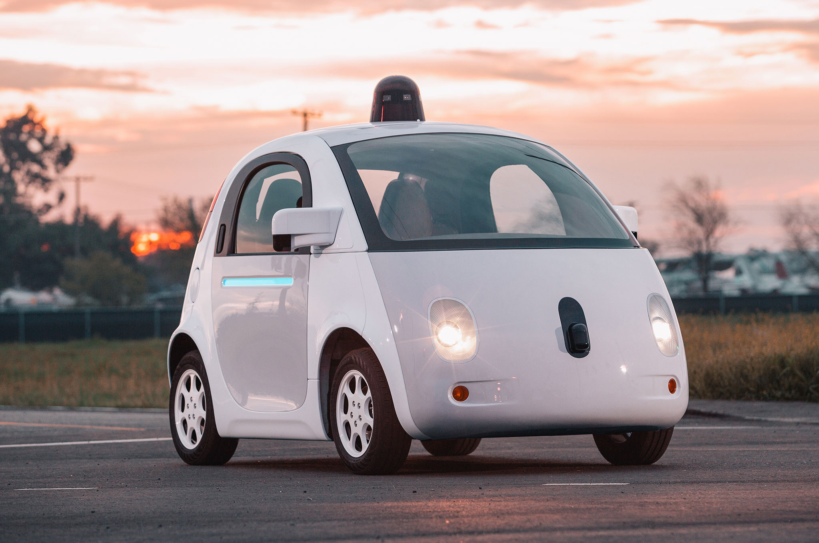

Slide 7
In an ideal world, autonomous vehicles will…
  Improve roadway safety by carefully navigating the road environment – without getting tired, distracted, or intoxicated
  Provide mobility for the elderly, disabled, and others who do not or cannot drive
  Decrease congestion by optimizing use of the roadway and through advanced ridesharing
  Reduce emissions through highly-efficient electric powertrains

Slide 8
On the other hand, AVs could…
  Increase VMT by lowering the cost of transportation and inducing more trips
  Exacerbate congestion through more travel, including zero-occupancy trips
  Increase sprawl as drivers tolerate longer travel distances
  Increase unemployment by automating professional driving jobs, from taxis and rideshare to long-haul trucking

Slide 9
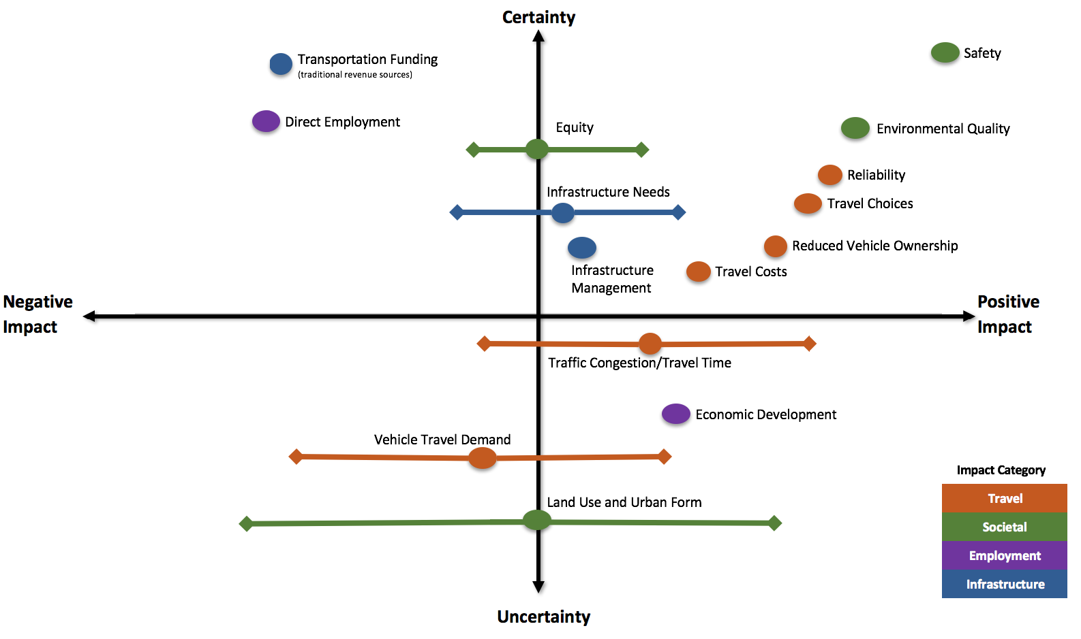
Potential Impacts of New Transportation Technologies
Source: Atlanta Regional Commission

Slide 10
Securing the Future
Automated vehicles could have positive and negative effects
Government policy helps secure the benefits – and mitigate the risks – of AV technology
  Federal Role: Safety, design, and performance requirements for automated vehicles
  State Role: Licensing, registration, and operation of vehicles on the roadway

Slide 11
NHTSA developing federal AV policy
  September 2016: “Federal Automated Vehicles Policy”
  September 2017: “Automated Driving Systems 2.0”
Key differences in federal responsibilities
  Elimination of “Privacy” focus area
  Emphasis on voluntary nature of guidance
  Elimination of discussion of potential binding standards
ODOT comment: If federal government asserts responsibility for developing safety standards, then federal government must develop safety standards

Slide 12
NHTSA’s Model State Policy
2.0
may consider forming
States should form AV safety technology committee including DOT, DMV, Gov’s Office, Law Enforcement, Office of Information Technology, etc.
States should examine laws to remove unnecessary barriers to AV testing and deployment
States should take necessary steps to establish authority over AV testing
States should establish process for accepting, reviewing, and approving applications for AV testing
may consider examining
may consider taking
may consider establishing

Slide 13
Safety Vocabulary for Automated Vehicles
Operational Design Domain (ODD)
  The conditions under which the automated system is designed to operate (geography, weather, road type)
Object and Event Detection and Response (OEDR)
  How the vehicle detects and responds to roadway entities and conditions. A list of objects the vehicle can recognize and behaviors it can perform.
Fallback (Minimum Risk Condition)
  If the vehicle malfunctions, it must return to a safe condition (e.g., pull out of traffic and stop), even without relying on a human driver

Slide 14
Takeaways
AVs need binding federal safety standards – voluntary guidance insufficient
States may oversee testing, licensing, operation on roadway
Other issues – VMT, congestion, emissions, land use – will be critical in long term

Slide 15
Automated Vehicles and Safety
2017 OR-PRIMA Conference
September 28th, 2017
Gleneden Beach, OR
Andrew Dick, CAEV Advisor
andrew.e.dick@odot.state.or.us
(503) 986-3839

