Slide 1




CIS Workers’ Comp Predictive Algorithm
Scott Moss
CIS P/C Trust Director

Slide 2
Why a Predictive Algorithm?
Early prediction of outcome of claim, based on member’s first notice of injury and doctor’s first notice report (In Oregon those reports are called an 801 and 827)
Tool for workers’ compensation supervisor to assign and monitor claims
Management tool to learn of potentially high-cost claims

Slide 3

Why a Predictive Algorithm? (continued)
Incorporate in CIS’ member incident tracking so members can estimate the cost of a claim that “didn’t happen”
Intelligence about the impact of risk factors on claims
Fun!
It’s the future

Slide 4
Development
10 years of CIS workers’ compensation claims data – 8,200 Claims
Several algorithm software programs available (I used Visual Logic)
Able to duplicate in Excel
Incorporate into the CIS homegrown claims system (COMPASS)

Slide 5
Factors (Date Questions)
1. Birthdate (Age)
2. Date of Hire (Length on Job)
3. Date of Injury
4. Date of Employer Knowledge
5. Day of Week

Slide 6
Factors
6. Medical Only/Indemnity
7. Death/Permanent Injury
8. Type of Injury
9. Body Part
10. Cause of Injury
11. Hospitalization
12. Off-work

Slide 7
Factors
13. Department
14. Male/Female
15. Same Body Part Injured
16. Witnesses

Slide 8
Factors (Learning Factors)
17. Referred to another physician
18. Palliative Care
19. Co-Morbids
20. Employment Issues
21. Opiates
22. Attorney
23. Weight

Slide 9
Predictive Outcomes
1. Risk Score
If Over 60
If Over 75
If Over 100
Claim reviewed by supervisor
Claim reviewed by CIS attorney
Notice to P/C Trust Director & Executive Director
Estimated Time Loss
Estimated Length to Close Claim

Slide 10
Predictive Outcomes (Continued)
4. Projected Cost
Medical Only
Expected (Mean)
Time Loss
Projected cost for medical only claim
Projected expected mean
Projected cost of a time loss claim

Slide 11
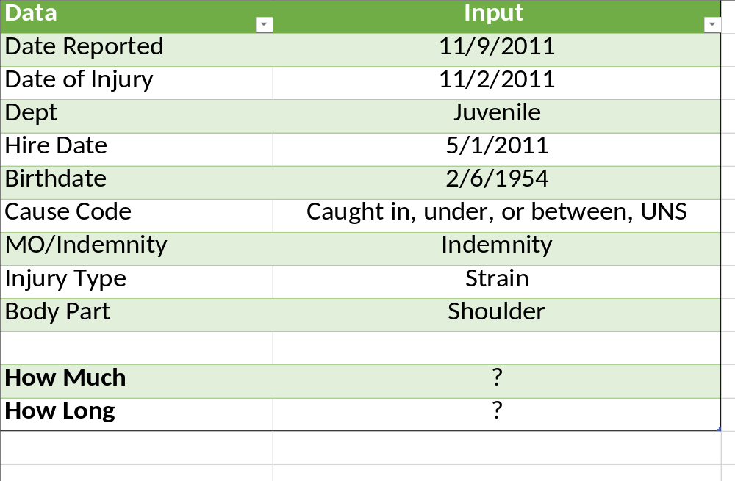
Let’s Play: You Against the Algorithm

Slide 12
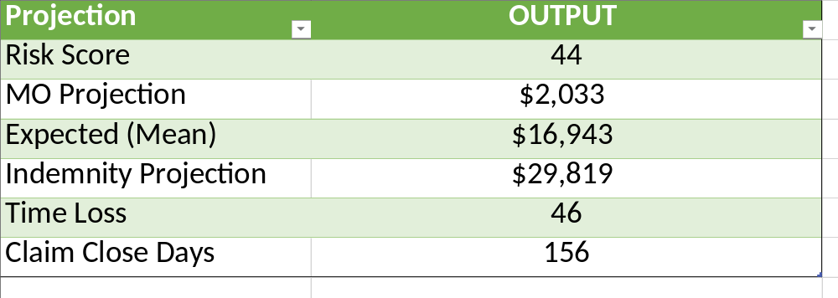
Let’s Play: Algorithm Projections

Slide 13
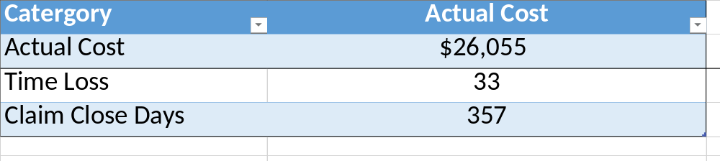
Let’s Play: Actual Claim Cost

Slide 14

Let’s Play: You Against the Algorithm
Random Indemnity Claim
    (Pick a number between 1-1000)

Slide 15
The Algorithm Every Risk Manager Needs to Know
An algorithm is a step-by-step process or set of rules using mathematical equation and reason to solve a problem.
You have the ability using your talents, knowledge, and judgement to solve problems at your entity.

Slide 16

THANK YOU!

Slide 17
CIS Contact
Scott Moss, MPA, CPCU, ARM-E, ALCM
P/C Trust Director
smoss@cisoregon.org
503-763-3840

