Slide 1
Homelessness: Challenges for Public Entities
Sally Erickson, Program Manager
CITY OF PORTLAND/MULTNOMAH COUNTY JOINT OFFICE OF HOMELESS SERVICES
EMAIL: AHFE@MULTCO.US | WEB: AHOMEFOREVERYONE.NET
Notes:
Nearly 14 years working for City or County govt.
Since July, JOHS

Slide 2


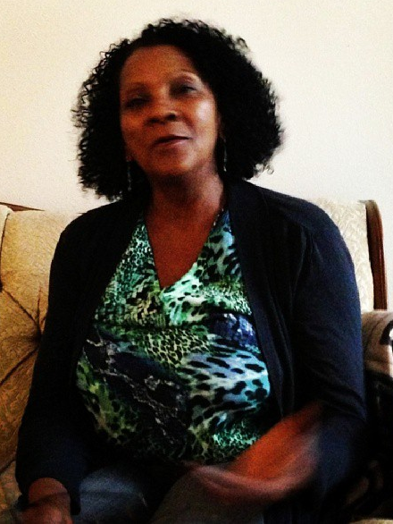
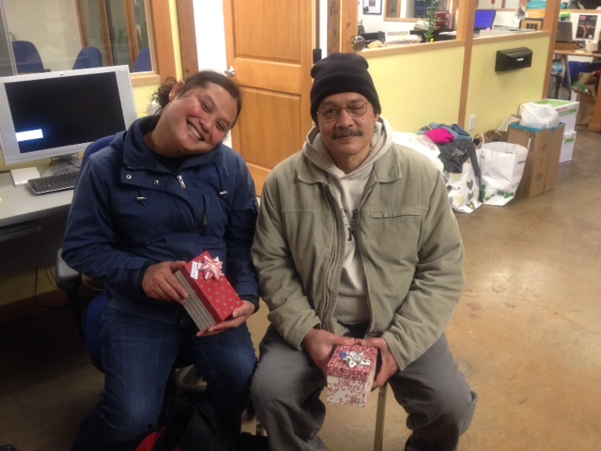

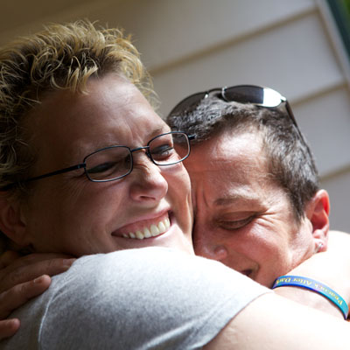
Notes:
Too often we have an image in our heads of who we mean when we talk about homelessness, but the population of people in our community facing a severe housing crisis is incredibly diverse.

Slide 3
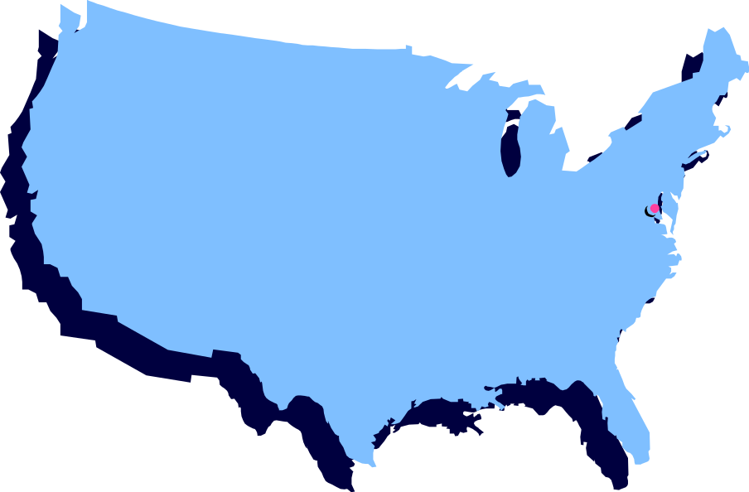

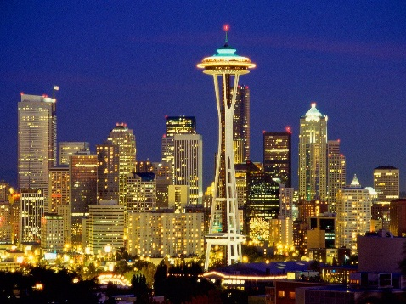


564,708
19,419
10,122
13,226
3,801
Source: U.S. Department of Housing and Urban Development (HUD). November 2015. The 2015 Annual Homeless Assessment Report (AHAR) to Congress: Part 1: Point-in-Time Estimates of Homelessness. Accessed from http://ow.ly/Vm0rc on 11/30/2015.
Notes:
Whether a library, park or right of way, all communities in the U.S. are having similar structural challenges with balancing the needs of homeless individuals and the community.
Nationally…
In Oregon & Washington…

Slide 4
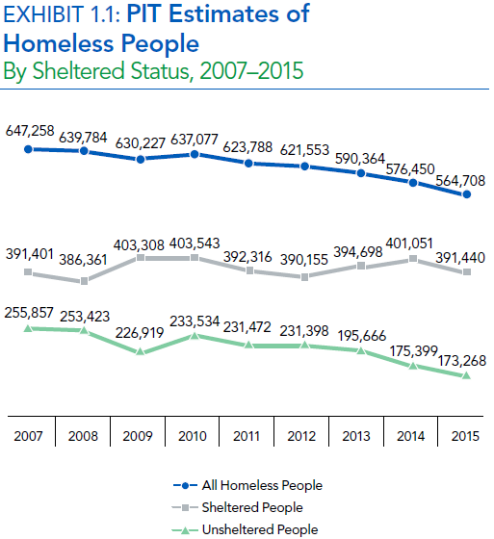
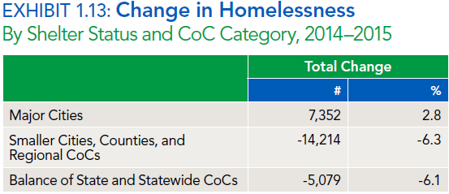
Nationally Multnomah County
Source: Point in Time Count of Homelessness in Portland and Multnomah County (Biannual 2007-2015). Accessed from https://www.portlandoregon.gov/phb/61362 on 11/30/2015.
Source: HUD. November 2015. 2015 AHAR. Accessed from http://ow.ly/Vm0rc on 11/30/2015.

Slide 5

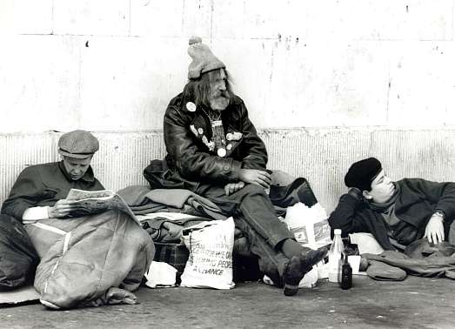
Economically Chronically
77%
23%
($$$)
($$$)++
Source: U.S. Department of Housing and Urban Development (HUD). November 2015. The 2015 Annual Homeless Assessment Report (AHAR) to Congress: Part 1: Point-in-Time Estimates of Homelessness. Accessed from http://ow.ly/Vm0rc on 11/30/2015.

Slide 6


10%
653 (17%)
Source: Source data from 2015 Point in Time Count of Homelessness in Portland and Multnomah County (https://www.portlandoregon.gov/phb/61362). Analyzed by Portland Housing Bureau 11/2015
Notes:
In Portland

Slide 7
low or no income
+
lack of affordable housing
untreated addictions
untreated mental illness
=
domestic violence
recession
lack of social supports
unemployment
health problems
racism
homelessness
Notes:
Why?

Slide 8
low or no income
+
lack of affordable housing
=
homelessness

Slide 9
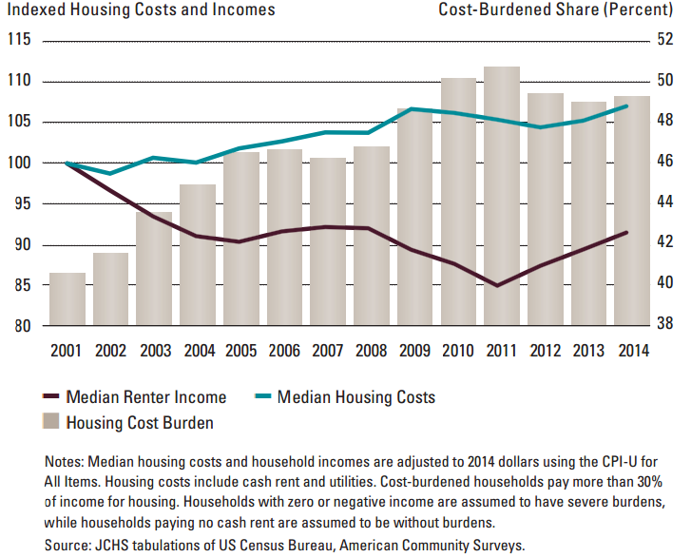
The Share of Renter Households Facing Cost Burdens Remains High as Income Growth Lags
www.jchs.harvard.edu/sites/jchs.harvard.edu/files/americas_rental_housing_2015_web.pdf

Slide 10
The Challenge: Rents Outpacing Incomes
Sources: Multifamily NW Survey Data, American Community Survey 2005-15

Slide 11
The Challenge: Rents Outpacing Incomes

Slide 12
The Result
New people becoming homeless every day
Those already homeless taking longer to find permanent housing
3,500 people housed last year, yet every shelter bed is full and 1,800+ people a night, many of them extremely vulnerable, have no choice but to sleep in public spaces
Notes:
→ So, what are we doing about it?

Slide 13
A Home for Everyone: Shared Vision, Values & Plan
Vision: No one should be homeless. Everyone needs a safe, stable place to call home.
Guiding Values
  Prioritize the most vulnerable
  Promote racial and ethnic justice
  Hold the programs we fund accountable and using data to make decisions
  Engage and involve the community
  Strengthen system capacity and increase leveraging opportunities
  Racial Equity
  Racial equity lens informs and guides resource allocation to effectively address disparities based on race and ethnicity
Key Focus Areas
  Housing
  Income & benefits
  Health
  Survival & emergency services
  Access to services
  Systems coordination
Priority Populations
  Families with children
  Unaccompanied youth
  Adults with disabilities
  Women
  Veterans

Slide 14

(Multnomah County, Portland, Gresham, Home Forward, Meyer Memorial Trust,
Portland Leadership Foundation, Portland Business Alliance, Coordinating Board Co-Chairs)
(People with lived experience, system providers, culturally specific organizations,
housing, faith, business, public safety, education, DHS, healthcare, legal, advocates)
(Consumers, providers) (CB members) (CB members & staff) (HYOC, HFSC, DV)
(Comprised of CB and community members)
Executive Committee
Coordinating Board
Community Advisory Forum
Resource Adv. Committee
Data & Eval.
System Adv. Groups
Policy Committees
Vets
Housing
Health
SOS
Econ. Opp.
Notes:
We have a broad range of stakeholders participating in planning and recommending local investment

Slide 15



Reducing Homelessness: A Balanced Approach
Prevention
Housing Placement
Diversion
Street to Housing
Shelter to Housing
Shelter
Street
Notes:
In Portland, the kinds of interventions we make: Homelessness Prevention , Housing, Placement, and Emergency Shelter / “Safety Off the Streets” options.
Our reality is, of course, more complex than this hypothetical. We aren’t able to prevent all homelessness, we can’t immediately place everyone into permanent housing, and we already have upwards of 2,000 people a night who are sleeping outdoors in our community on any given night, another 2,000 who are sleeping in emergency shelter and transitional housing, and thousands more who are doubled-up, precariously housed, or overly rent-burdened. Many of us are “one paycheck away” from homelessness and, if we don’t have a friend or family member from whom we can borrow $100 to cover this month’s rent, it can have disastrous results.
But the point is that if we want to reduce the number of people living on our streets – opening more emergency shelter is only one response, and in many respects the least desirable of the three options, so with the resources we have we have to take a balanced approach.
Where we can, we should reduce street homelessness through prevention. Where we are unable to do that, we should seek to do it by expanding housing placement. And only where neither of those are options, should we respond by expanding shelter.

Slide 16
The Need for Shelter: Safety off the Streets
Unsheltered

Slide 17
Unsheltered in Portland / Multnomah County
50% – People experiencing homelessness in shelter
1,800 – Unsheltered people each night
    50% – Chronically homeless (disabled & homeless 1 yr+)
    500 – Women
    ↑ – Adults 55+ and African-Americans
Notes:
I thought this group might be more interested in impacts and strategies around unsheltered homelessness.
In Portland (see slide)
23% increase in people over 55
48% increase among unsheltered African Americans adults without children (represent 24% of homeless population, only 6% of the population of Multnomah County)

Slide 18
Common Responses to the Camping Challenge in Portland
“Create a shelter bed for everyone! People who want help can go to shelter -- those who don’t can leave town or be arrested.”
“Get rid of the anti-camping ordinance! You can’t enforce a camping ordinance against homeless people unless you have someplace they can go.”
“ We shouldn’t be dealing with camping! It’s a distraction from the work we need to do on long-term solutions, like permanent housing.”

Slide 19
A More Helpful Response
Implement strategies in response to camping that balance:
  Diverse desires and needs of those experiencing homelessness
  Concerns that ‘camping’ raises for others in the community
  Resource trade-offs between different approaches to providing immediate safety for those who cannot currently get access to permanent housing

Slide 20
Expand & Improve Shelter
Carefully calibrated facility-based shelter expansion that addresses barriers to shelter (ex.: pets, couples, excessive rules), especially for highly vulnerable people.
→ However, mass shelter won’t itself solve camping and can have negative consequences for other strategies

Slide 21
Evaluate Different Types of Camping
Unorganized Camping
Self-Organized Camping
Non-Profit Run Self-Governed Communities
Notes:
3 different types of camping

Slide 22
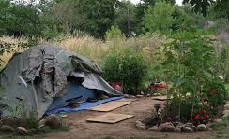
Camping: Public Safety &
Service Collaboration
Local & National Examples:
  Seattle: Law Enforcement Assisted Diversion (LEAD) – Low level offenders diversion
  San Francisco: Homeless Outreach Team (SF HOT): collaboration among Dept. of Public Health, Human Services Agency, SF Public Library and Public Health Foundation Enterprises
  Portland:
    JOIN Street Outreach
    Cascadia Behavioral Health’s High Intensity Street Outreach
    Campsite cleanup/support: 3 trucks; 1 in each precinct trained to deal with bio-hazards
    Needle exchange programs, sharps containers in parks
Notes:
There are many local and national examples of this kind of public safety and service collaboration:
In Seattle (and now Portland): LEAD - Law Enforcement Assisted Diversion -- instead of low level offenders being charged or going to jail, they’re directed to low barrier harm reduction model at Central City Concern. (County funding through Health Dept.)
San Francisco’s Homeless Outreach Team (SF HOT): collaboration among Dept Public Health, Human Services Agency, SF Public Library and Public Health Foundation Enterprises (PHFE). Engage and stabilize the most vulnerable and at-risk homeless individuals through outreach, medical services, engagement and advocacy, transitioning individuals into stable living and healthcare environments. They work in small teams to outreach and provide care management and medical services to homeless individuals.
JOIN (for years) , Cascadia Behavioral Health: High Intensity Street outreach
Campsite cleanup/support: Portland now has 3 trucks -- 6 workers total -- 1 in each precinct trained to deal with bio-hazards and picking up debris
Needle exchange programs, sharps containers in parks with high numbers of needles found

Slide 23
Unorganized Camping
For many, only or desired option until housing available
Without increased resources, we can’t stop it, but we can manage it:
  Official guidelines or police enforcement priorities – “low impact camping”
  Coordinated social service outreach & public safety officers
From camping to permanent housing:
  Mobile housing placement, using housing first/harm reduction model
  Training and cooperation among public safety and land-managing entities
Notes:
Many homeless people prefer/need until permanent housing is available, rather than facility- based shelter or even organized camping. For now, some amount is unavoidable
No jurisdictions gets to declare their property off limits. You can’t enforce a zero tolerance policy -- too resource-intensive and cordoning off space just shifts activity to other spaces. That said, there ARE going to be areas that need to be off-limits to camping. In areas around schools, playgrounds. Draw clear enforcement priorities and message through outreach.
It’s not that you’re legalizing camping. What we’re doing it making enforcement prioritization decisions.
Direct enforcement to: High impact camps, unlawful conduct, harassing behavior -- people who, by their behavior causing livability issues for neighbors
For those who are outside, we need these cooperative strategies
Draw contrast to people living their lives vs. the addiction crisis. (which is also prevalent in the housed community)

Slide 24
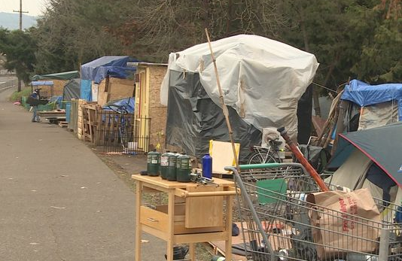
Self-Organized Camps
Can work, but has limits: Dignity Village & R2D2
Challenges include:
  Hard to control who enters, how many, and how people behave
  If surrounding community experiences adverse impacts, they associate that with homeless people in general
  Media often cover only problems occurring & reinforce negative stereotypes
  If police action occurs, established groups can be displaced; can become a political & media event; escalates trauma and conflict for those involved
  Resource demands for local govt. (staff/funding); impacts on planned efforts
Notes:
Many homeless people prefer/need until permanent housing is available, but it is extremely difficult to make successful; when it fails, it jeopardizes public support for, and our ability to remain focused on, sustained efforts to help people end their homelessness

Slide 25
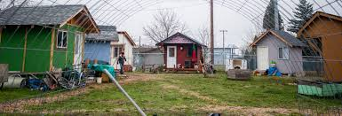
Non-Profit Run,
Self-Governed Communities
They can work very well:
  Multiple options: “Rest Stops,” “Transitional Communities,” “Tent Cities”
  Cost effective: Fully utilizes skills, abilities, resources of those living in the community
  Rebuilds self-confidence and personal support networks: Self-governed nature strengthens those who live there in ways that help succeed after they transition out
  Can use public resources: Because they are legal and non-profit run, public funding can help provide quality infrastructure and “back of the house” organizational capacity.
  Can be integrated with other service systems: Can be a full partner in efforts to transition people out and into appropriate permanent affordable housing as quickly as possible.
Notes:
There are successful examples of this down the west coast and in other parts of the country.
Done well, offer benefits of Self-Organized Camping to people experiencing unsheltered homelessness and have essential features that provide cost-effective immediate safety and integrate with services that rely on “shelter” only where and as long as permanent housing is not available

Slide 26
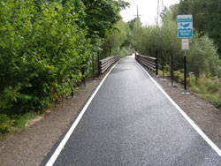
Major Projects: Springwater Corridor
Largest local camp cleanup on record
300-500 people affected
Two months of service coordination to identify the most vulnerable and help them relocate
Ongoing outreach support
Clackamas Service Center
Multi-agency Resource Fairs
  Shelter intakes
  Housing assessments
  Motel vouchers
  ID
  OHP outreach
  Mental health outreach
  Transportation assistance
Notes:
Two recent major projects that I thought would be of interest to this audience:
- At Springwater, our office partnered with police and outreach workers, trying to connect people to services
- Develop a clear message around low-impact camping that’s jointly messaged through social service and law enforcement outreach
- Respectful engagement with campers -- “we understand there’s not a place you can go, but we can connect you with places you can go eventually. We will not enforce camping ordinances if you’re keeping your area clean, in a small group, and you’re trying to engage in services.”
Springwater approach - most helpful were the Clackamas Service Center, TPI, Cascadia who were comfortable being on-site, actively coordinating on phone. Actually on-site, on the day the camp was going to be cleaned. Able to de-escalate and help people relocate and pack up. Outreach less oriented to permanent housing and more to impact mitigation. 500 people there. No one arrested, no lawsuits filed.
From a risk perspective, doing that coordination, taking time, relationship completely diffused the situation

Slide 27
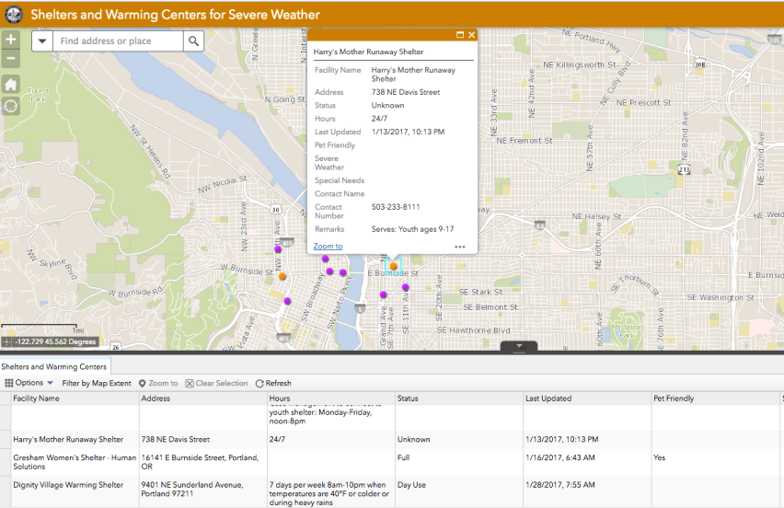
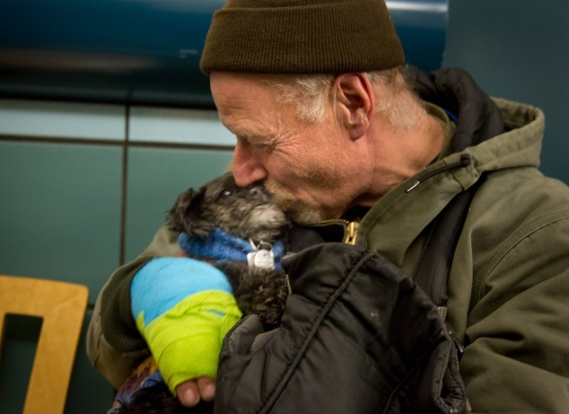
Major Projects: Severe WeatherResponse
Unprecedented # severe weather days: 30+ in Dec., Jan. and Feb.
500-765 additional people in warming center beds each night
Opened public buildings: Multnomah County East, Portland Building, and two Community Centers.
Mobilized unprecedented outreach and transportation support: Volunteers, PF&R, Parks, PPB, Sheriff
St. Henry Catholic Church, Gresham
St. Peter and Paul Episcopal Church
Bud Clark Commons, Portland
Hooper Detox Center
Imago Dei, Portland
Montavilla Warming Center
Union Gospel Mission, Portland
First Baptist, Gresham
St. Francis Catholic Church, Portland
Mt. Scott Community Center
University Park United Methodist Church
Charles Jordan Community Center
Anawim Christian Community, Gresham
Portland Building
American Legion Post 134, Portland
Clackamas Service Center
Multnomah County East
Bridges to Change

Slide 28

Thank you
A HOME FOR EVERYONE | JOINT OFFICE OF HOMELESS SERVICES
WWW.AHOMEFOREVERYONE.NET

