Slide 1

Your Message Is Your Life Ring
CIS Media Training
Bill LaMarche, Member Relations Manager

Slide 2



Who’s this guy?
Public Information Manager City of Beaverton - five years
Media Relations Manager Oregon Zoo/Metro - ten years
Public Relations Officer Oregon Coast Aquarium - three years

Slide 3

It’s a whole new media world
Taking pictures on smart phones means everyone’s a reporter
Posting on social media is immediate and takes it global
(if newsworthy)

Slide 4
Some day, media will call because…
Something bad happened
Somebody did something bad
Something bad could happen
Something bad happened that you’re ‘responsible’ for
Something bad is going to happen
Natural disaster/fire
Embezzlement, sex scandal
Natural disaster, budget layoffs, potential litigation
Death, injury
Raising costs, reducing services, layoffs/changes in personnel

Slide 5
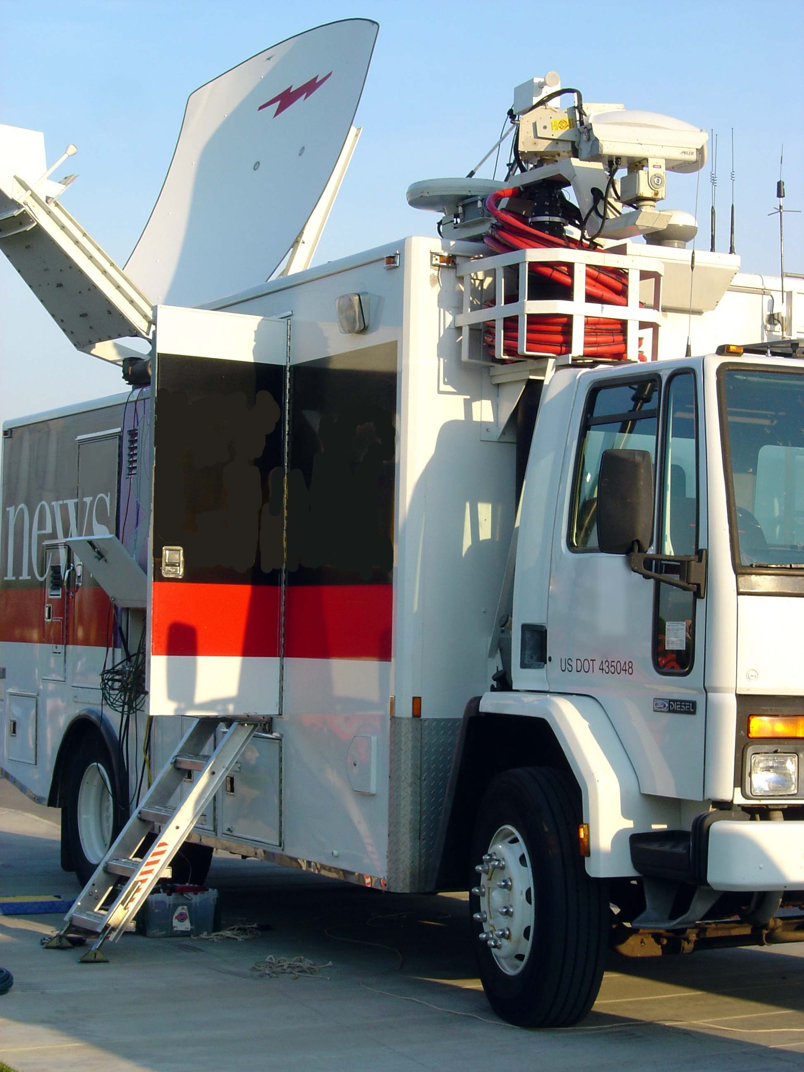

Today’s reporters
Most reporters aren’t out to get you; however some are!
Most reporters enjoy when their story goes national
All reporters want respect
All reporters want transparency
Some unprepared (or arrogant) sources will get “lambasted” by a reporter

Slide 6

Know your main messages
Think about what you want to say
Write down the 3-5 things that you want people to remember
Make messages about the audience (not about you)
Give yourself 15 minutes to think it through
Take time to practice key messages aloud

Slide 7
Importance of being first, fast and accurate
Go ahead and beat your critics to the punch
  Share what happened
  Highlight how you feel about it
  Share what you’re doing about it
Give guidance to media (another briefing at this time, updates are forthcoming, info placed on website/social media)
Use hashtags to correct inaccurate information

Slide 8

How to secure a fair story

Slide 9
Anticipate questions, including the hard ones
Focus on audience (not you)
Plan messages, keep it simple
Be respectful, open and gracious to reporters
Listen, then answer questions directly
State most important messages early and often
Convey compassion and empathy — be real
Keep it brief (if you don’t say it, they can’t print or air it)
Follow up with email/fact sheet after interview

Slide 10
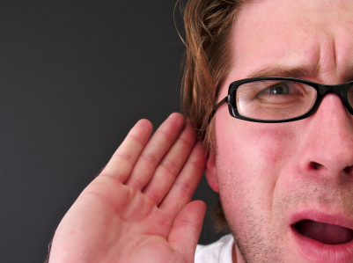
More sensitive topics
Issues related to:
  Personnel
  Legal
  Political
Run by legal counsel for approval
Determine whether you speak with media or not

Slide 11

What to do… and what not to…

Slide 12
Best practices for media success
Be concise…Give quotes without over sharing
Reiterate what’s in the public record
  “We know you’re interested in the recent tort claim, however, we do not comment on pending litigation. This will be resolved in the courtroom — and until there’s a public resolution, this statement will stand on its own.”
Be prompt, compassionate and ready to speak
Own mistakes; be contrite

Slide 13
More dos
Listen to reporters
Tell the truth and stick to your key messages
Use straight talk
Be specific and stay within your expertise
Be accurate first, then timely
Be the source… don’t let someone else tell your story

Slide 14
Absolute worst things to do to reporter
Lie (never ever lie; the truth always comes out)
Stonewall (it leads to anger, animosity and mistrust)
Speak in jargon (remember your audience)
Fail to be gracious and professional (everyone has a job to do)
Fail to respect a reporter’s time or deadline

Slide 15
Some common mistakes
AVOID
“No Comment” or speaking “off the record”
Speculating
Repeating a reporter’s negative language
Asking to preview story
Letting a major factual error go uncorrected (web stories can be updated)

Slide 16

The power of social media
Disseminates information widely
Relieves media queries (via phone)
Demonstrates thoughtful and interactive leadership
Humanizes the organization
Provides company’s point of view
Creates an outlet for advocacy
(if appropriate)

Slide 17
A crisis is upon you; what do you do?
Know what you want to say (your brief key points)
Be real, be genuine
Have approved written statement
Hold media conference as soon as possible
Email and post news release or statement
Follow up calls to most important media outlets (local first)
Share updates on Facebook/Twitter

Slide 18

Questions?
Your message is your life ring, swim towards it.

Slide 19
CIS… supporting members since 1981
We help members navigate treacherous waters
We provide crisis communications counsel to CIS members
We’re here to lend a hand
Bill LaMarche
Member Relations Manager
CIS
503-763-3824
blamarche@cisoregon.org
www.cisoregon.org

