Slide 1
EV’s and Fleet- Spring PRIMA 2023
Donny Leader, Public Works Department Fleet Manager
April 14, 2023

Slide 2
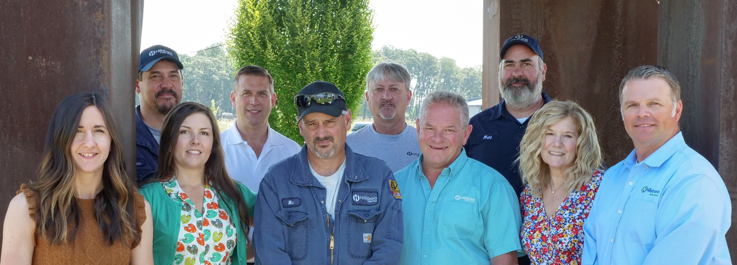
Fleet Division Overview
Fleet is part of the Facilities and Fleet Division within the Public Works Department and is responsible for:
Managing and servicing all city vehicles and equipment
Emphasis on large specialized equipment and the Fire Department apparatus
Purchase and dispose of fleet vehicles

Slide 3
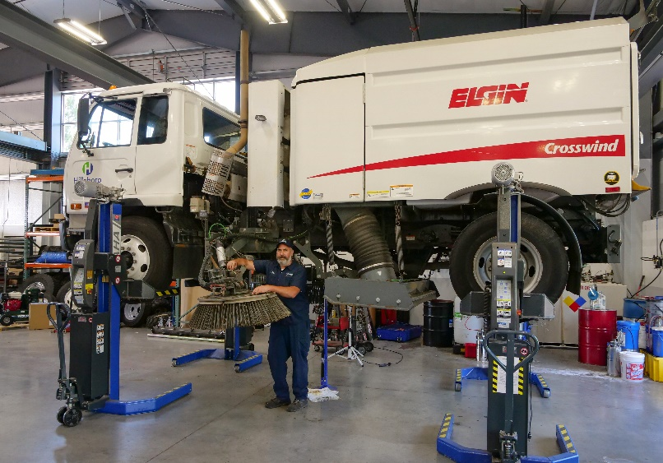
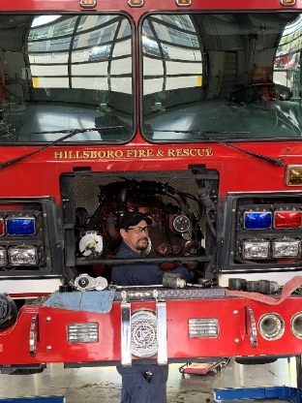
Fleet Division Overview
Six technicians along with three program and support staff with over 220 years of combined fleet experience with EVT, ASE, APWA, and NAFA certifications.
Over 603 active vehicles and equipment valued over $37 million.
Capital acquisition budget for fiscal year 2022-23 is about $7.1 million.
Operating budget for fiscal year 2022-23 is $2.1 million.
Notes:
Hillsboro has added 48 vehicles in the last 3 FY’s, 19-20 to 22-23.

Slide 4
Fleet Composition
Notes:
EV Vehicles currently at 11, up from 3 in FY19-20. 20 new and replacement EV this FY and next. Ramping up quickly so the conversation turns to Infrastructure.

Slide 5
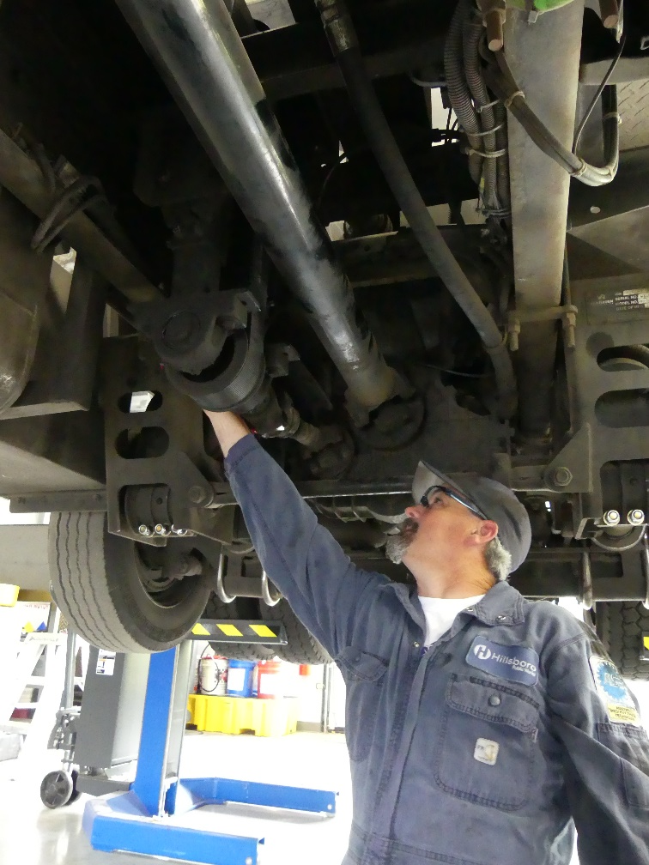
Fleet Policy and Guidelines
Policy Statement: The Fleet policy document outlines the methodologies, policies, and framework with which the City of Hillsboro Fleet Management provides oversight and makes recommendations in all areas of fleet.
Policy Scope: The fleet policy applies to city owned, rentals, leases, donations, loans, seized, demonstrator vehicles, and equipment and all employees, temporary workers, volunteers, or others operating city vehicles and equipment for City business purposes.

Slide 6
Fleet Policy and Guidelines
Guidance toward our sustainability goals are described in order to reduce environmental impacts from City operations.
Fleet Policy Topics
Care and treatment of vehicles and equipment
Safety
Logos
Appearance
Vehicle numbering
Vehicle idling
Operational standards and conduct
Take home vehicles
Maintenance and repair
Replacement criteria and lifecycles
Vehicle disposition

Slide 7
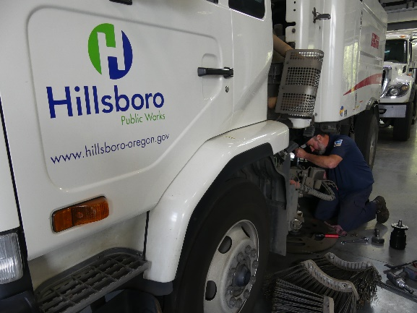
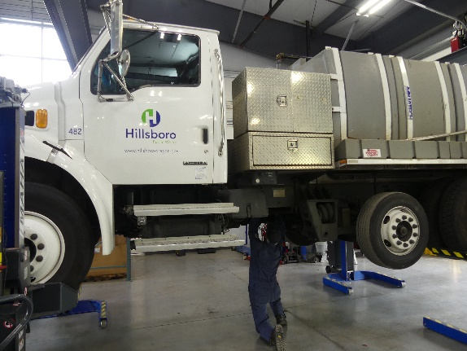
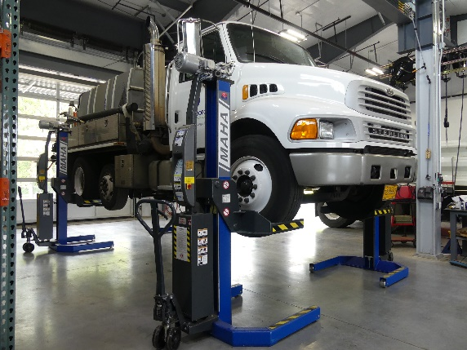
Fleet Action Plan
Improve City Vehicle Performances by:
Keeping current on preventative maintenance
Implementing telematics (GPS) in every unit
Purchasing electric, plug-in hybrid, and hybrid vehicles when it meets operational needs
Reducing fleet average age
Reducing unnecessary idling
Using synthetic oils to reduce fuel usage
Increasing the use of renewable diesel, biodiesel, ethanol, and other non-fossil based petroleum fuels
Notes:
AVERAGE AGE 8.26

Slide 8
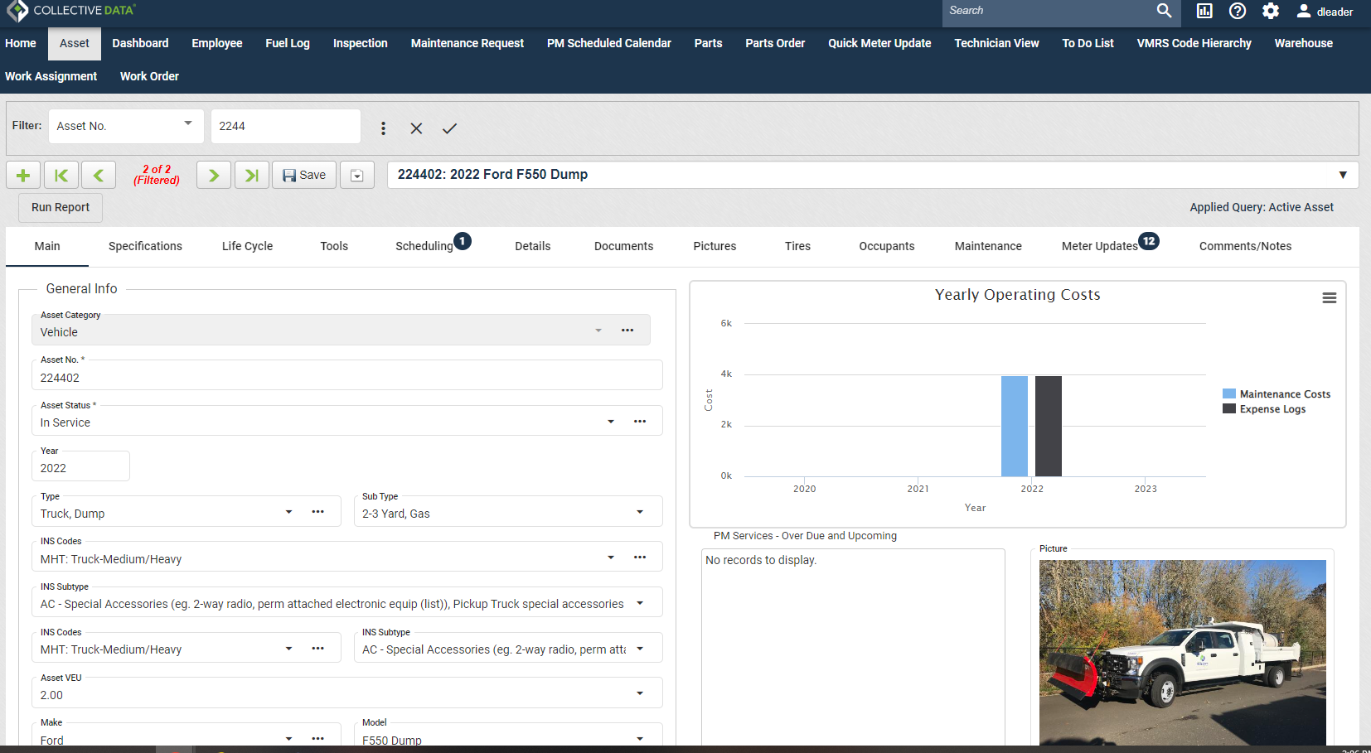
Asset Management Software

Slide 9
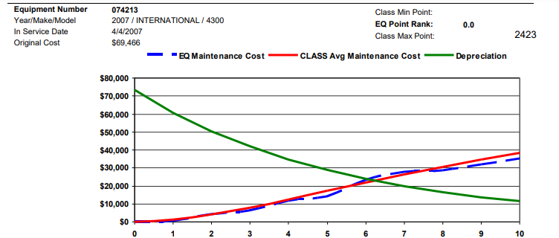
Economic Lifecycle

Slide 10
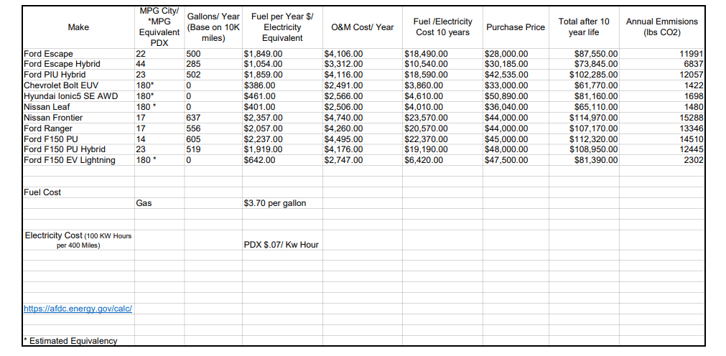
Lifecycle- GAS/ EV/ HYBRID

Slide 11

Sustainability Goals
By 2030 achieve 100% fossil fuel free staff vehicles and 40% reduction for other exempt vehicles such as non-passenger emergency response, etc.
City of Hillsboro worked in collaboration with regional partners to increase access to renewable fuel and bio diesel at the local fuel stations for fleet vehicle use as a means to reduce carbon emissions.
Notes:
Sustainable Goals are also written into a Fleet Policy, which includes “electric first” purchasing where applicable.

Slide 12
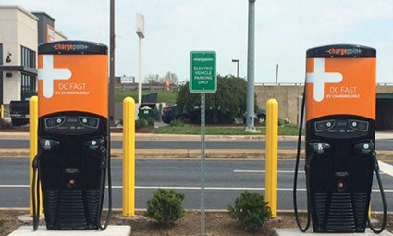
EV Infrastructure
70 Public Charging Ports, includes 1 DCFC.
12 Fleet Only Chargers
EV Infrastructure Steering Committee
  Finance
  Facilities
  Operations
  Sustainability
Employee Charging Policy
  Group.
PGE Partner Program
Notes:
12 EV Chargers, includes two at our Civic Center for Motor Pool Cars. Future Plans for a new Police Department will include an electric vehicle charging infrastructure for EV cars located on site.

Slide 13
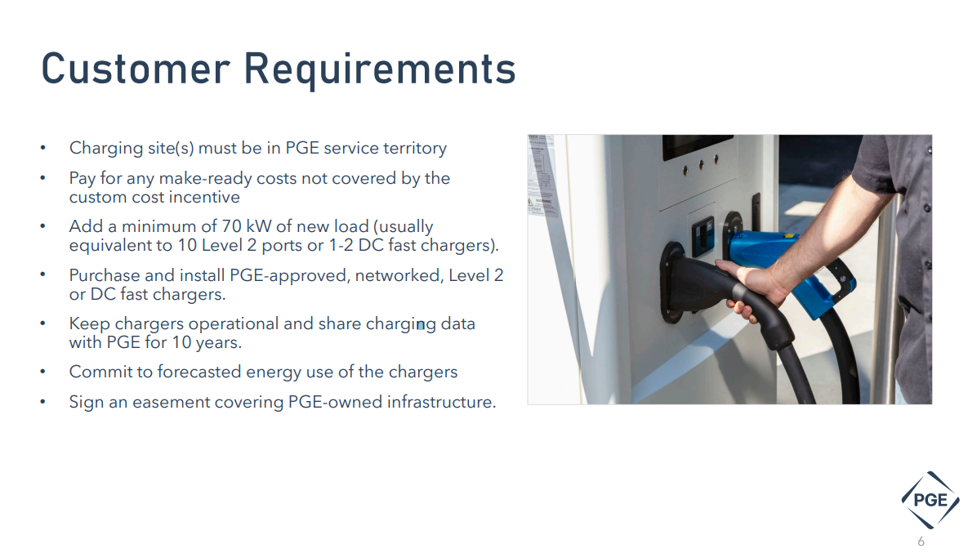
PGE Fleet Partner

Slide 14




Fleet Acknowledgements
2022 100 Best Fleet Award: The Government Fleet Magazine and NAFA recognized the City of Hillsboro in April 2022 in the top 100 best fleets in North America. City of Hillsboro Fleet ranked 58 of 38,000 public fleet facilities.
2021 Green Fleet Award: City of Hillsboro Fleet was recognized in September 2021 in the top 50 green fleets.
Automotive Service Excellence - Blue Seal of Excellence: Recruiting the best employees, supporting their training, and insisting on the best equipment.
EcoBiz Certified Shop: Environmental certification for adopting best practices and preventing pollution.

Slide 15
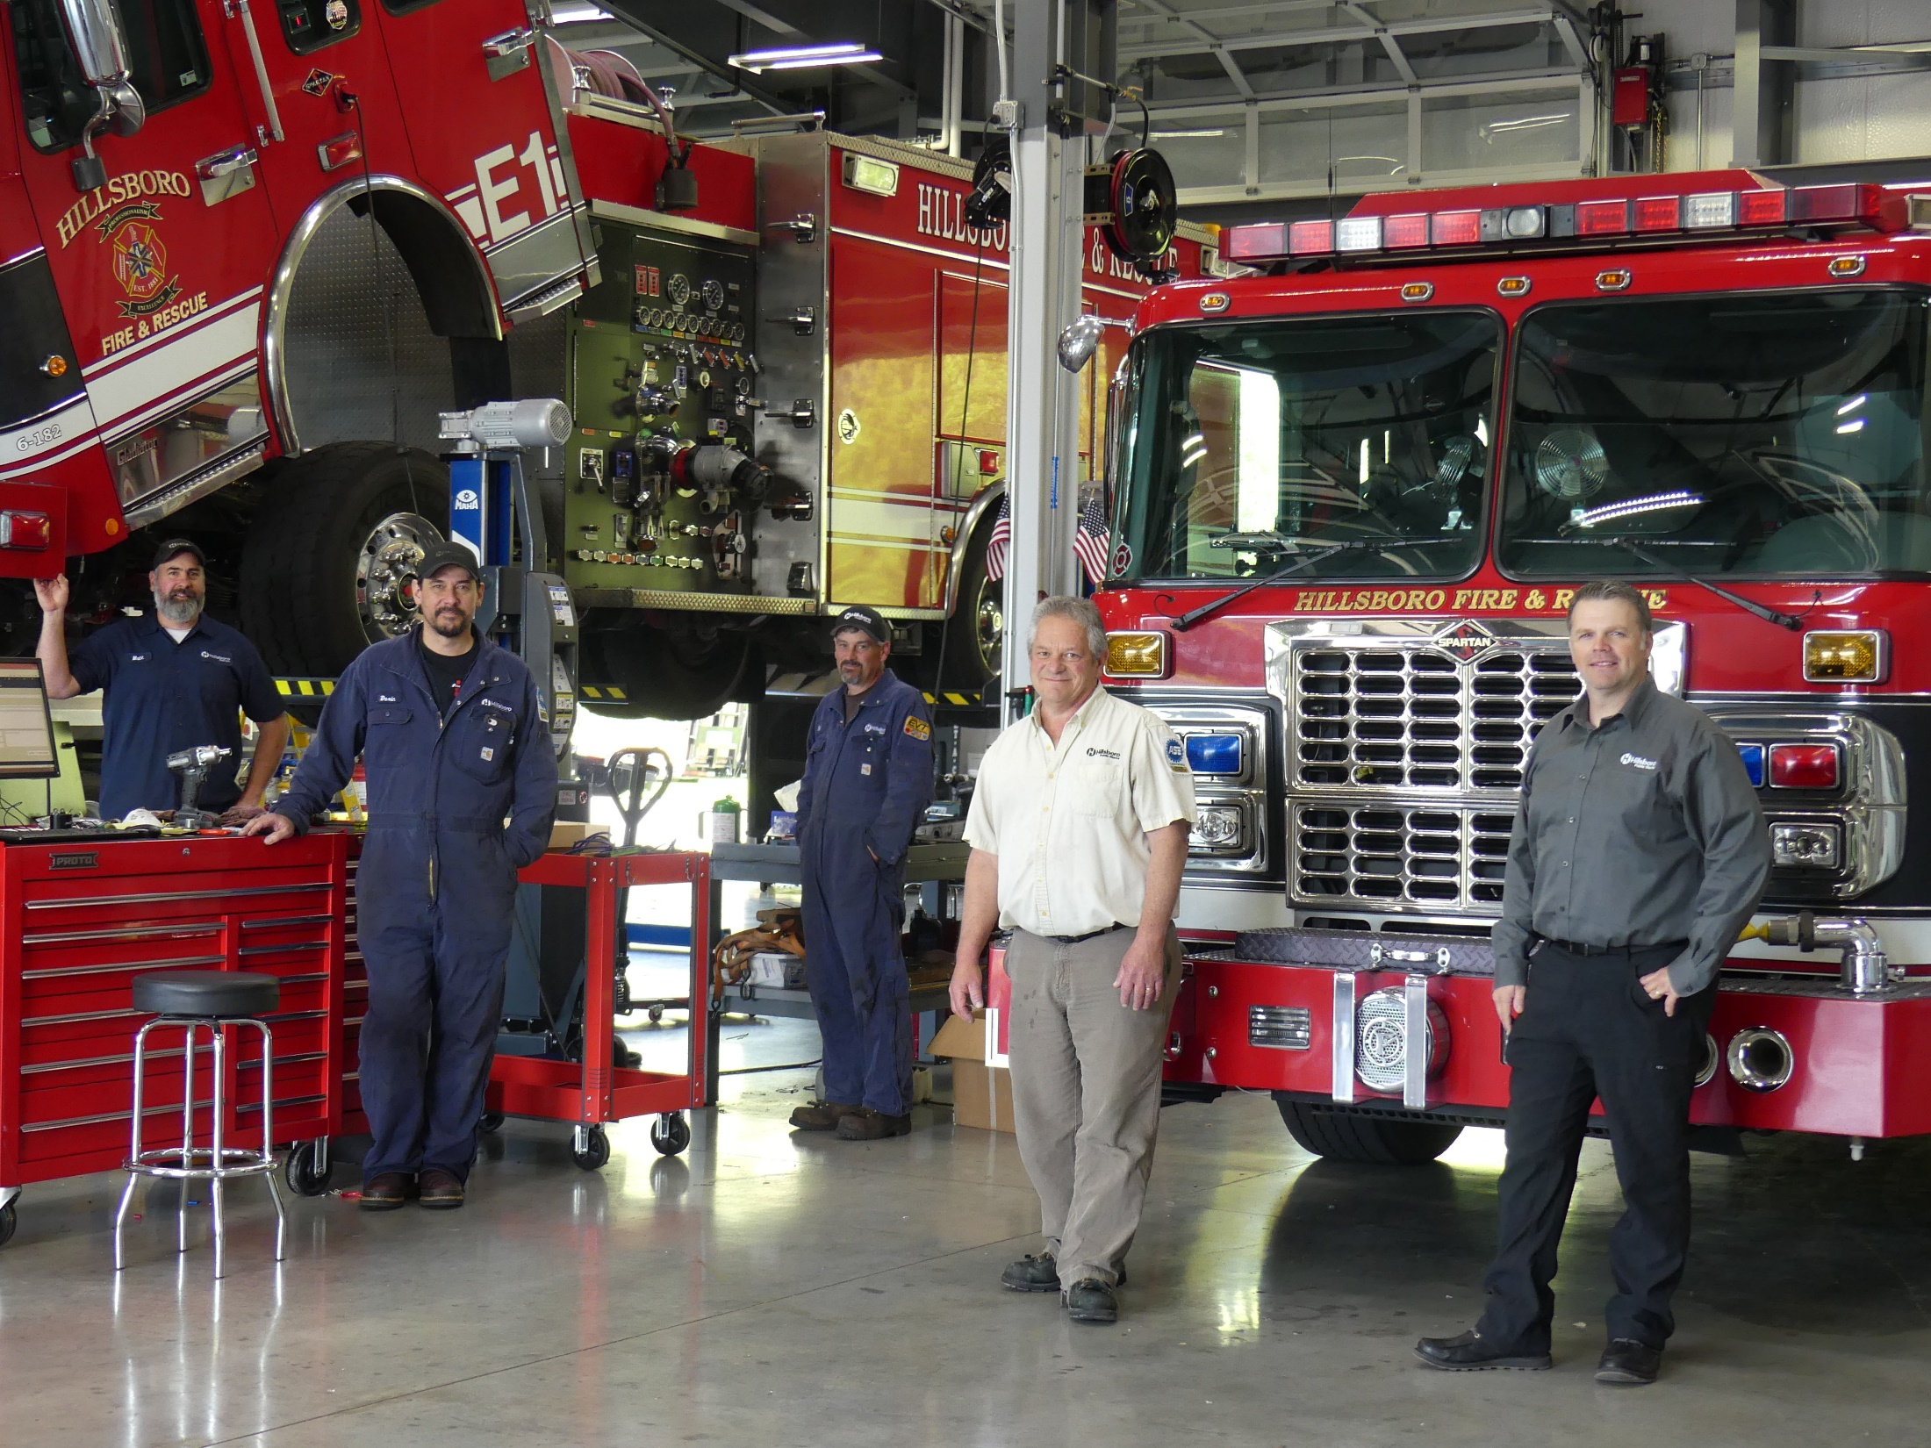
Thank you and Questions
donny.leader@hillsboro-oregon.gov

