Slide 1
Preparedness, Hazards, Recovery, & You
April 14, 2023 www.Oregon.gov/oem

Slide 2
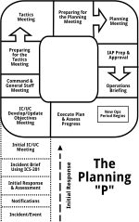






Emergency Management

Slide 3

This is What We Do

Slide 4
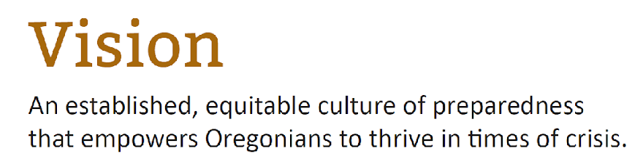
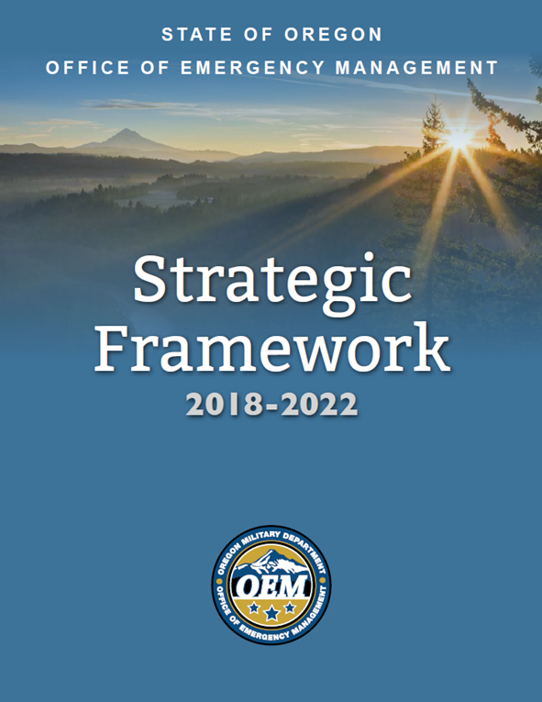
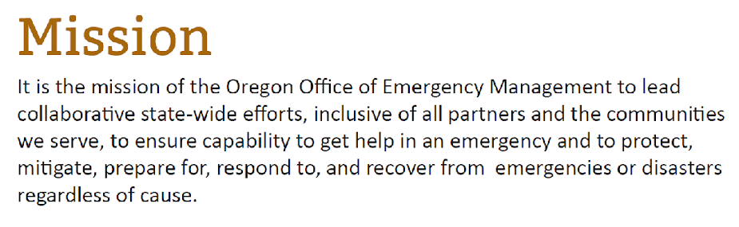
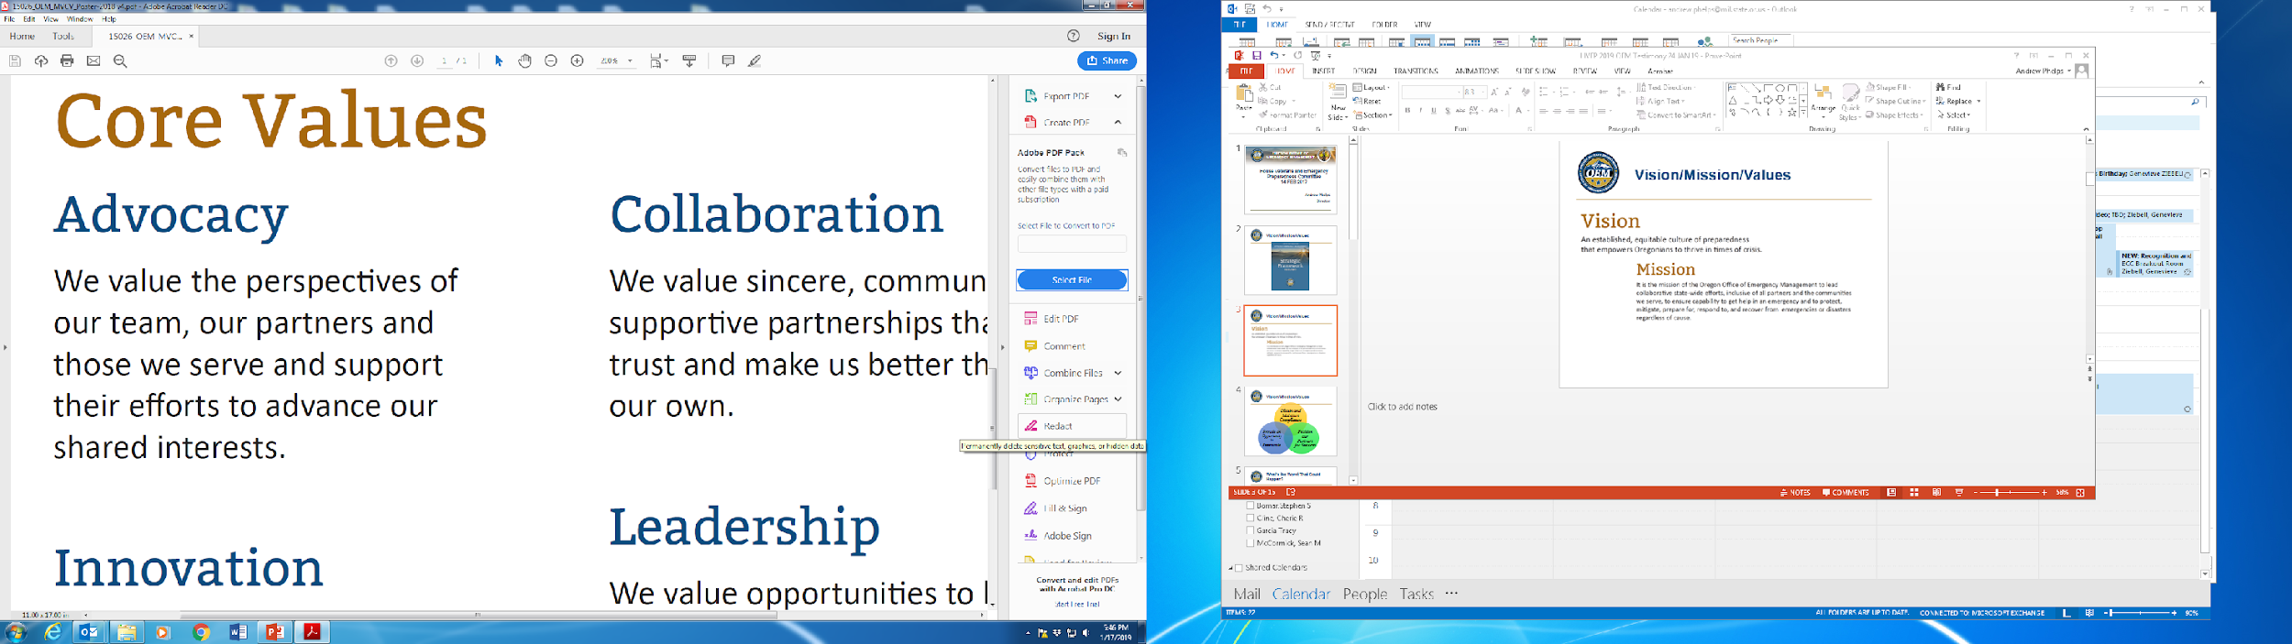
Vision/Mission/Values
Notes:
Goal Areas
ECC Readiness
Sound Fiscal Practices
Build and Sustain Relationships
Staff Development
Program and Process Documentation
Lenses
Obtain and Maintain Compliance
Foster opportunities to Innovate
Position Partners for Success

Slide 5
Laws and Admin Rules
Oregon Revised Statutes (ORS)
  401
    State and all counties must
      Official
      Emergency Management Plan
      Operations Center
    Cities and Tribes May
  402 State Mutual Aid
  403 Communications
  404 Search and Rescue
Oregon Administrative Rules (OAR)
  104
    Program rules and implementation guidance

Slide 6
State Emergency Management Structure
Governor
Governor’s Disaster Cabinet
Economic Recovery Council
OEM Director
OEM Preparedness & Response Division
OEM Mitigation & Recovery Division
Federal Emergency Management
State Emergency Coordination Center
State Recovery
County/Tribal Emergency Management
Local Cities and Communities

Slide 7
HAZARDS

Slide 8
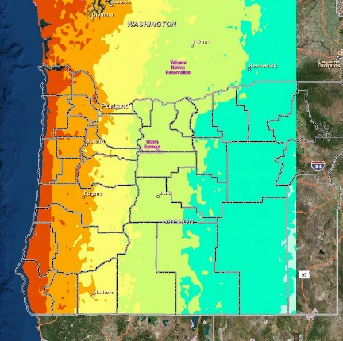
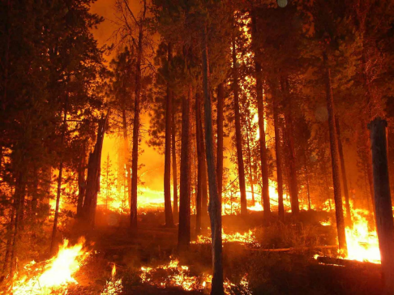
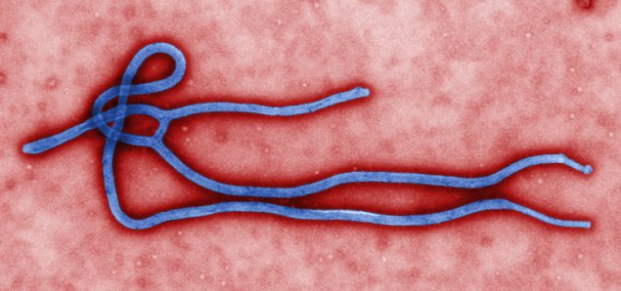
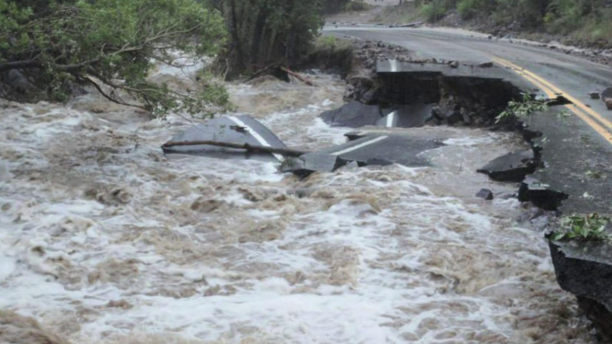
What’s the Worst That Could Happen?
Naturally Occurring Hazards
Flood
Wildfire
Earthquake
Tsunami
Severe Weather
Drought
Tornado
Winter Storm
Pandemic
Solar Storm
Volcanoes

Slide 9
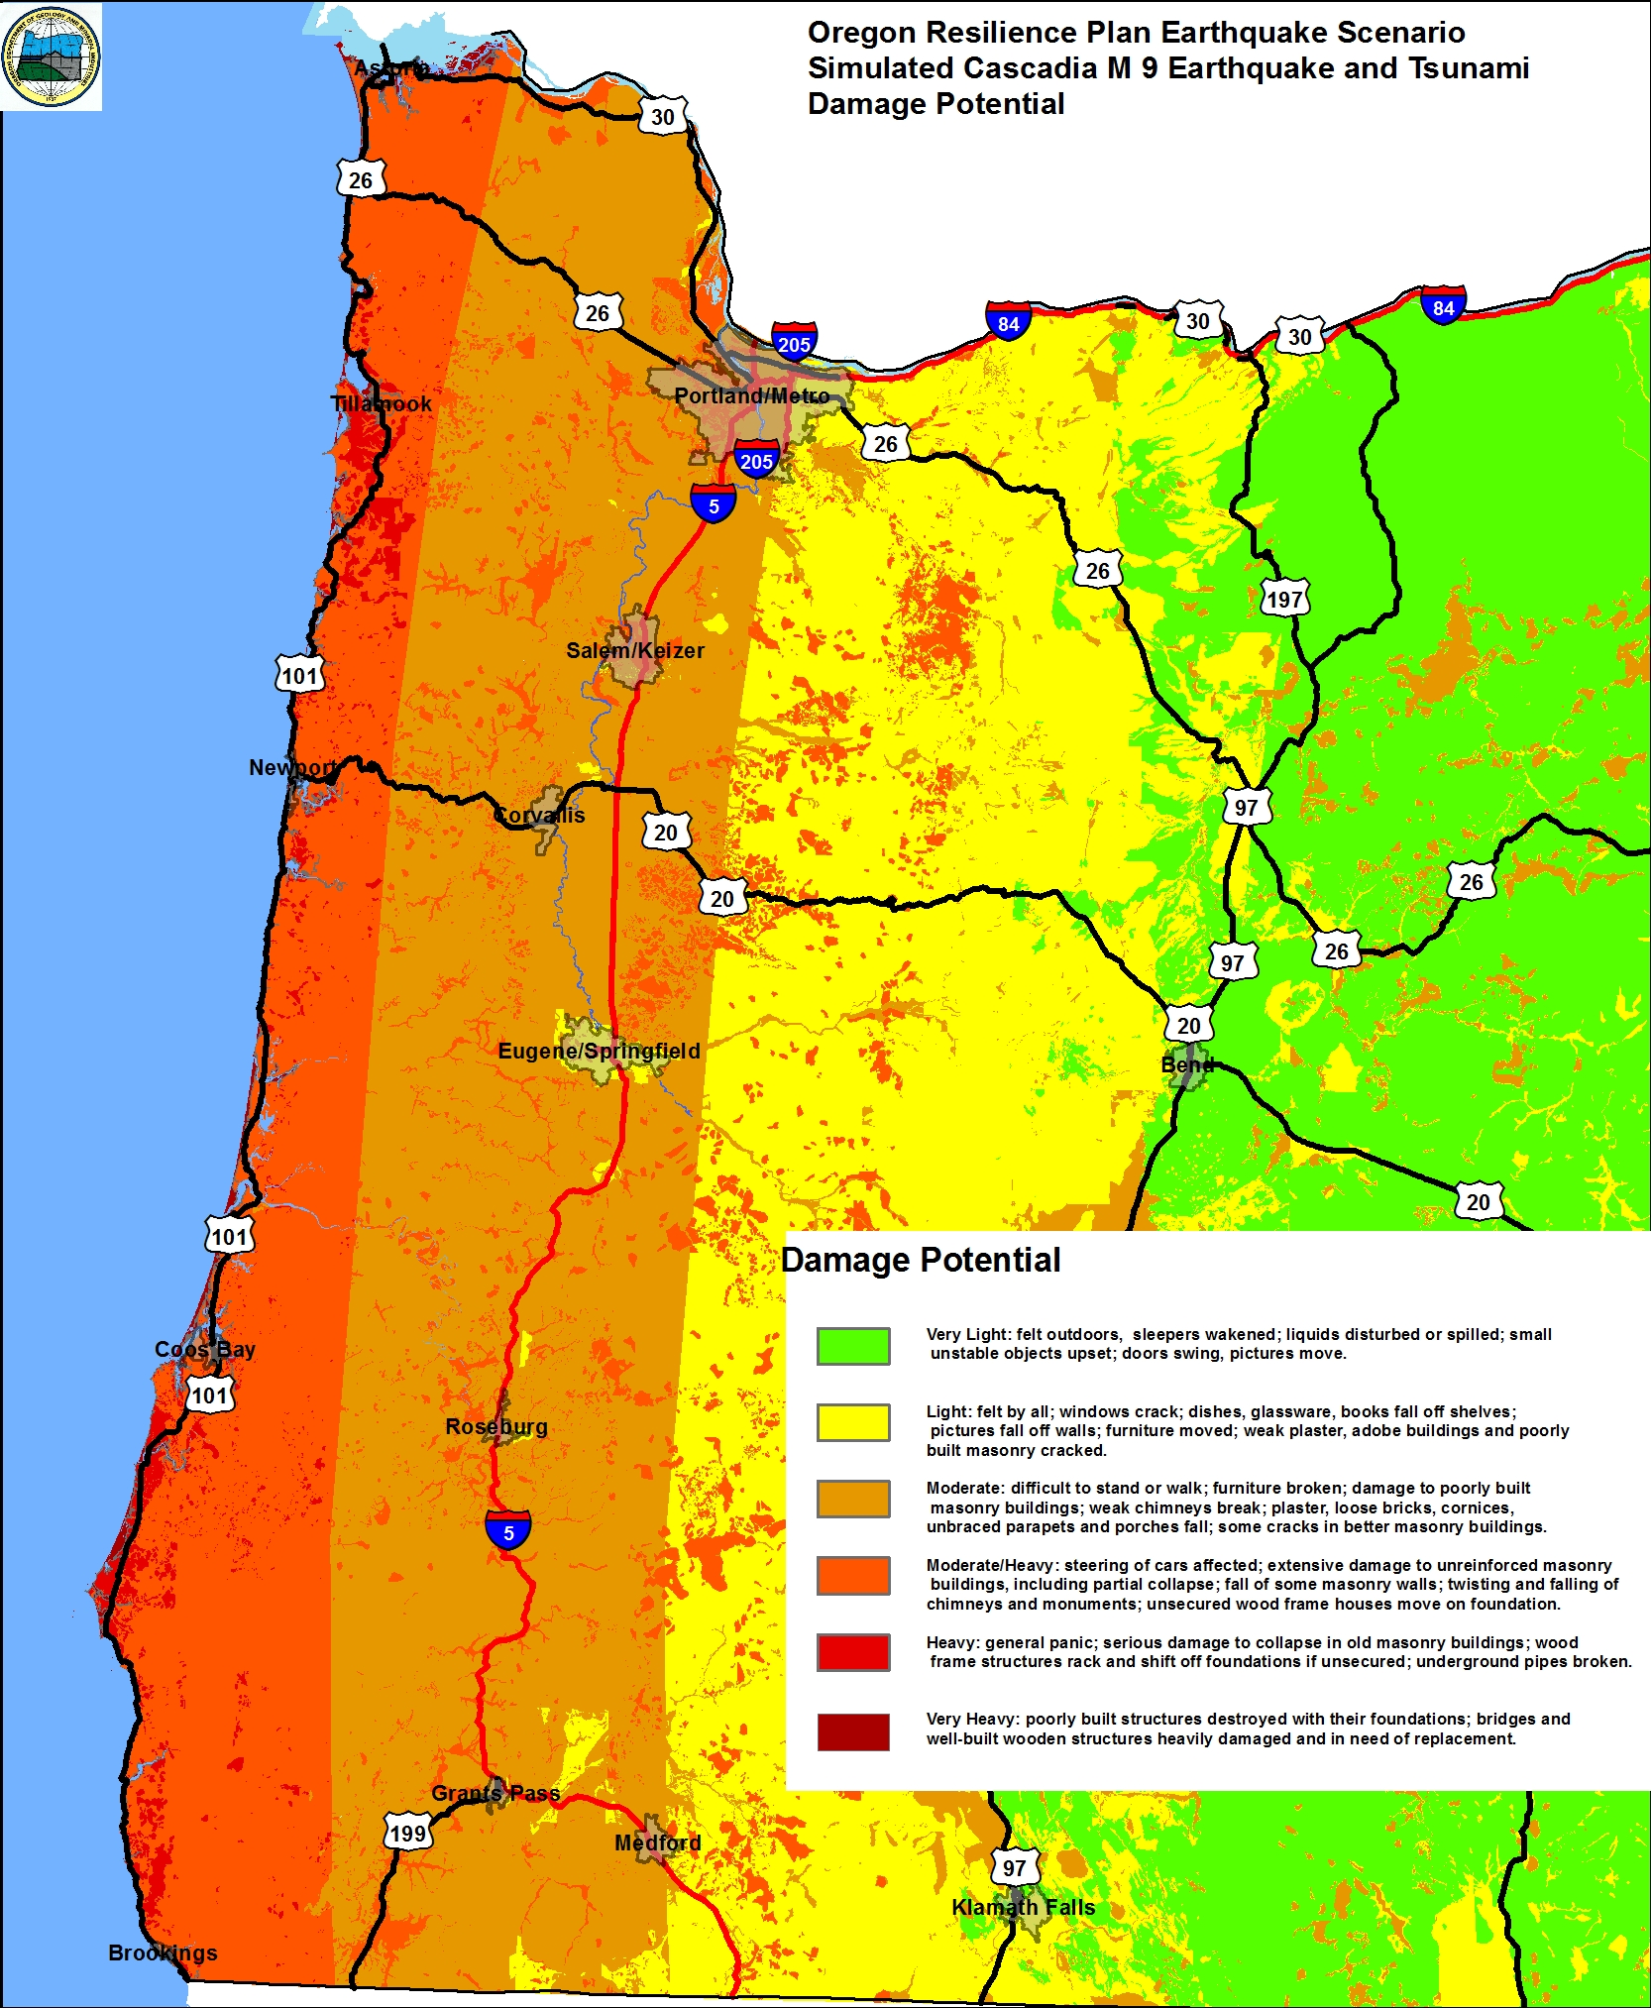
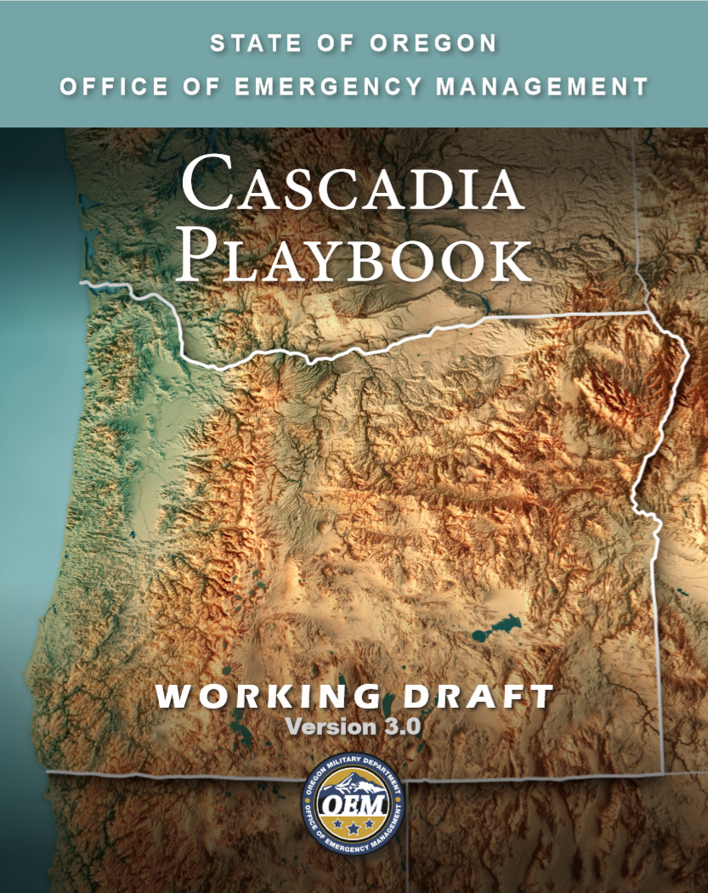
Cascadia
600-mile fault line
Capable of M9.0 event
Aftershocks/100+ tsunami
2016/2022 Cascadia Rising Exercise
  National Level Exercise (NLE)
  Federal, State, Tribal, County, and local
Playbook Project Status
Earthquake Early Warning
Community Outreach
DOGAMI Urban Area Report

Slide 10


Slide 11
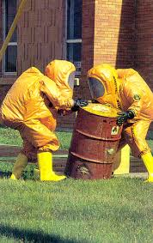


What’s the Worst That Could Happen?
Human-Caused Hazards
Cyber Incident
Hazardous Materials Release
Urban Conflagration
Active Shooter/Mass Casualty
Dam Failure
Nuclear Power Plant Incident
Civil Disturbance
Act of Terrorism
Transportation Incident
Homelessness
Notes:
KJ

Slide 12

See Something Say Something
https://www.oregon.gov/oem/hazardsprep/Pages/See-Something-Say-Something.aspx

Slide 13


Slide 14
State Response

Slide 15

State Prioritization
Resource Request Prioritization
Checks and Balances
Life Safety
Protection of Property
Protection of Environment
Declaration of Emergency
  Local
  County
  State
Request from County Government
Local Resources have been fully engaged
  Mutual Aid

Slide 16
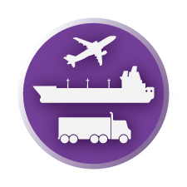

















Emergency Support Functions (ESFs)
ESF 1
Transportation
ESF 2
Communications
ESF 3
Public Works
ESF 4
Firefighting
ESF 5
Information and Planning
ESF 6
Mass Care
ESF 7
Resource
Support
ESF 8
Health and Medical
ESF 9
Search and
Rescue
ESF 10
Hazardous
Materials
ESF 11
Agriculture, Animals, and Natural Resources
ESF 12
Energy
ESF 13
Law Enforcement
ESF 14
Business and Industry
ESF 15
Public
Information
ESF 16
Volunteers and Donations
ESF 17
Cyber and Critical
Infrastructure Security
ESF 18
Military
Support

Slide 17
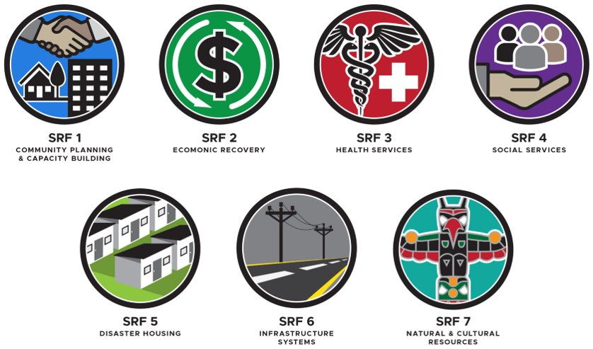
State Recovery Functions (SRFs)
Notes:
Cover in detail each State Recovery Function and how they align.
I’ll say up front that recovery operations are significantly different than response operations. Response operations are a sprint to neutralize the threat – whether it be a flood, fire, snowstorm, earthquake or tornado. Its acutely focused on saving lives and property. Disaster Recovery is about stabilizing and rebuilding communities that have been impacted. This work is a marathon that often has no deadline. For example – some of you may remember the Vernonia Floods in 2007 – ODEM closed the books on that disaster that covered one county in 2019. it was 12 years worth of work. I anticipate that we will not be closing the books on the catastrophic fires of 2020 until sometime around 2050 to 2055 and every time I say that it seems like those aren’t even real years! 2055
We cannot provide effective recovery assistance to impacted communities without a multiagency collaborative. Our partner agencies are critical to Oregon’s success. The following is the framework of our SRF lead agencies.
SRF 1 = Department of Land Conservation and Development
SRF 2 = Business Oregon
SRF 3 = Oregon Health Authority
SRF 4 = Oregon Department of Human Services
SRF 5 = Oregon Housing and Community Services
SRF 6 = Department of Administrative Services, Oregon Department of Energy, Oregon Department of Transportation and the Public Utilities Commission
SRF 7 = Department of Environmental Quality
Couple important points here
Each SRF has several supporting agencies identified. There is an old saying that it takes a village to raise a child. In emergency management it takes multiple state and federal agencies and organizations to rebuild communities.
We also adapt SRF leads and support agencies based on the circumstances of each disaster. For example as OEM assembled the recovery team for the 2020 wildfires it became apparent that SRF 7 needed a joint operation and the Oregon Watershed Enhancement Board and the Oregon Department of Forestry joined with the Department of Environmental Quality in a unified command
We also, based on the circumstances of each disaster recovery operation, we may need to set up task forces – these operate independently and are loosely tied to a SRF. For the 2020 wildfires we developed a Debris Management Task force lead by ODOT, DEQ and OEM, a Housing Task Force to update the Oregon Disaster Housing Plan and the Potable Water Task Force
Finally for Presidentially Declared disasters we pull all federal assets into this structure and function as the Interagency Strategic Recovery Team (ISRT) This concept aligns with FEMA’s Interagency Recovery Coordination (IRC)

Slide 18
Declaration Process
Disaster Occurs
Local Response Activities and Mutual Aid
County Disaster Declaration
County Requests Assistance
ECC Coordinates Assistance
Governor Declares State of Emergency
Initial Damage Assessment (IDA)/Preliminary Damage Assessment (PDA)
Request Federal Assistance
Federal Disaster Declared

Slide 19
Ladder of Assistance
Federal
  Provides assistance when State resources are exhausted.
State
  Provides assistance when county resources are exhausted.
County
  Provides assistance when local resources are exhausted.
Local
  Provide direct “First Responder” response and incident management.
    Incident response is always a local responsibility
Incident
Notes:
The ladder of assistance provides the simple structure needed to ensure the most immediate, effective, and efficient resource is made available for any situation.
Local
County
State
Federal
Equipment
Personnel
Services
Programs

Slide 20
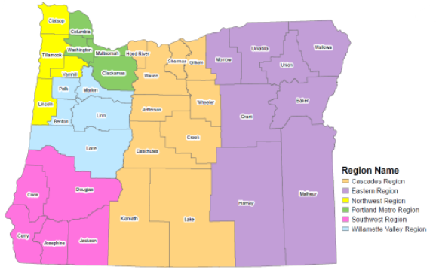
Regional Coordination Program
Mitigation and Recovery & Response and Preparedness:
  Staffed by six coordinators and two managers for each division
Direct liaisons for 36 counties and 9 tribes
  Program succusses:
    Incident response and EOC support
    Engagement in mitigation plans and funding opportunities
    Support for all hazard recovery efforts
    Training and exercise
7

Slide 21
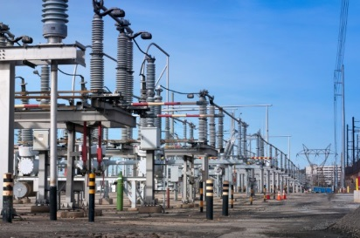
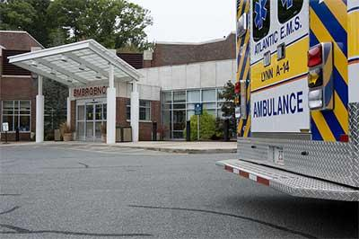
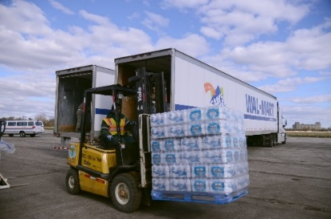
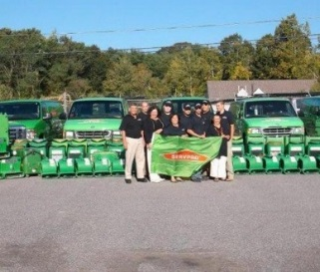
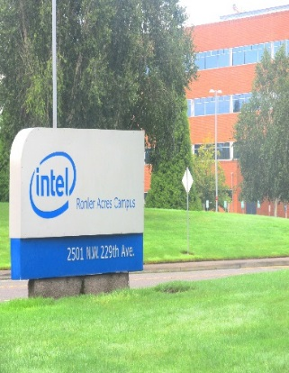
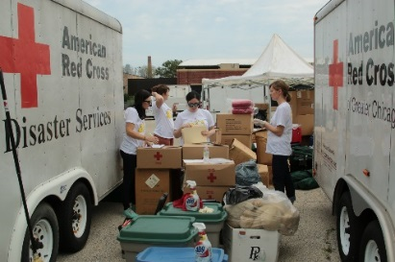
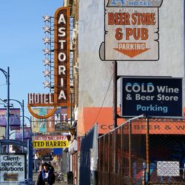

Private Sector Program
Build / sustain collaborative partnerships
Private sector integration
  Ability to absorb and adapt
  Business Continuity
Helping communities and economies during recovery
  ESF 14: Connecting business and industry with emergency management
Critical
Infrastructure
Health Care
Suppliers
Contractors
Energy / Water
Communications
Hospitals
EMS
Food & Water
Shippers Manufacturers
Engineers
Debris Removal
Large Employers
Non Profit
Private Businesses
Media Partners
Intel
Nike
VOADs
Red Cross / Faith Based
Restaurants / Retail Hospitality
Broadcast Infrastructure
Print / Radio

Slide 22
Keys to Preparedness Success

Slide 23
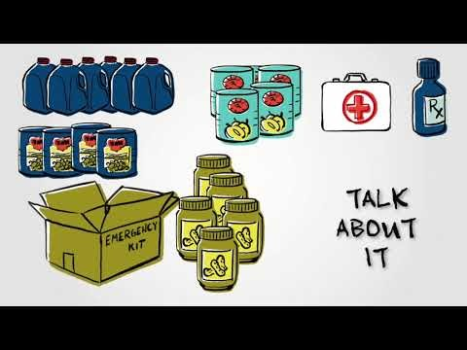


Being Prepared
Organizationally Prepared
Organization Continuity of Operations Planning
  Succession Planning
  Critical tasks
  Data and resource resiliency
Response Plans
  Operations
  Procedures
  Checklists
Employee Personally Prepared
At Least 2 Weeks Ready
  Food
  Water
  Medications
  RE-unification Plans
  Rout from work or home to Kids and Loved ones
  Out of area contact

Slide 24



2 Weeks Ready
2 Weeks Ready
  Year long outreach program
  Facebook.com/2WeeksReady
https://www.oregon.gov/oem/hazardsprep/Pages/2-Weeks-Ready.aspx

Slide 25
Individual & Family Preparedness Resources
Build a Plan: https://www.ready.gov/family-plan
How to Build a Kit: https://www.redcross.org/get-help/how-to-prepare-for-emergencies/survival-kit-supplies.html
Preparedness Publications: https://www.oregon.gov/OEM/hazardsprep/Pages/Preparedness-Publications.aspx
Current Situation:
  Real-time Assessment and Planning Tool for Oregon (RAPTOR)
  https://www.oregon.gov/oem/emops/Pages/RAPTOR.aspx

Slide 26

Education and Outreach
Publications
  Without Warning comic books
  Living on Shaky Ground
  Go-Kit Passport
  Tsunami Brochure

Slide 27
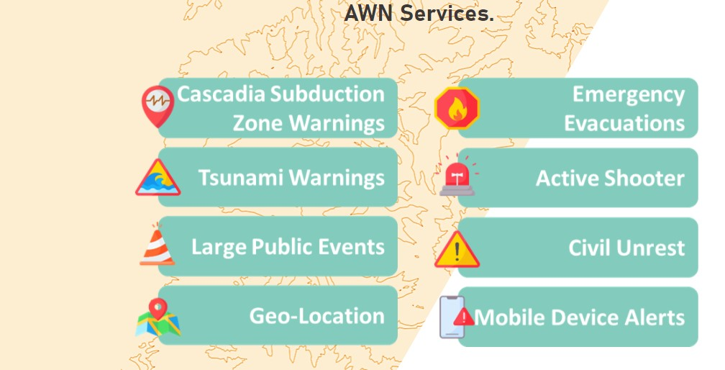
OR-Alert
https://oralert.gov/
  Statewide Alert and Warning Information
    Emergency Alert System (EAS)
    Internet Public Alert and Warnings System (IPAWS)
    Wireless Emergency Alerts (WEA)
      AMBER Alerts
      Evacuation Orders
      Other
  Community Based
  Alerts: Local County
  Emergency Management

Slide 28
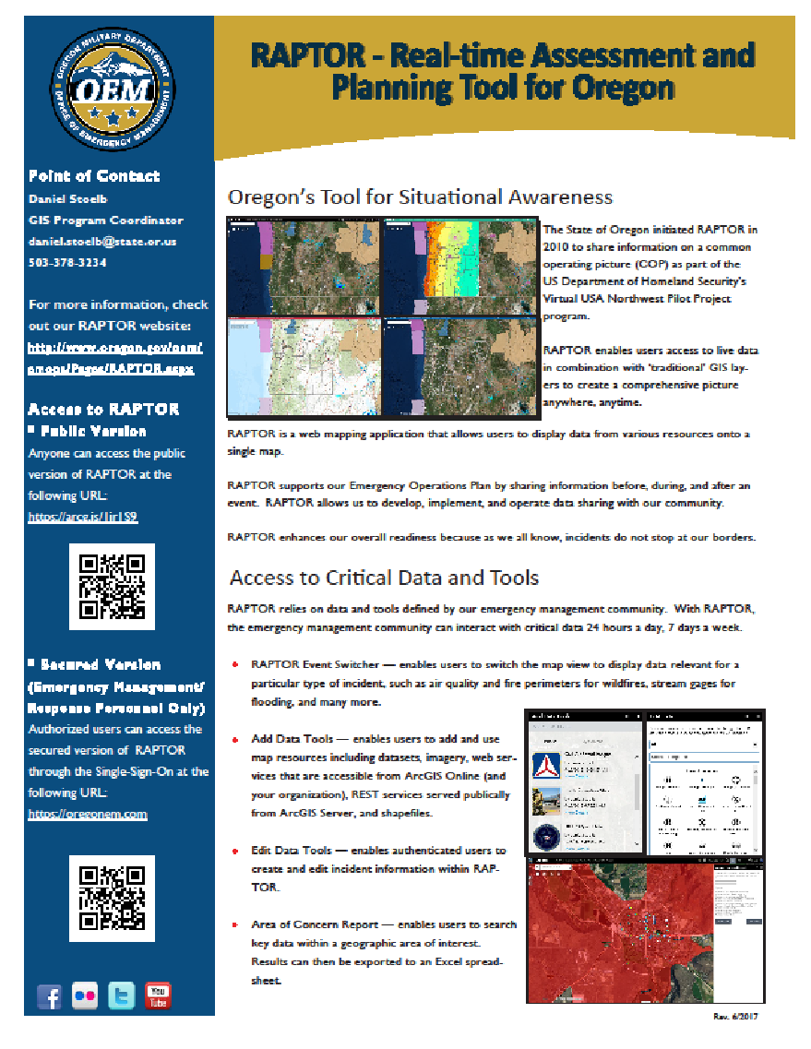

Slide 29
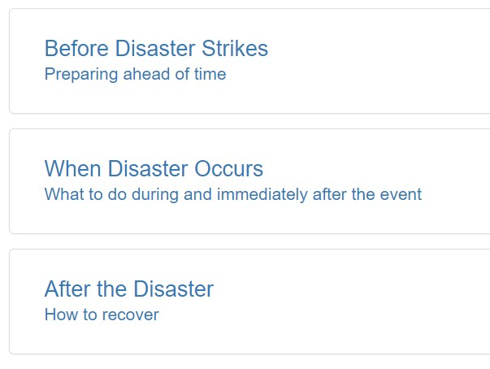
Business Preparedness Tools
Business Preparedness
https://www.oregon.gov/oem/hazardsprep/Pages/Business-Preparedness.aspx

Slide 30
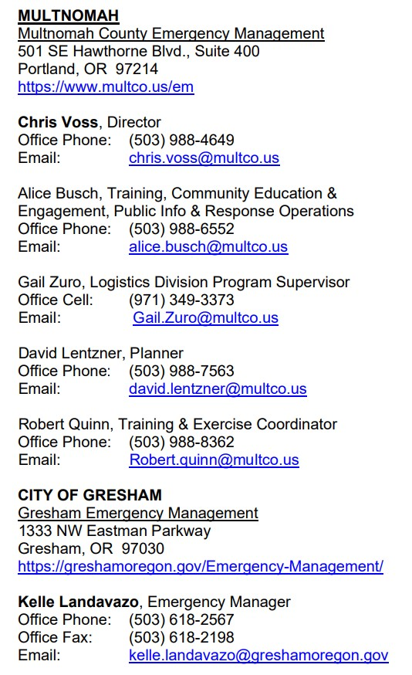
Community Emergency Management Contacts
County, Tribal, and City Emergency Management Contacts
https://www.oregon.gov/oem/Documents/locals_list.pdf

Slide 31


Oregon Shake Out
Shake Out: https://www.shakeout.org/oregon/resources/

Slide 32
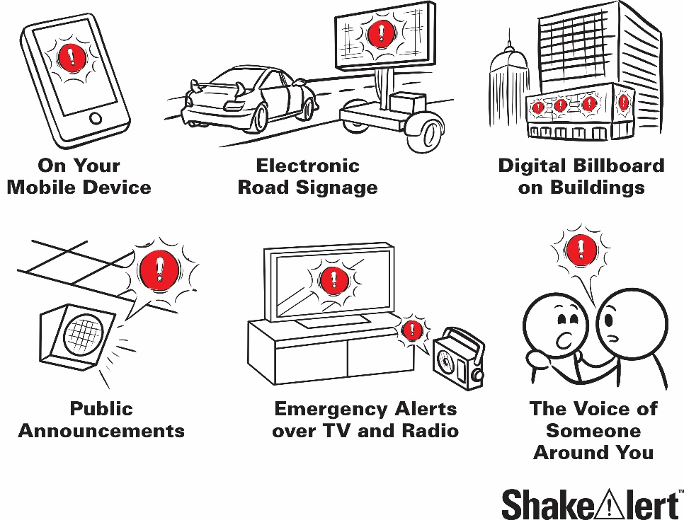
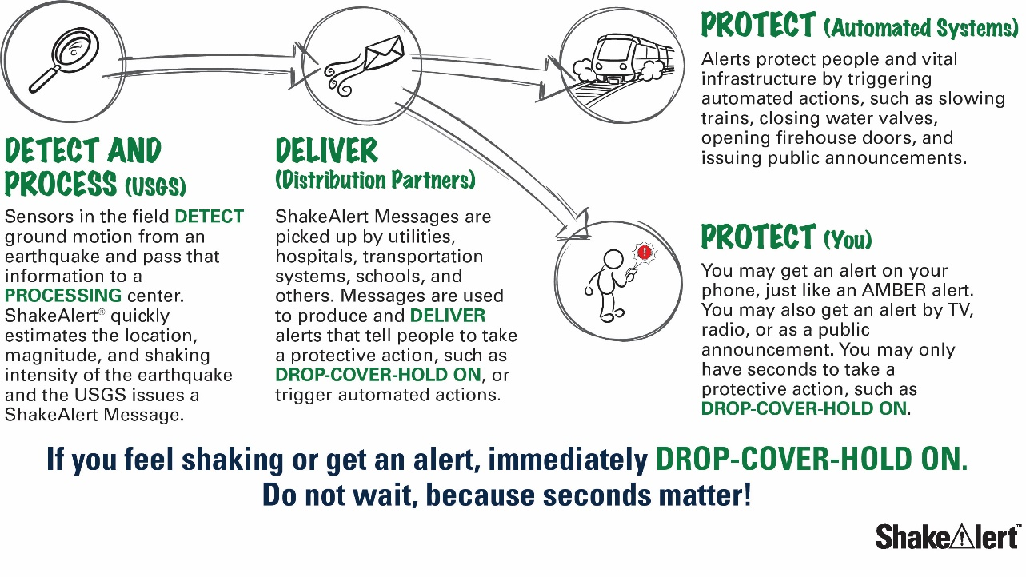
Shake Alert
Shake Alert: https://www.shakealert.org/
  USGS Shake Alert Site: https://www.usgs.gov/news/entire-us-west-coast-now-has-access-shakealert-earthquake-early-warning?qt-news_science_products=4#qt-news_science_products
  Shake Alert App: https://earlywarninglabs.com/mobile-app/

Slide 33
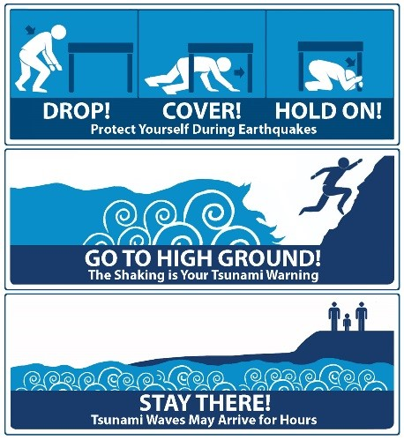
Tsunami Preparedness
https://www.oregon.gov/OEM/hazardsprep/Pages/Tsunami.aspx

Slide 34


Slide 35
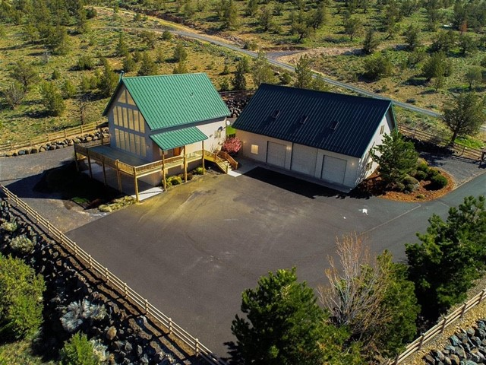
Defensible Space

Slide 36
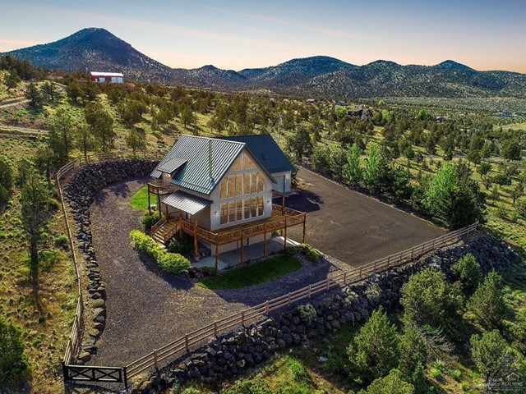
Defensible Space

Slide 37
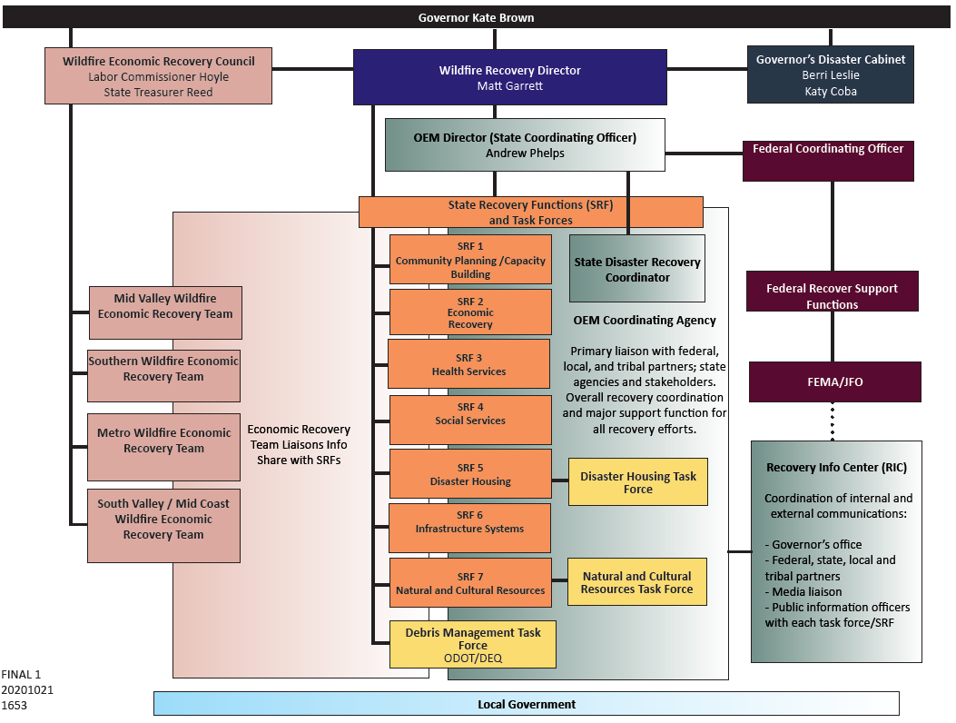
Organized Chaos

Slide 38
Oregon Recovery Plan - Supporting Agencies
INTERAGENCY RECOVERY COORDINATION STRUCTURE
State Recovery Function | State Coordinating Agency | Federal Coordinating Agency
SRF 1 - Community Planning and Capacity Building | Oregon Dept. of Land Conservation and Development | USDHS – FEMA US Environmental Protection Agency
SRF 2 – Economic Recovery | Business Oregon | US DOC – Economic Development Administration
SRF 3 – Health | Oregon Health Authority | US Dept. of Health and Human Services
SRF 4 - Social Services | Oregon Dept. of Human Services | US Dept. of Health and Human Services
SRF 5 - Housing | Oregon Housing and Community Services | US Dept. of Housing and Urban Development
SRF 6 - Infrastructure | Oregon Dept. of Administrative Services Oregon Dept. of Energy Oregon Dept. of Transportation Public Utility Commission of Oregon OEM Public Assistance | FEMA Public Assistance
SRF 7 - Natural and Cultural Resources | Oregon Dept. of Land Conservation and Development | US Dept. of the Interior
Advisory |  | US Environmental Protection Agency US Dept. of Agriculture – Rural Development FEMA Philanthropic Advisor

Slide 39
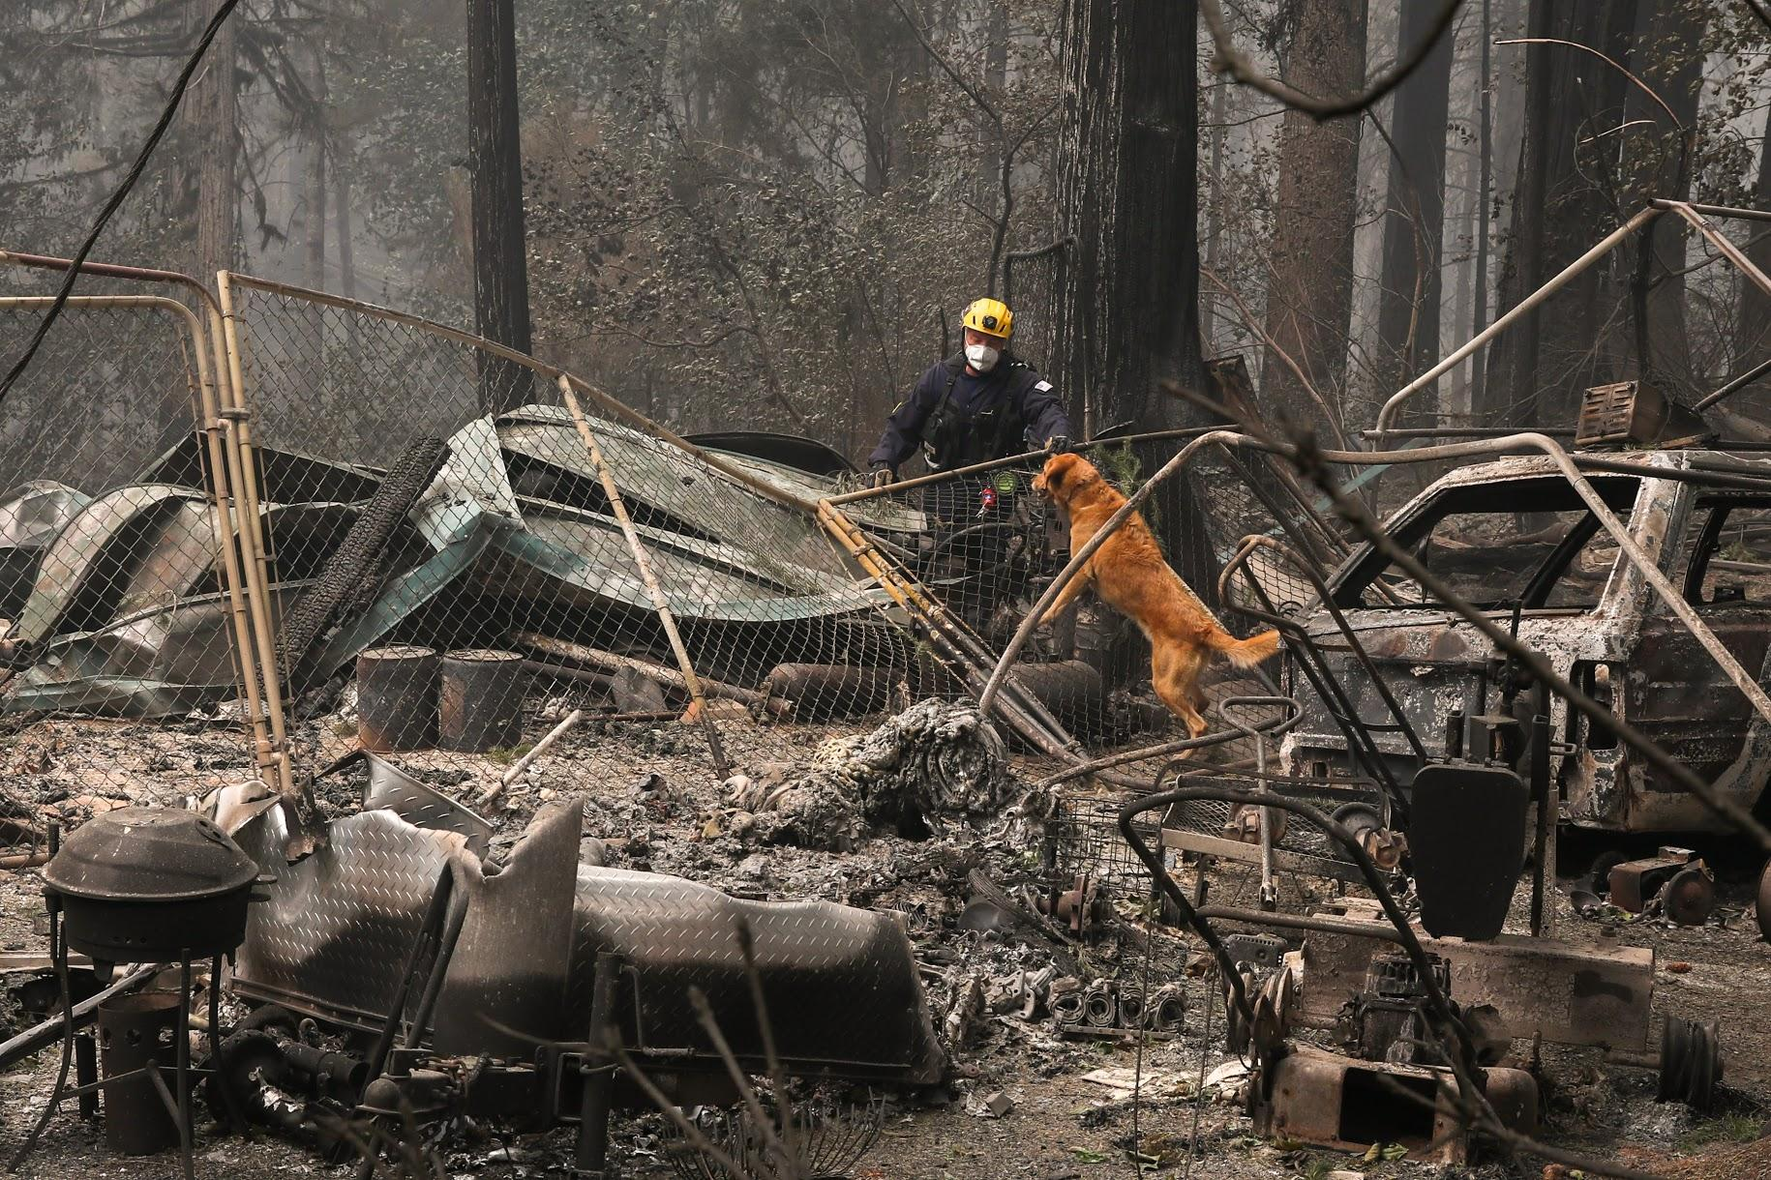
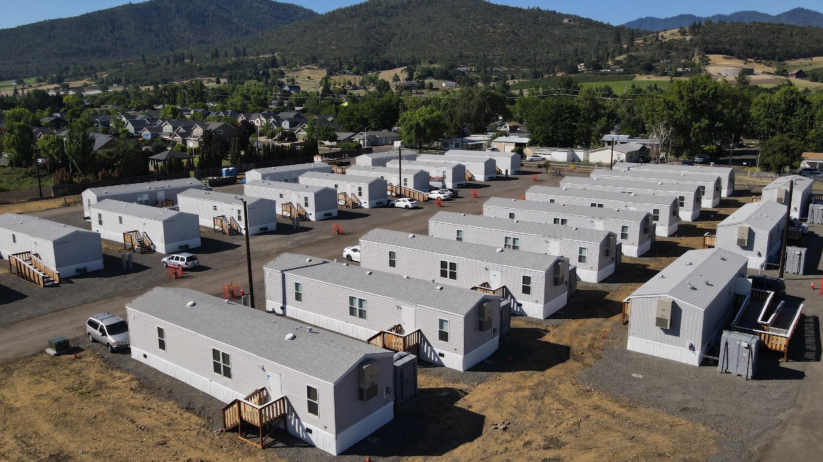
Lessons Learned
Oregon Disaster Recovery Plan
Recovery Coordination Center (RCC)
Voluntary Agency Liaison/Non-Governmental Organization (NGO) Coordination
Regional Mitigation/Recovery Program
FEMA Engagement
  Public Assistance (PA)
  Individual and Households Program (IHP)
  Direct Housing

Slide 40
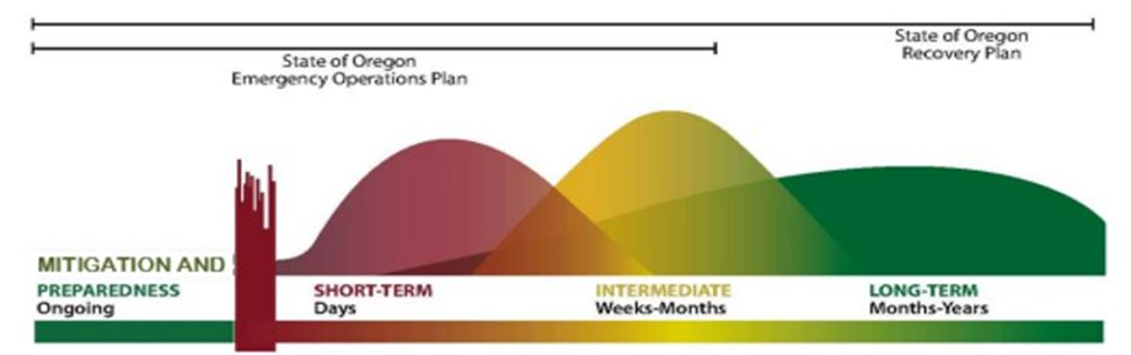
Recovery Operational Cadence
Recovery operations can work on a rolling timeline
Short term 30 days or less
Intermediate 30 to 120 to 180 days
Long Term 120-180 days to years

Slide 41
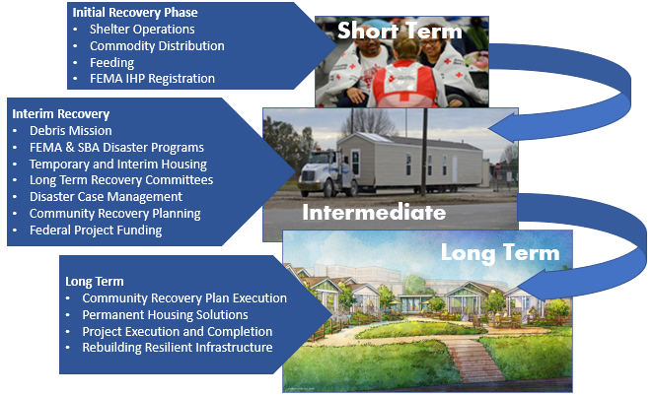
Disaster Recovery Overview

Slide 42
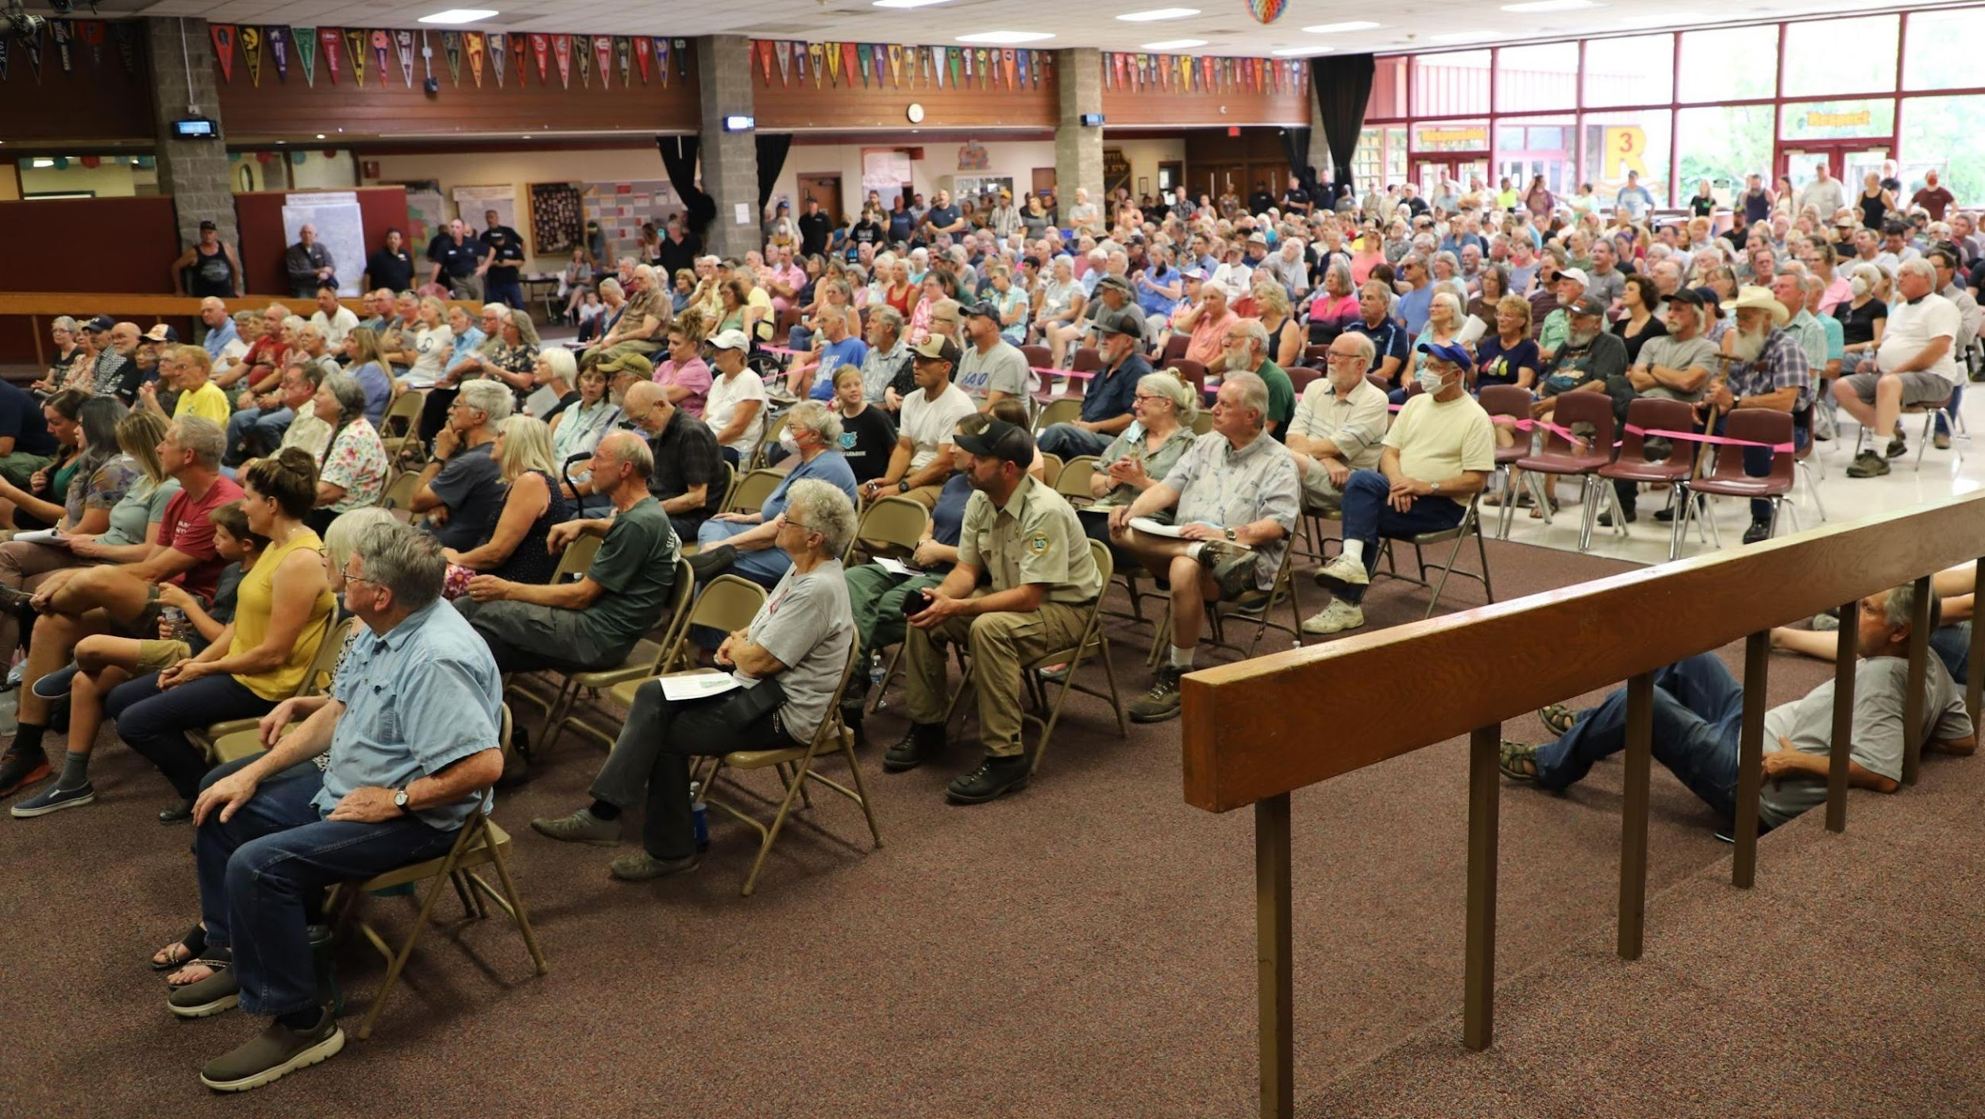
State/Federal Immediate Engagement
Town Hall Meetings
Whole community engagement
Firsthand information from survivors
Establishing expectations
Establishing recovery operation local contacts
Listen and Support
Elected Officials Meeting
Open direct line of communication with OEM/FEMA
Establish objectives and timelines
Provides safe and secure environment for problem solving

Slide 43
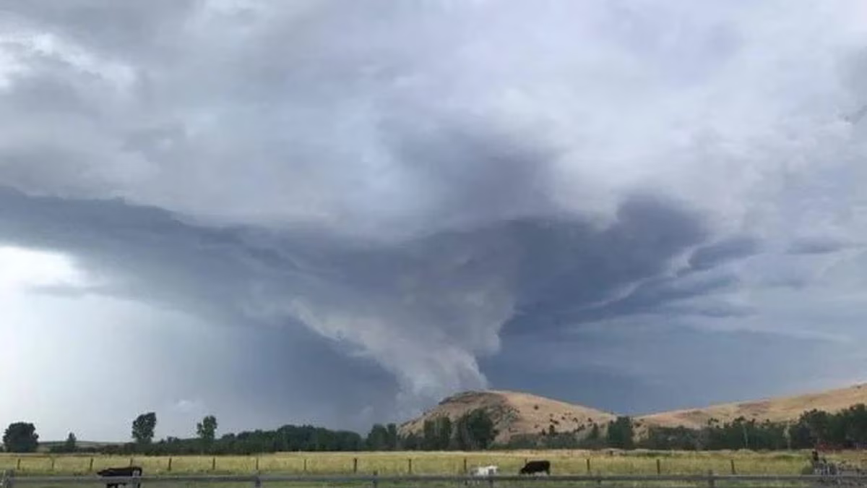
Non-Presidential Disasters
Wallowa Hail and Straight-line Winds
  August 11, 2022
  All structures in and surrounding the City of Wallowa experienced significant damage.
  Vehicles throughout area significant damage – many totaled
Emergency Board Request for $2M
  One-off program
  Unknown damage estimates at time of request
  Required established funding channels
  To date – approximately $500K in assistance
Notes:
Hit on lack of federal funds – no state capability for IA program
Partial activation of DRP

Slide 44
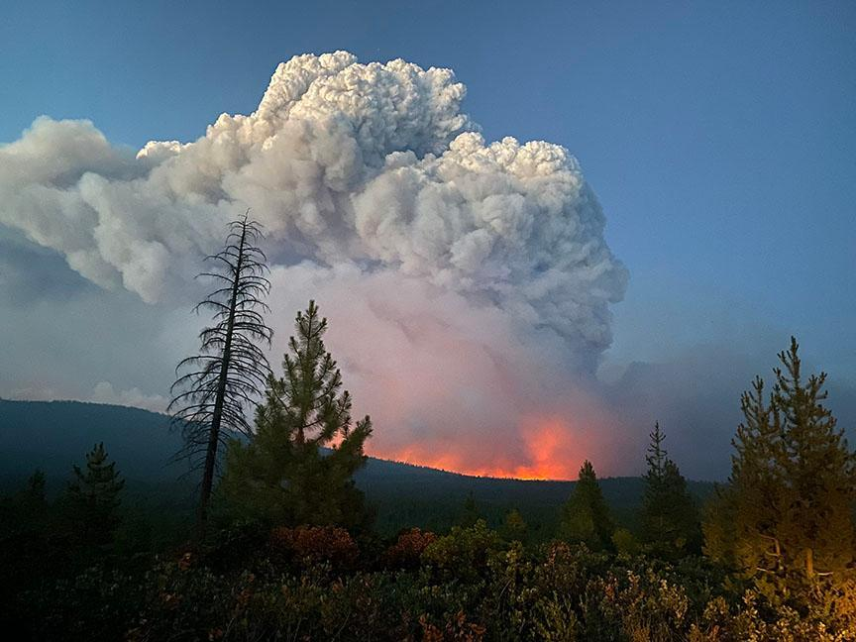
Non-Presidential Disasters
Bootleg Fire
  July 6, 2021
  413,735 acres/647 sq. miles burned
  Caused by lighting
  Gov. Declared State of Drought Emergency March 31, 2021
  Nearly 200 (400+ structures) homesteads destroyed
  Presidential Declaration requested
    Declined
    SBA offered low interest loans

Slide 45
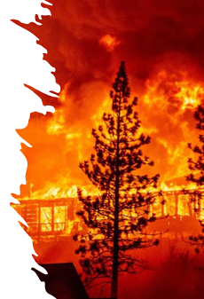
Labor Day Wildfire Recap
Acres Burned
  1.1 million acres
  5 cities burned over or significantly impacted
  4000+ homes destroyed
  40,000 evacuated
  9 lives lost
FEMA Individual & Households Assistance Program
  3259 Applications Approved
  $39,005,327 Approved
FEMA Public Assistance obligated to date
  509 Projects
  $628M
Hazard Mitigation Assistance obligated
  $96M obligated

Slide 46
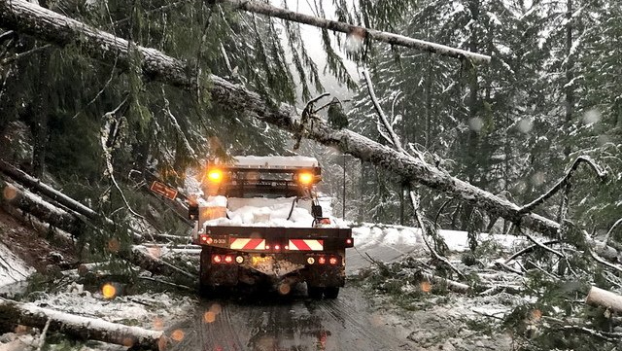
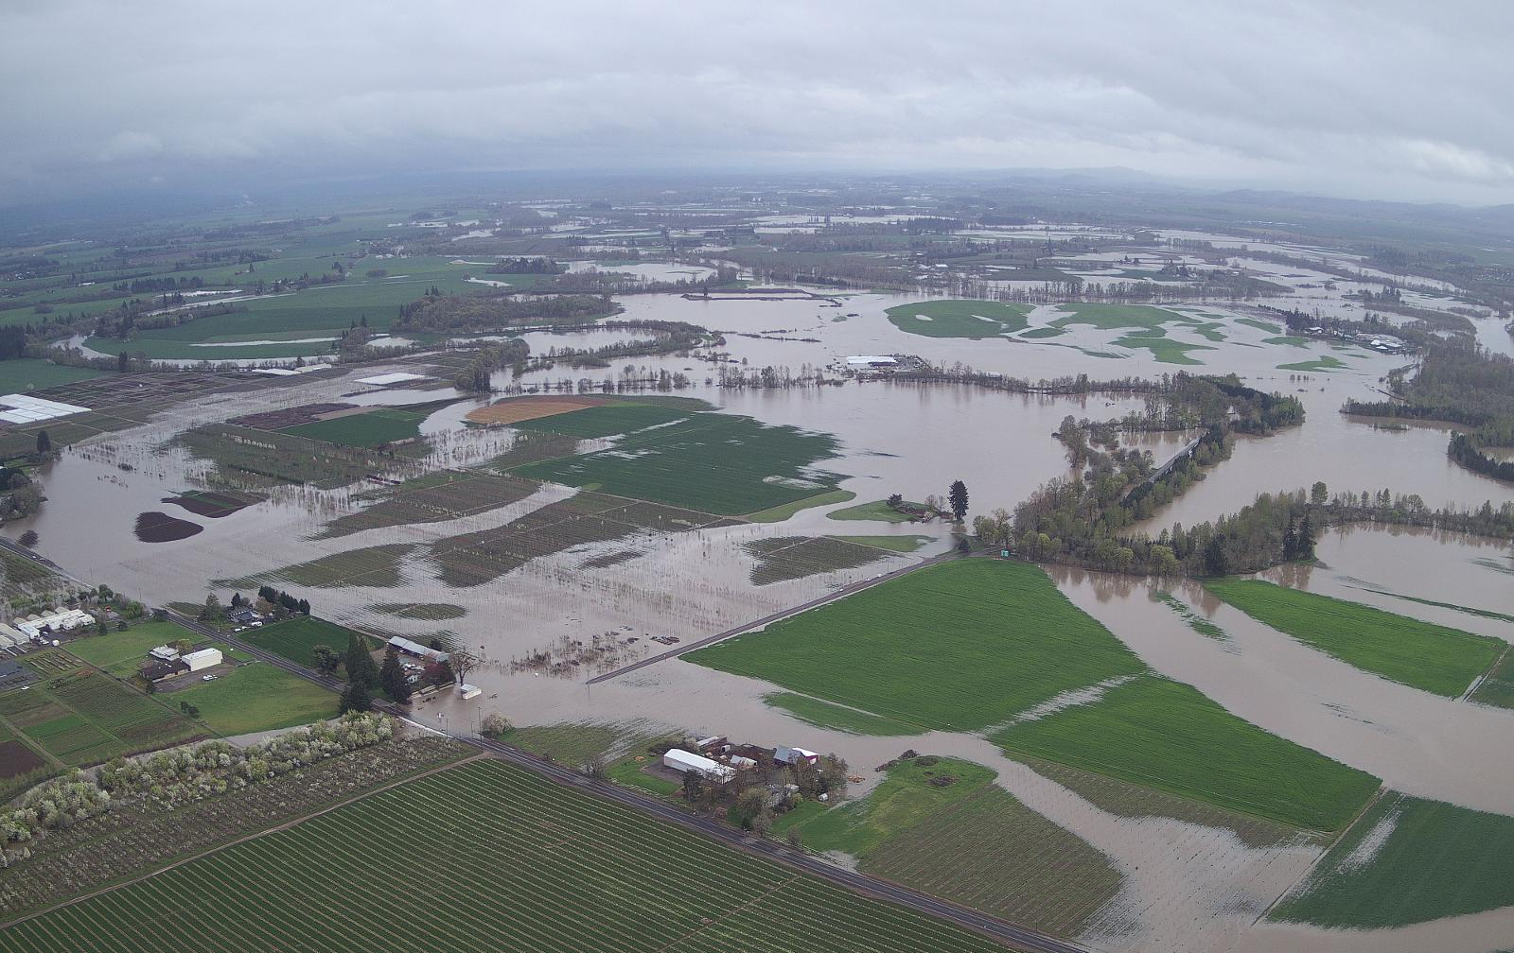
Recent Presidential Disaster Declarations
Severe winter storms, flooding, landslides, and mudslides
DR-4432
Incident Period: 2/23 to 2/26/2019
Jurisdictions Impacted
  Coos, Curry, Douglas, Jefferson, and Lane
Programs
  Public Assistance
  Hazard Mitigation
Damage Estimate: $30,028,943
DR-4452
Incident Period: 4/6 to 4/21/2019
Jurisdictions Impacted
  Curry, Douglas, Grant, Linn, Umatilla, and Wheeler
Programs
  Public Assistance
  Hazard Mitigation
Damage Estimate: $8,210,093

Slide 47

Recent Presidential Disaster Declarations
DR-4499 Covid 19 Pandemic
Incident Period: 1/20/20 and continuing
Jurisdictions Impacted
  Statewide
Programs
  Public Assistance
  Hazard Mitigation
Damage Estimate:
  $2,000,000,000
DR-4519 Severe Storms, Flooding, Landslides, and Mudslides
Incident Period: 2/05 to 2/09/2020
Jurisdictions Impacted
  Umatilla, Union, Wallowa Counties and Confederated Tribes of the Umatilla Reservation
Programs
  Public Assistance
  Hazard Mitigation
Damage Estimate:
  $18,000,000
  $10,000,000

Slide 48
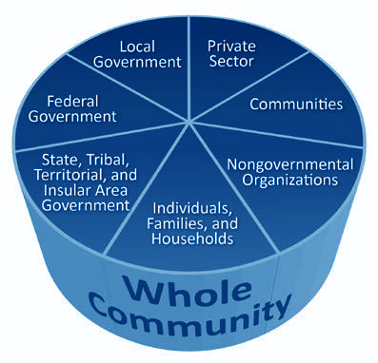
Questions?

Slide 49
Matt Marheine, Deputy Director
Preparedness and Response Division Director matt.marheine@oem.oregon.gov
503-378-3434
Stan Thomas, Deputy Director
Mitigation and Recovery Division Director stan.thomas@oem.oregon.gov
503-378-3181

