Slide 1




Wildfire in Oregon
Mariana Ruiz-Temple
State Fire Marshal

Slide 2

The Growing Wildfire Crisis
In the US since 2000:
  Nearly 2,000 communities threatened by wildfire
  Close to 100,000 structures destroyed
246% increase in structure loss (1999-2009 vs. 2010-2020)
Fire Season | Structures Lost
2020 | 3,823 structures lost, 2,267 primary residences.
2021 | 421 structures lost, 166 primary residences. *
2022 | 10 structures lost, 2 primary residences. *
2023 | 127 structures lost, 50 primary residences.
*Data above is only from fires under OSFM command.
Notes:
A concentrated education campaign will launch this spring with new materials and prioritized radio and TV campaigns leading up to fire season.
There is the potential for a property owner incentive program to accompany the educational campaign, more to come on this.

Slide 3
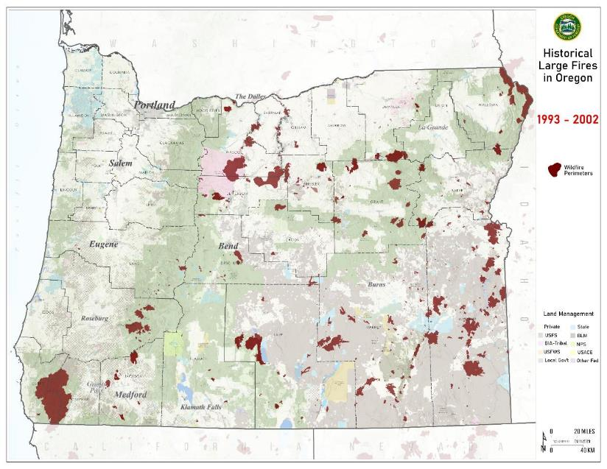
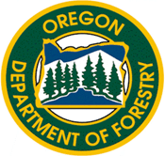

Oregon Large Wildfire History 1993-2002
Notes:
Actively monitoring daily through MAC and RMCS
AOC is stood up to monitor and mobilize OFMAS resources
FDBC works with Chiefs to identify impact to local resources and identifies in advance decision points when they will request OFMAS assistance.
Request to OSFM
SFM Notification to G.O.
Generally preloaded Requests takes minute
SFM request for E.O. to allow out of state resources
Incident process-Robust

Slide 4
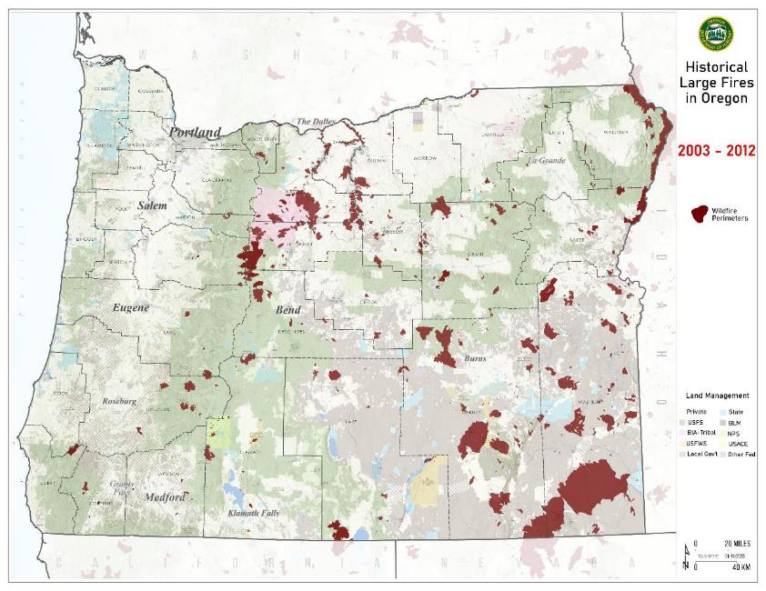
Oregon Large Wildfire History 2003-2012
Notes:
Actively monitoring daily through MAC and RMCS
AOC is stood up to monitor and mobilize OFMAS resources
FDBC works with Chiefs to identify impact to local resources and identifies in advance decision points when they will request OFMAS assistance.
Request to OSFM
SFM Notification to G.O.
Generally preloaded Requests takes minute
SFM request for E.O. to allow out of state resources
Incident process-Robust

Slide 5
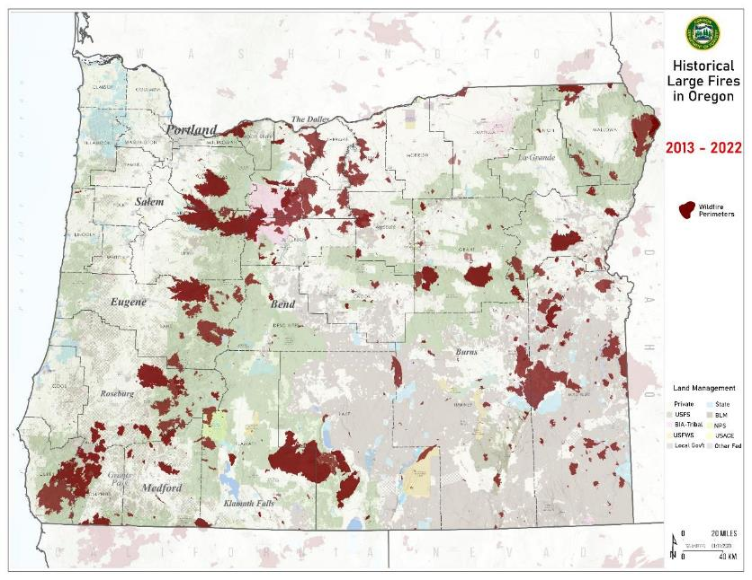
Oregon Large Wildfire History 2013-2022
Notes:
Actively monitoring daily through MAC and RMCS
AOC is stood up to monitor and mobilize OFMAS resources
FDBC works with Chiefs to identify impact to local resources and identifies in advance decision points when they will request OFMAS assistance.
Request to OSFM
SFM Notification to G.O.
Generally preloaded Requests takes minute
SFM request for E.O. to allow out of state resources
Incident process-Robust

Slide 6
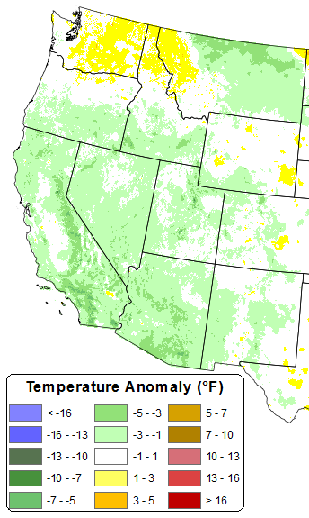
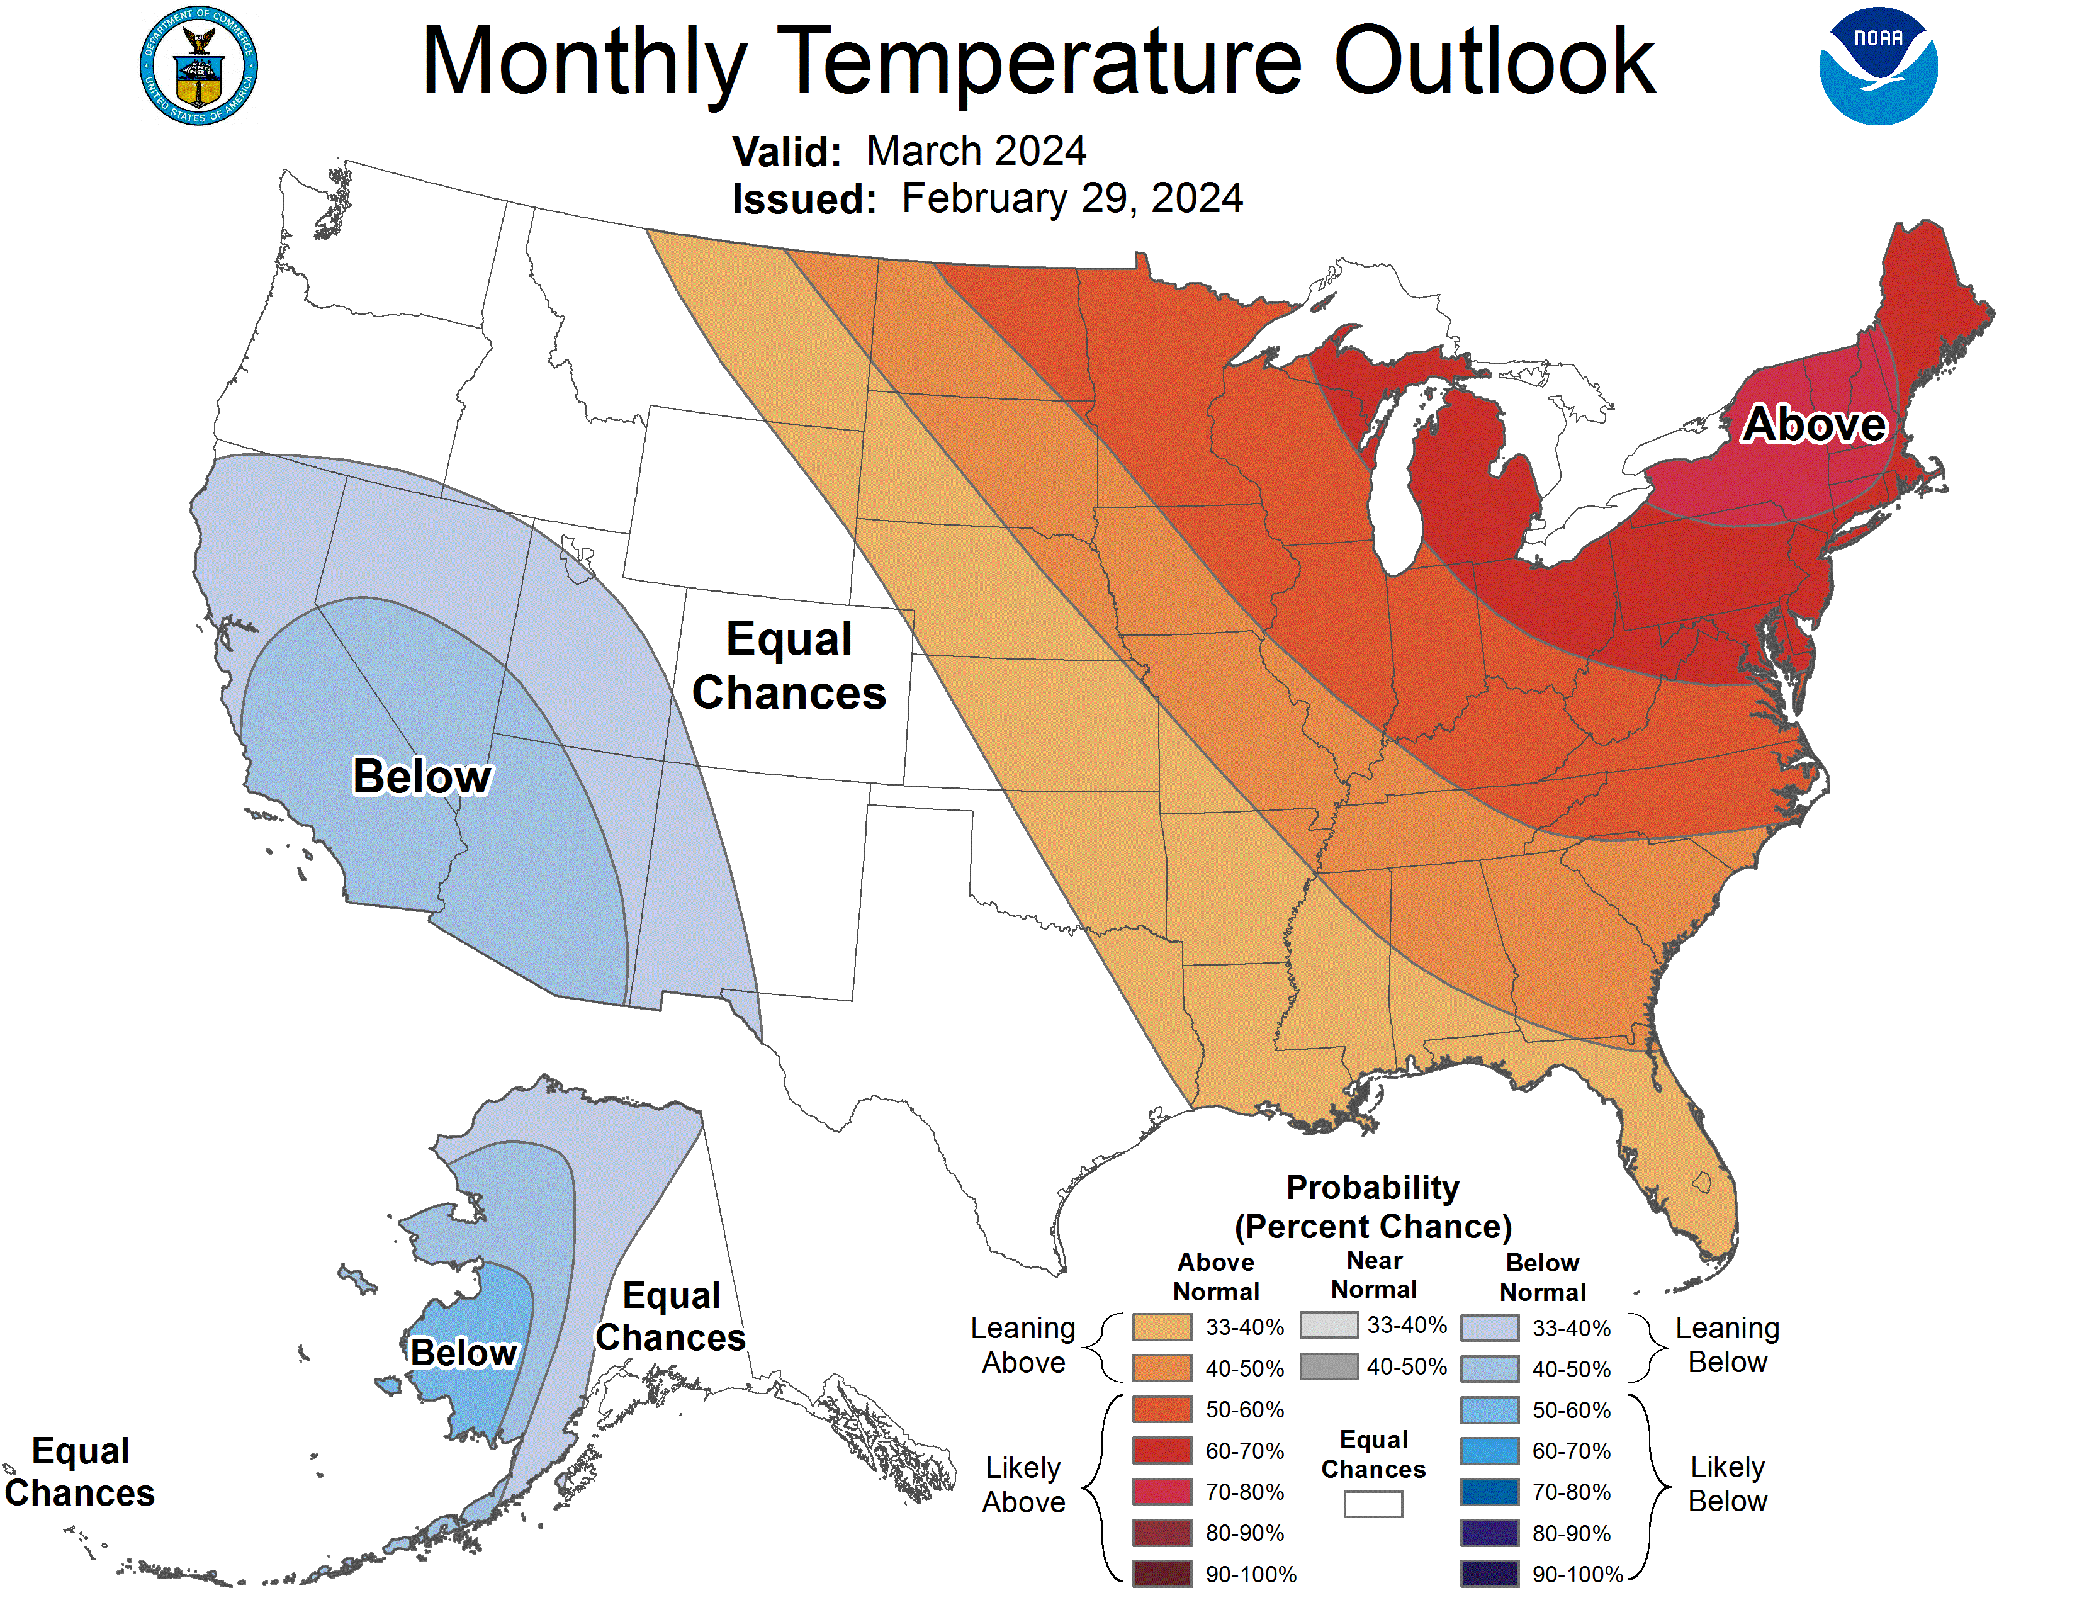
Temperature Forecast vs. Observed: March 2024
Temperature: March outlook
Observed in March 2024
Notes:
Characterization: Mean temperature observations were slightly above normal in much of Washington but near normal or slightly below normal for Oregon and southward.

Slide 7
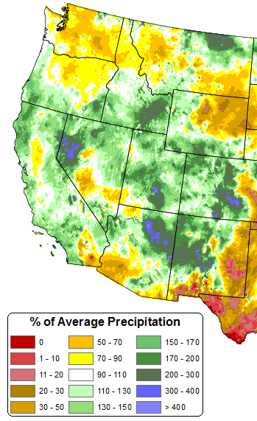
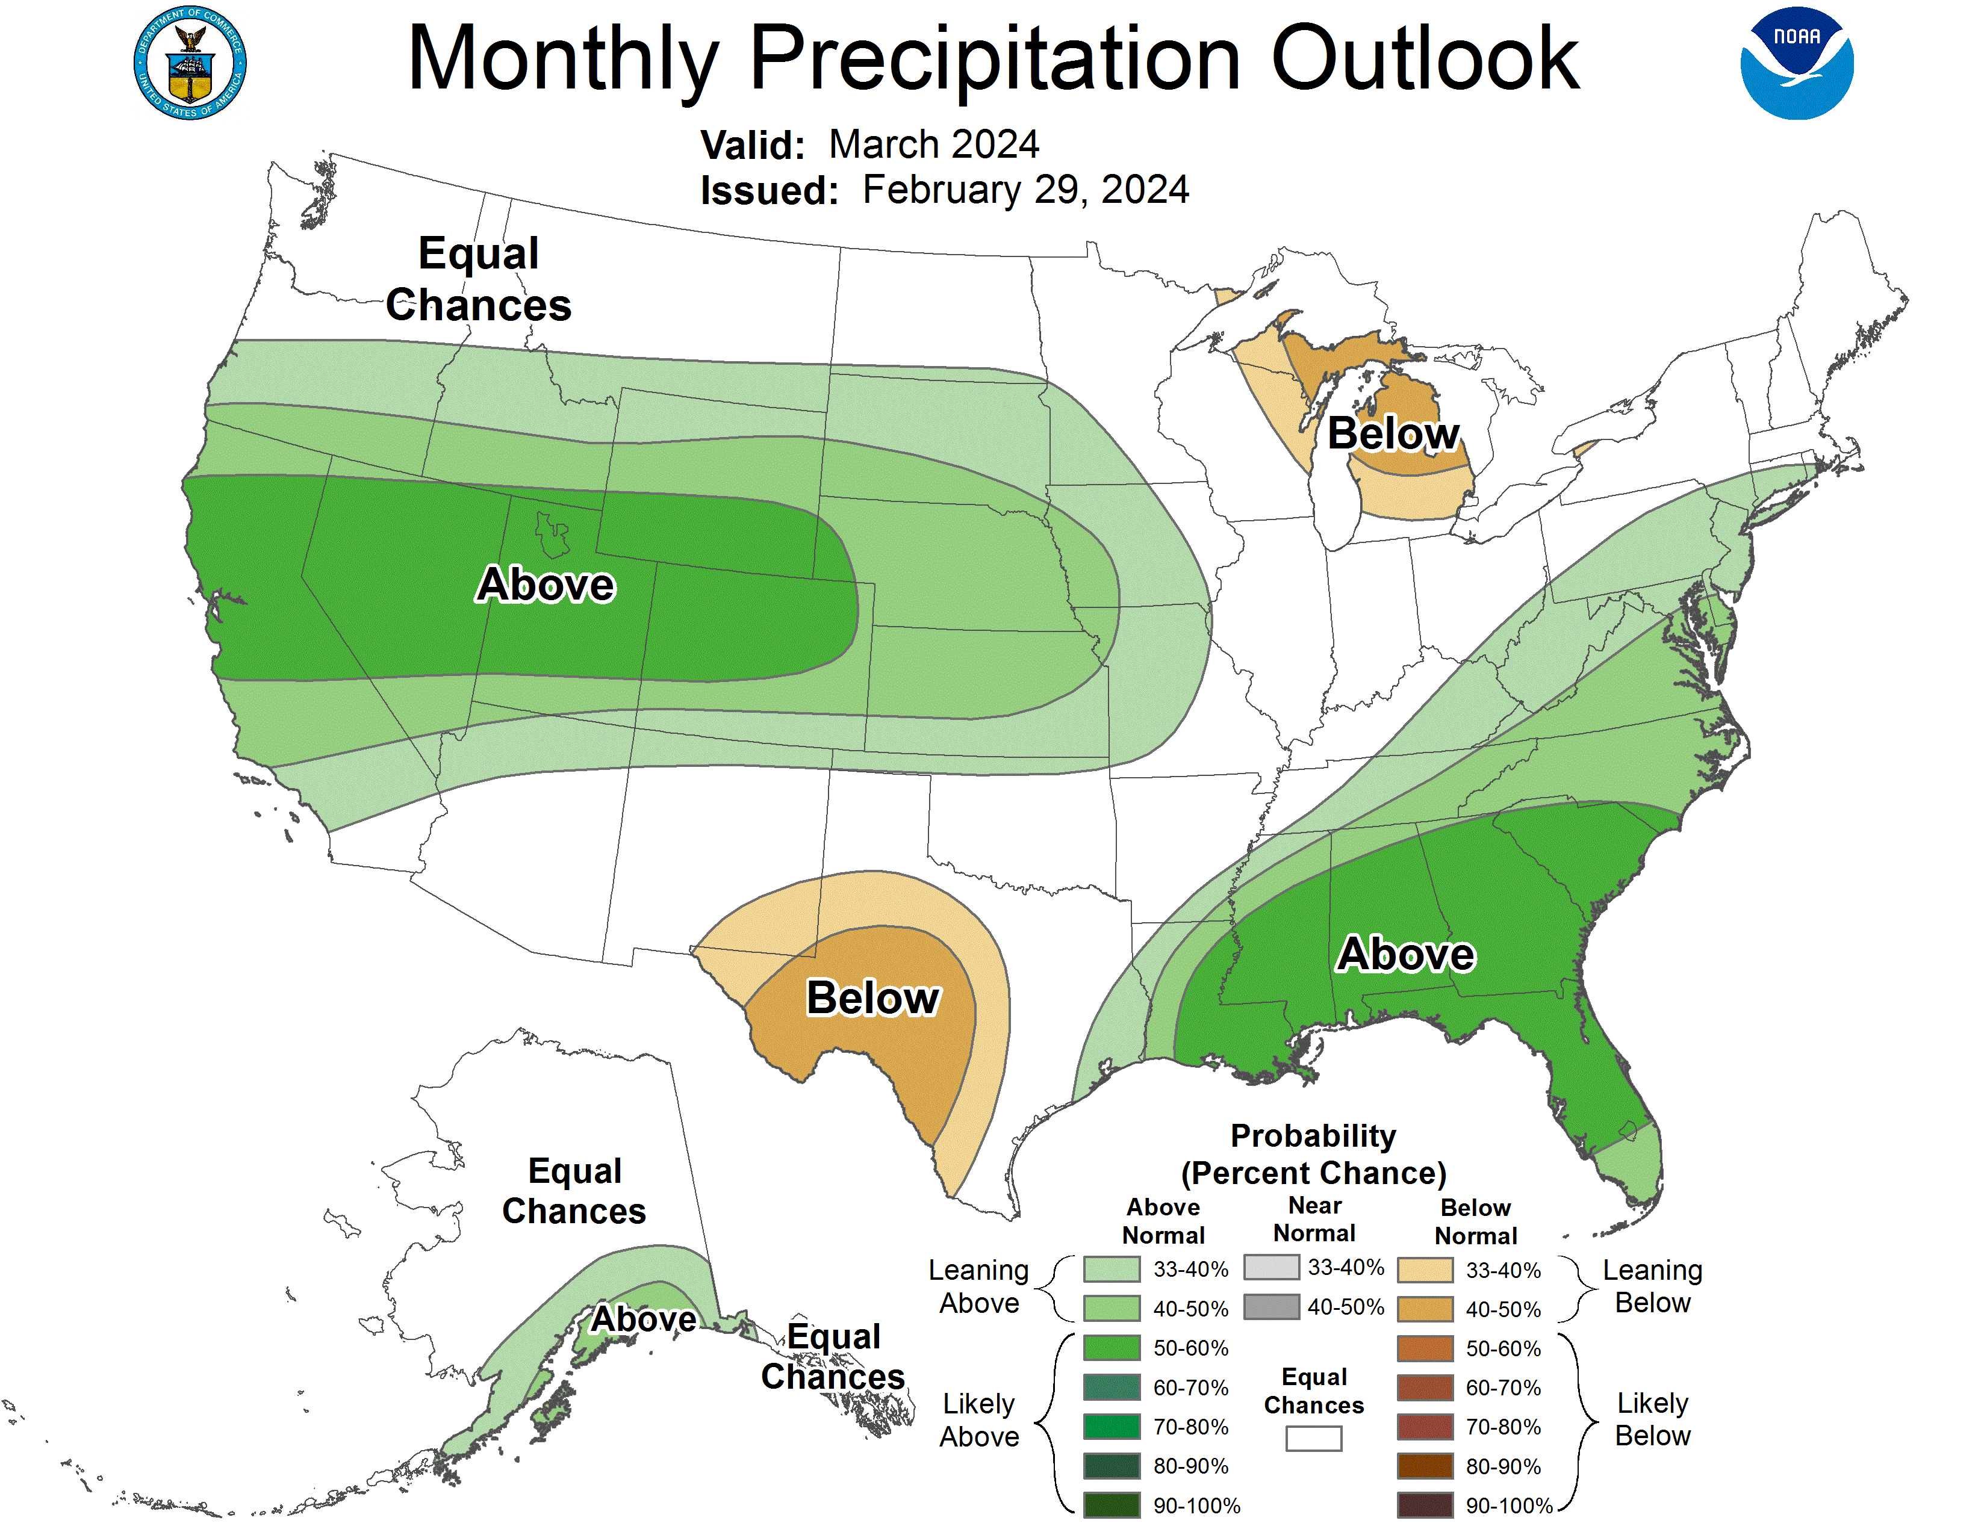
Precipitation Forecast vs. Observed: March 2024
Precipitation: March outlook
Observed in March 2024
Notes:
Characterization: Above average precipitation was observed over the Oregon Coast Range and southern Oregon but generally less than average over central and northeast Oregon and much of Washington.

Slide 8
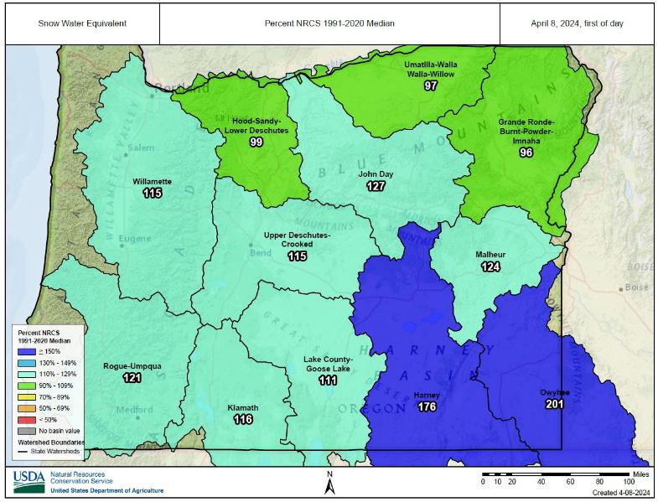
Snow Water Equivalent April 2024
Notes:
Characterization: Accumulation of new snow tracked close to normal for Oregon through much of March 2024. Northern portions of Oregon are slightly below average and SE Oregon well above average, however the desert portions are expected to diminish quickly.

Slide 9
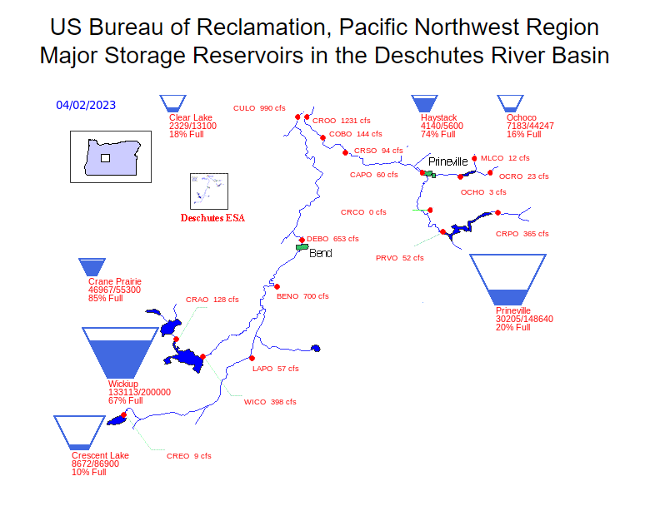
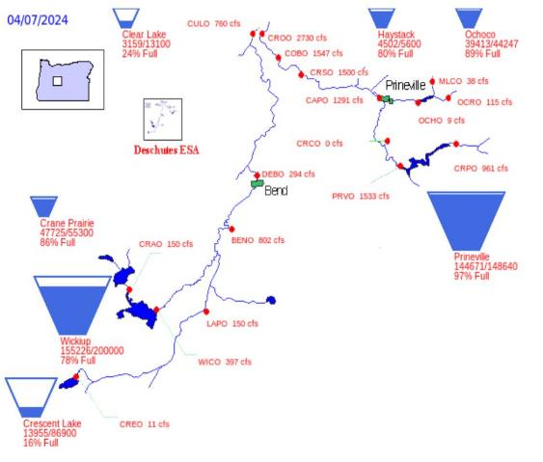
Deschutes River Basin Reservoir Levels
April 2023
April 2024

Slide 10

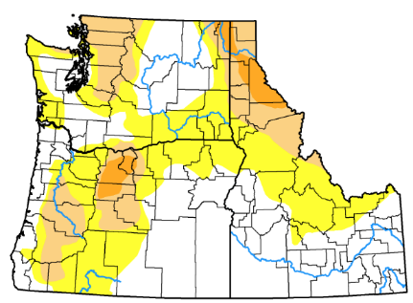

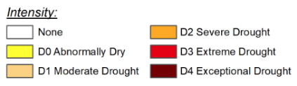
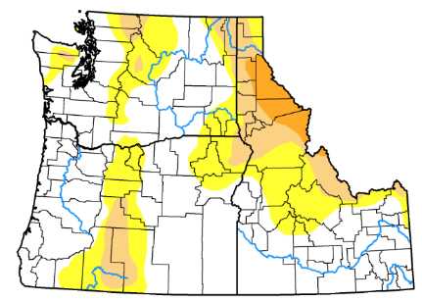


Notes:
Drought monitoring involves observing indicators and indices that evaluate changes in a region's hydrological cycle. Indicators, which are used to describe drought conditions, are variables such as precipitation, temperature, streamflow, ground and reservoir water levels, soil moisture, and snowpack.

Slide 11
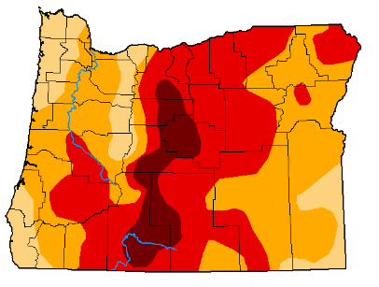
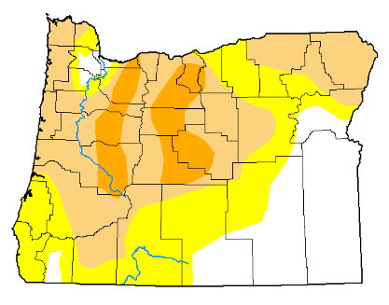
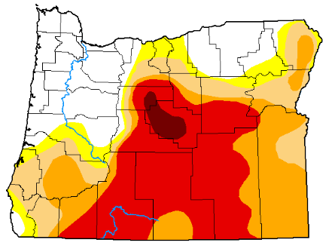
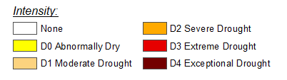
Statewide Drought Indicators
July 2021
July 2023
July 2022
Notes:
Exception drought in critical area’s will continue to plague the state.
Good news if you look at the NW corner of the state in 2021 vs 2022 you will see drought has relinquished.
Additionally, in Early April the conditions were shaping up for another early fire season, this spring weather (moisiture and cooler temps) has pushed the onset of an early fire season back and been a welcomed respite.
The challenges as you look at these charts
Notice- drought in 2021 and the outcome= Oregon’s third largest wildfire bootleg.
The expansion of the exceptional drought is very concerning for fire managers
Critically drought stricken fuels over a large area as we get into the heart of Oregon’s fire season could lead to very explosive fire growth- such as on Boot.

Slide 12
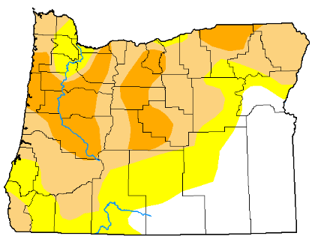
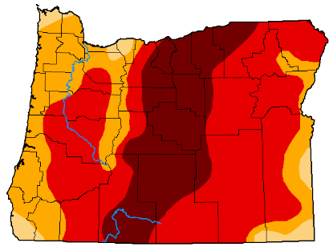
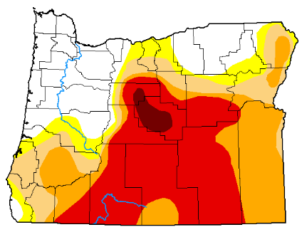
Statewide Drought Indicators
August 2021
August 2023
August 2022
Notes:
Exception drought in critical area’s will continue to plague the state.
Good news if you look at the NW corner of the state in 2021 vs 2022 you will see drought has relinquished.
Additionally, in Early April the conditions were shaping up for another early fire season, this spring weather (moisiture and cooler temps) has pushed the onset of an early fire season back and been a welcomed respite.
The challenges as you look at these charts
Notice- drought in 2021 and the outcome= Oregon’s third largest wildfire bootleg.
The expansion of the exceptional drought is very concerning for fire managers
Critically drought stricken fuels over a large area as we get into the heart of Oregon’s fire season could lead to very explosive fire growth- such as on Boot.

Slide 13
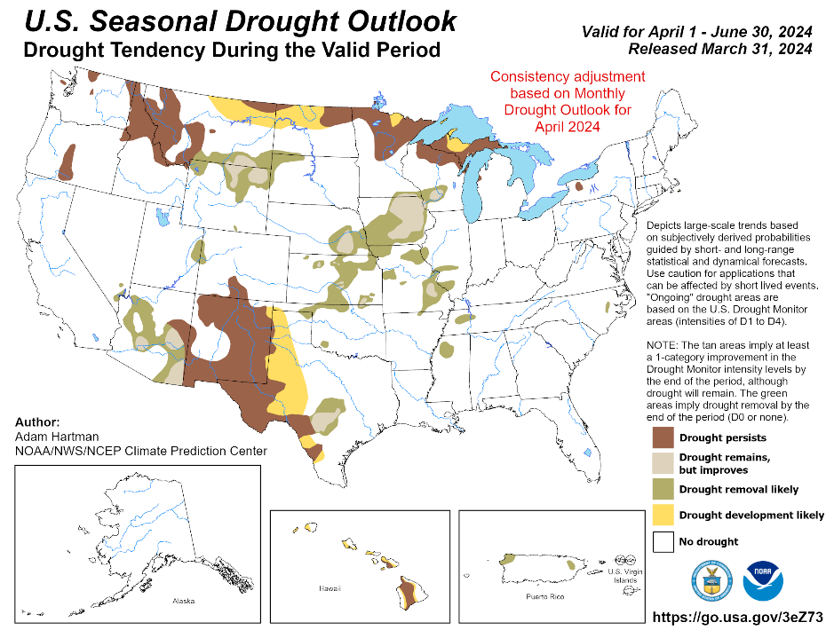
Notes:
Comparable throughout the west to gauge capacity

Slide 14
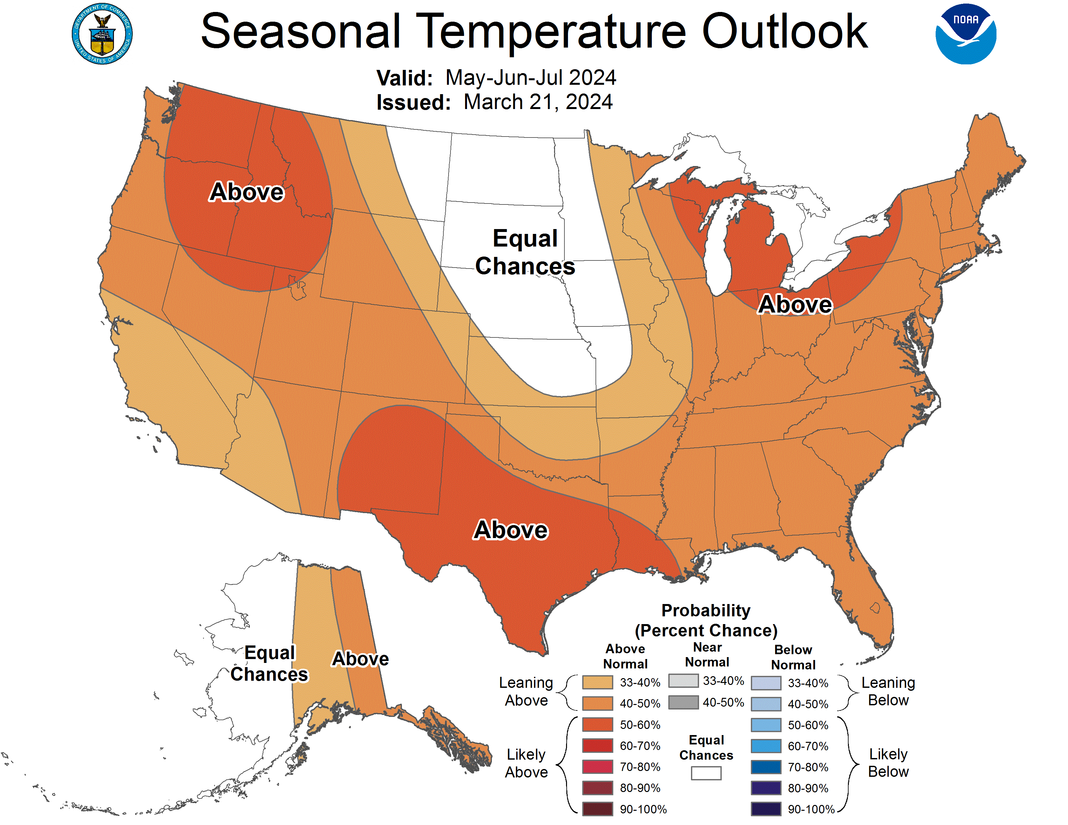
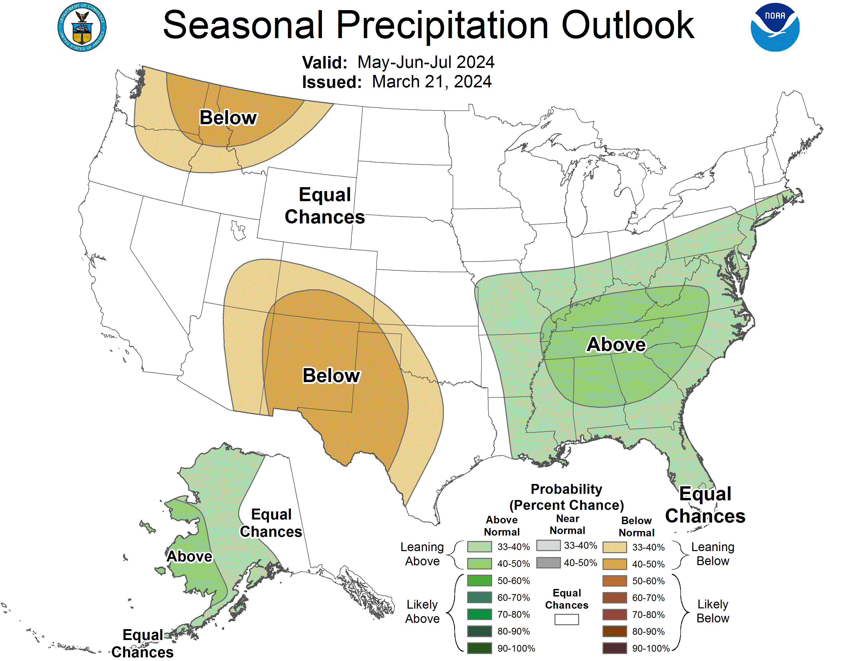
May-June-July 2024 Outlook
Temperature
Precipitation
Notes:
Characterization: Much of the CONUS is under elevated risk for warmer-than-typical temperatures for May through July. Much of the PACNW as well as the Rockies and southern plains are favored for below average accumulation of precipitation.

Slide 15
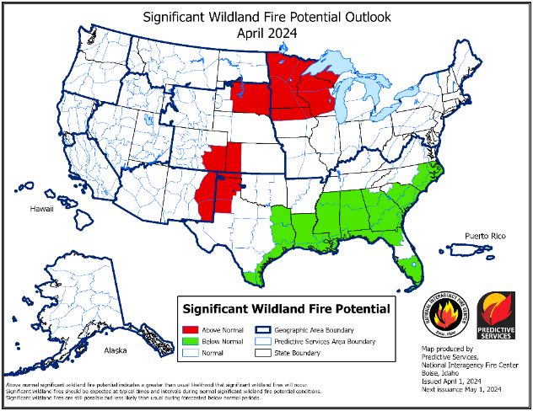
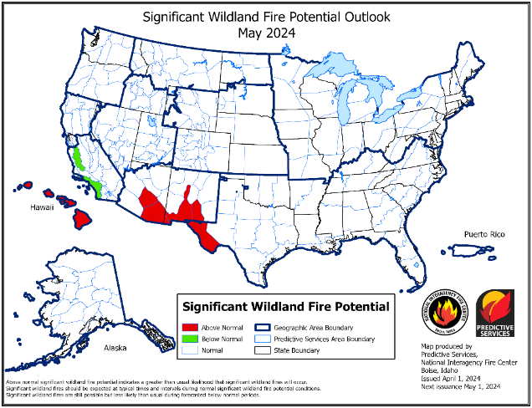
Significant Fire Potential Outlooks
Notes:
The risk of significant fires in most of the western states is generally estimated to be normal (ie low risk) except for the southern plains and lower elevations of the desert southwest.
Sections of southern California are estimated to be at lower-than-normal risk in May.

Slide 16
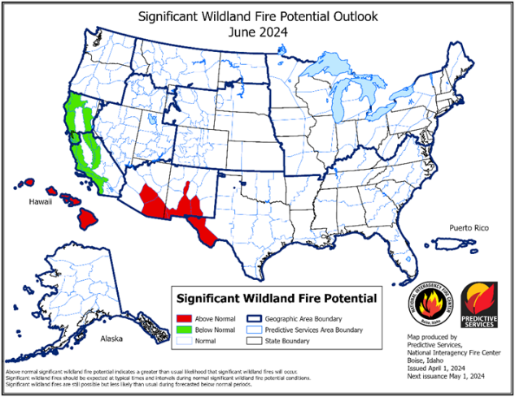
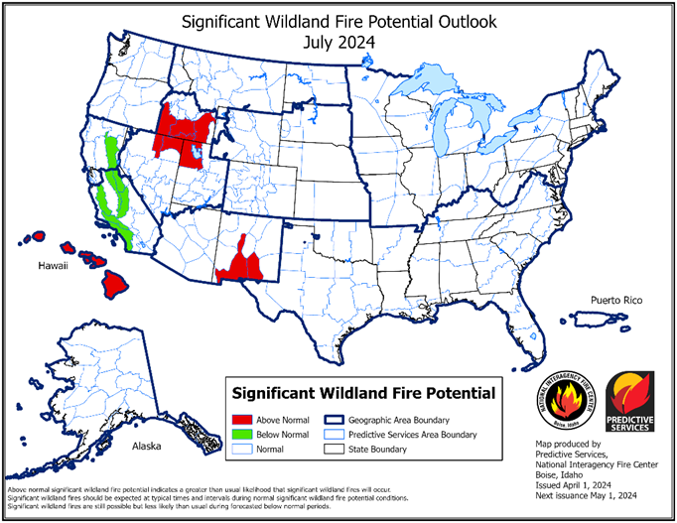
Significant Fire Potential Outlooks
Notes:
The risk of significant fires in most of the western states is generally estimated to be normal (ie low risk) except for the southern plains and lower elevations of the desert southwest.
Sections of southern California are estimated to be at lower-than-normal risk in May.

Slide 17
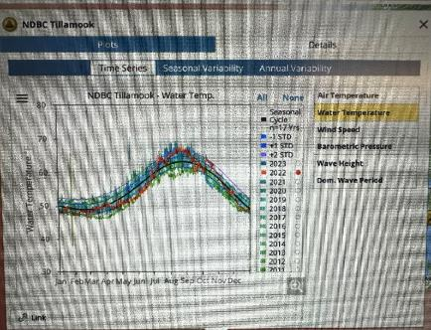
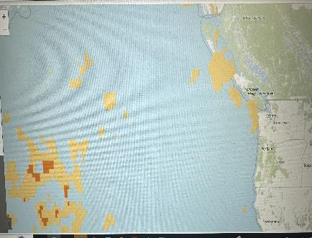
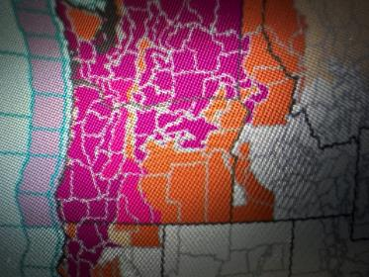
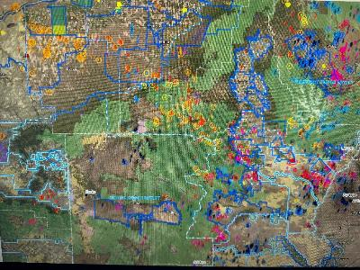
What we Watch?
Notes:
The risk of significant fires in the Pacific Northwest and other western states is anticipated to be normal (low risk) except for lower elevations of the southwest.
The Hawaiian Islands are expected to elevate into above average risk for Significant Fires.

Slide 18

Fire Season 2024 Outlook
  Conditions point to a normal start to fire season
  Potential for warm/dry May/June increases risk for East Slope of Cascades, NE, and SE Oregon, along with continued drought mid/late summer
Notes:
The Engine Program is nearing completion with 27 type 3 engines (midsize), 20 type 6 engines (smaller), and 30 tactical tenders in production. As the engine builds are finished, they will be strategically placed across the state to add firefighting capacity and critical response resources to protect our communities.
Type 3: The remainder will be delivered throughout the late winter or early spring.
Final Inspections
Tender – Late February
Type 6 – February 13th
Type 3 - Complete

Slide 19
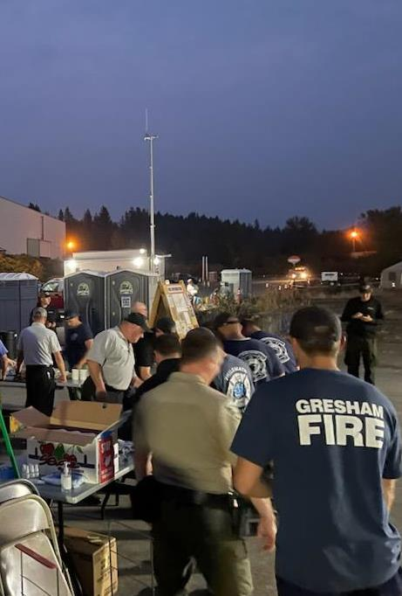
Oregon’s Response System
State Response
  Oregon Dept. of Forestry
  Oregon Dept. of State Fire Mashal
Fed Response
  USFS, BLM, FWS, NP
Notes:
The Engine Program is nearing completion with 27 type 3 engines (midsize), 20 type 6 engines (smaller), and 30 tactical tenders in production. As the engine builds are finished, they will be strategically placed across the state to add firefighting capacity and critical response resources to protect our communities.
Type 3: The remainder will be delivered throughout the late winter or early spring.
Final Inspections
Tender – Late February
Type 6 – February 13th
Type 3 - Complete

Slide 20
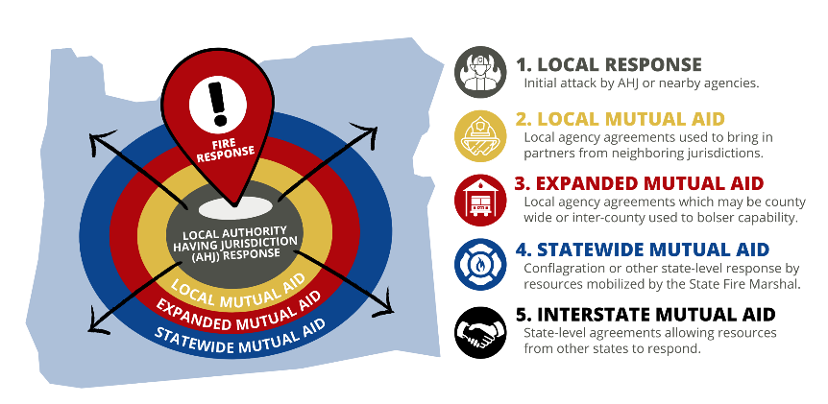
Oregon Fire Mutual Aid System
Oregon Fire Mutual Aid System
  11,000 firefighters
  304 fire agencies
  7 Regional Mobilization Coordinators
Oregon’s 33 Fire Defense Board Chiefs
  Annual training
  Annual mobilization drill
Oregon Fire Service Mobilization Plan
  All Hazards
Oregon’s method to mobilize resources when an incident exceeds local capability. This system has been in place for 70 years.
Notes:
Actively monitoring daily through MAC and RMCS
AOC is stood up to monitor and mobilize OFMAS resources
FDBC works with Chiefs to identify impact to local resources and identifies in advance decision points when they will request OFMAS assistance.
Request to OSFM
SFM Notification to G.O.
Generally preloaded Requests takes minute
SFM request for E.O. to allow out of state resources
Incident process-Robust

Slide 21
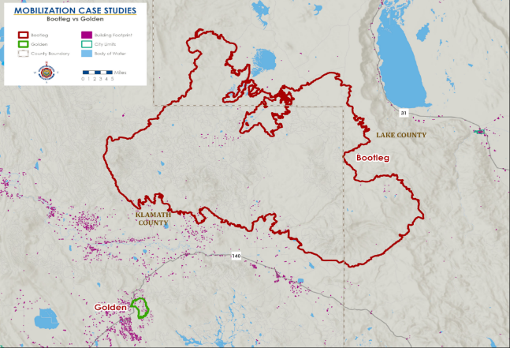
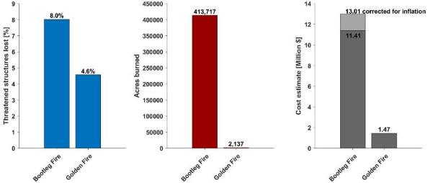
Mobilization Case Study: Bootleg vs. Golden Fire
 | Bootleg | Golden Fire
Start Date: | July 6, 2021 | July 22, 2023
Location: | Beatty Oregon (Klamath County) | Bonanza Oregon (Klamath County)
Temperature: | 97 degrees Fahrenheit | 97 degrees Fahrenheit
Wind Speed: | 13 mph average (Northwest direction) | 12 mph average (West-Northwest direction)
Notes:
Emergency Response
Keep fires small and away from communities
Continuous improvement of and service to the Oregon Fire Mutual Aid System (OFMAS)
Creation of statewide Engine Program to bolster OFMAS
Rapid and efficient response to hazardous materials incidents
Reg Svc
Conduct thorough and effective fire safety inspections and audits in program areas for public safety
Provide technical expertise to regulated industries to assist them accomplish compliance
Assist emergency planners, responders, and the public to access information about hazardous substances in their communities so they may be better prepared
FLSE​
Increase the number of resources, tools and educational materials for the Oregon Fire Service and the communities OSFM serves.​
Increase the number of outreach opportunities (events, planning efforts, partner connections) ​
Partner with the Oregon fire service and partners to reduce fires, loss of life, injury and property damage.​
Increase the awareness of the Community Risk Reduction process to the Oregon Fire Service.​
Continue to utilize the data to help guide, tell the stories and drive programs to support the Oregon Fire Service and people of Oregon. ​
FLSS​
Conduct fire investigations to determine the origin and cause; leverage the lessons learned to build program messaging and prevention outreach.​
Conduct fire investigations to assist in the criminal prosecution of arson fires.​
Conduct fire code inspections and abate fire hazards in commercial buildings, institutional occupancies such as schools, multi-family housing of three or more units, and high-hazard operations, including state properties and corrections facilities, to prevent potential fires by maintaining a high level of fire and life safety in vulnerable populations.​
Develop and adopt the Oregon Fire Code, updating every 3 years, through a robust and transparent process utilizing the Oregon Fire Code Advisory Board (OFCAB) reflective of Oregon values.​
Provide the Oregon Fire Service and stakeholders with fire code interpretation and technical expertise when local questions or issues arise.​
Conduct fire department access and water supply plan review for new developments.​
Provide community outreach and fire prevention program development assistance to local jurisdictions to increase community resilience. ​
Increase the capability of the Oregon Fire Service by providing certification training in areas of fire investigation, competency recognition, and fire inspection.​
Conduct unscheduled surveys of Skilled Nursing Facilities (SNFs), Ambulatory Surgical Centers (ASC), inpatient Hospice facilities, Hospitals, and End-Stage Renal Disease (ESRD) facilities across the state that receive federal Centers for Medicare/Medicaid (CMS) funding to ensure compliance and protect this vulnerable population.

Slide 22
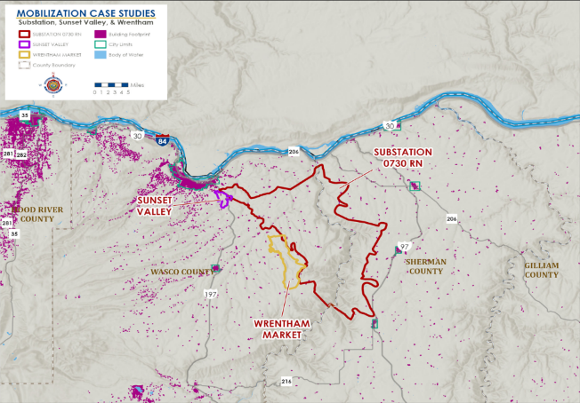
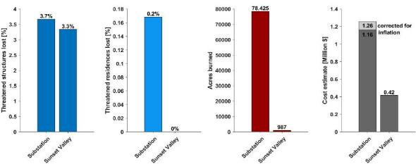
Mobilization Case Study: Substation vs. Sunset Valley Fire
 | Substation | Sunset Valley
Start Date: | July 17, 2018 | July 1, 2021
Location: | The Dalles Oregon (Wasco County) | The Dalles Oregon (Wasco County)
Temperature: | 89 degrees Fahrenheit | 75 degrees Fahrenheit
Wind Speed: | 9 mph average (North direction) | 6 mph average (Northwest direction)
Notes:
Emergency Response
Keep fires small and away from communities
Continuous improvement of and service to the Oregon Fire Mutual Aid System (OFMAS)
Creation of statewide Engine Program to bolster OFMAS
Rapid and efficient response to hazardous materials incidents
Reg Svc
Conduct thorough and effective fire safety inspections and audits in program areas for public safety
Provide technical expertise to regulated industries to assist them accomplish compliance
Assist emergency planners, responders, and the public to access information about hazardous substances in their communities so they may be better prepared
FLSE​
Increase the number of resources, tools and educational materials for the Oregon Fire Service and the communities OSFM serves.​
Increase the number of outreach opportunities (events, planning efforts, partner connections) ​
Partner with the Oregon fire service and partners to reduce fires, loss of life, injury and property damage.​
Increase the awareness of the Community Risk Reduction process to the Oregon Fire Service.​
Continue to utilize the data to help guide, tell the stories and drive programs to support the Oregon Fire Service and people of Oregon. ​
FLSS​
Conduct fire investigations to determine the origin and cause; leverage the lessons learned to build program messaging and prevention outreach.​
Conduct fire investigations to assist in the criminal prosecution of arson fires.​
Conduct fire code inspections and abate fire hazards in commercial buildings, institutional occupancies such as schools, multi-family housing of three or more units, and high-hazard operations, including state properties and corrections facilities, to prevent potential fires by maintaining a high level of fire and life safety in vulnerable populations.​
Develop and adopt the Oregon Fire Code, updating every 3 years, through a robust and transparent process utilizing the Oregon Fire Code Advisory Board (OFCAB) reflective of Oregon values.​
Provide the Oregon Fire Service and stakeholders with fire code interpretation and technical expertise when local questions or issues arise.​
Conduct fire department access and water supply plan review for new developments.​
Provide community outreach and fire prevention program development assistance to local jurisdictions to increase community resilience. ​
Increase the capability of the Oregon Fire Service by providing certification training in areas of fire investigation, competency recognition, and fire inspection.​
Conduct unscheduled surveys of Skilled Nursing Facilities (SNFs), Ambulatory Surgical Centers (ASC), inpatient Hospice facilities, Hospitals, and End-Stage Renal Disease (ESRD) facilities across the state that receive federal Centers for Medicare/Medicaid (CMS) funding to ensure compliance and protect this vulnerable population.

Slide 23
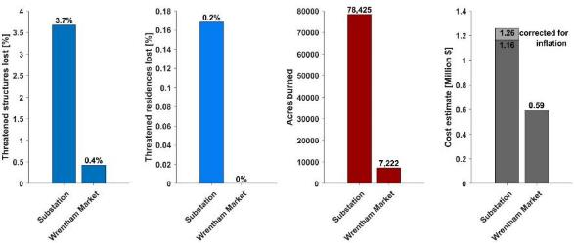
Mobilization Case Study: Substation vs. Wrentham Market Fire
 | Substation | Wrentham Market
Start Date: | July 17, 2018 | June 29, 2021
Location: | The Dalles Oregon (Wasco County) | Dufur Oregon (Wasco County)
Temperature: | 89 degrees Fahrenheit | 88 degrees Fahrenheit
Wind Speed: | 9 mph average (North direction) | 6 mph average (North direction)
Notes:
Emergency Response
Keep fires small and away from communities
Continuous improvement of and service to the Oregon Fire Mutual Aid System (OFMAS)
Creation of statewide Engine Program to bolster OFMAS
Rapid and efficient response to hazardous materials incidents
Reg Svc
Conduct thorough and effective fire safety inspections and audits in program areas for public safety
Provide technical expertise to regulated industries to assist them accomplish compliance
Assist emergency planners, responders, and the public to access information about hazardous substances in their communities so they may be better prepared
FLSE​
Increase the number of resources, tools and educational materials for the Oregon Fire Service and the communities OSFM serves.​
Increase the number of outreach opportunities (events, planning efforts, partner connections) ​
Partner with the Oregon fire service and partners to reduce fires, loss of life, injury and property damage.​
Increase the awareness of the Community Risk Reduction process to the Oregon Fire Service.​
Continue to utilize the data to help guide, tell the stories and drive programs to support the Oregon Fire Service and people of Oregon. ​
FLSS​
Conduct fire investigations to determine the origin and cause; leverage the lessons learned to build program messaging and prevention outreach.​
Conduct fire investigations to assist in the criminal prosecution of arson fires.​
Conduct fire code inspections and abate fire hazards in commercial buildings, institutional occupancies such as schools, multi-family housing of three or more units, and high-hazard operations, including state properties and corrections facilities, to prevent potential fires by maintaining a high level of fire and life safety in vulnerable populations.​
Develop and adopt the Oregon Fire Code, updating every 3 years, through a robust and transparent process utilizing the Oregon Fire Code Advisory Board (OFCAB) reflective of Oregon values.​
Provide the Oregon Fire Service and stakeholders with fire code interpretation and technical expertise when local questions or issues arise.​
Conduct fire department access and water supply plan review for new developments.​
Provide community outreach and fire prevention program development assistance to local jurisdictions to increase community resilience. ​
Increase the capability of the Oregon Fire Service by providing certification training in areas of fire investigation, competency recognition, and fire inspection.​
Conduct unscheduled surveys of Skilled Nursing Facilities (SNFs), Ambulatory Surgical Centers (ASC), inpatient Hospice facilities, Hospitals, and End-Stage Renal Disease (ESRD) facilities across the state that receive federal Centers for Medicare/Medicaid (CMS) funding to ensure compliance and protect this vulnerable population.

Slide 24
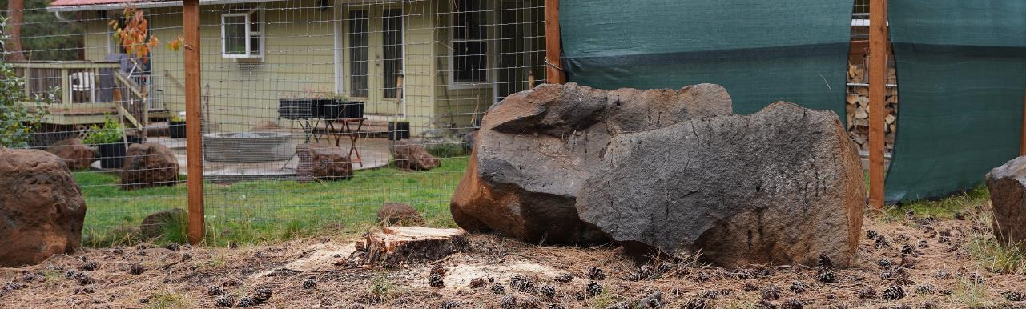
What can we do?
Prevent the fires we can.
Prepare yourself, your home, and your family
  Get a defensible space assessment
  Take action now before there is smoke in the air.
Notes:
Approximately 70% of all the wildfires in Oregon are caused by humans. We can prevent wildfires to give our first responders the best chance.
make sure your campfires are cold to the touch before you leave
don’t use equipment like chainsaws or mowers in hot, dry weather
Take action to increase your home’s chance of survival. Good defensible space can give homes a 70-80% chance of surviving a wildfire without fire service needing to intervene.
Now is the time to prepare your yard and home for fire season.
You can request an assessment by visiting Oregon Defensible Space dot com.
OSFM and its partner agencies have offered more than 350 free assessments in the past month to make sure Oregon is as prepared as possible for fire season 2024

Slide 25
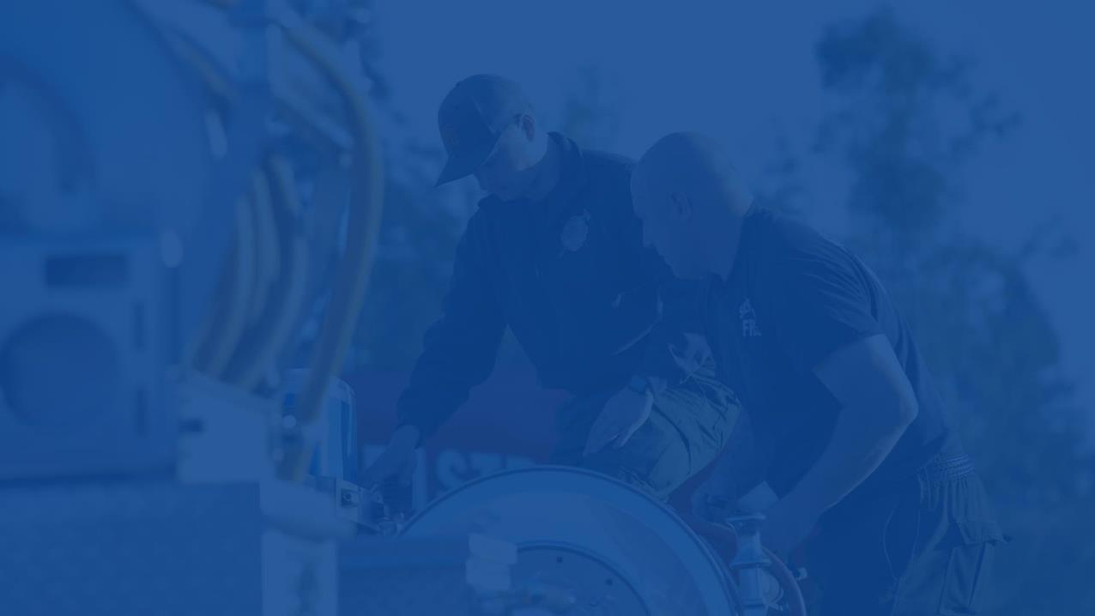

Thank you.

